Slide 1
TRD GAS Refill Version 5, 16th December 2015
B. Beischer, Th. Kirn, Th. Siedenburg, S. Zeissler

Slide 2
TRD-ACC-TAS SHIFTER:
TRD-Gas-Expert Phone Numbers
Gas Expert Telephone Numbers:
TRD Mobile: 16 9779 (from outside CERN: +41 76 487 9779)
Thorsten Siedenburg: Office: +49241 80 27186; Private: +49 241 4002544;
Mobile: +49 157 88464495
Stefan Zeissler: cell +41 76 4876254
Valery Zhukov: Office: +41 (0)22 767 8188 Mobile: +41 76 487 6537

Slide 3
TRD Gas Refill - Preparation
For each Gas Refill a log file has to be created and filled in by hand.
The log files are stored in ~/Gas_Refills
Create a new directory with name: yyyy_mm_dd, e.g.
trd@pcpoc25 Gas_Refills$ mkdir 2013_01_23
trd@pcpoc25 Gas_Refills$ cd 2013_01_23
Follow instructions of automated worksheet for TRD Gas Refill
(still separate in the moment, calculation by hand described on pages 5-11, continue on page 12!)
Take care, not to change the number of lines by adding or deleting text.

Slide 4
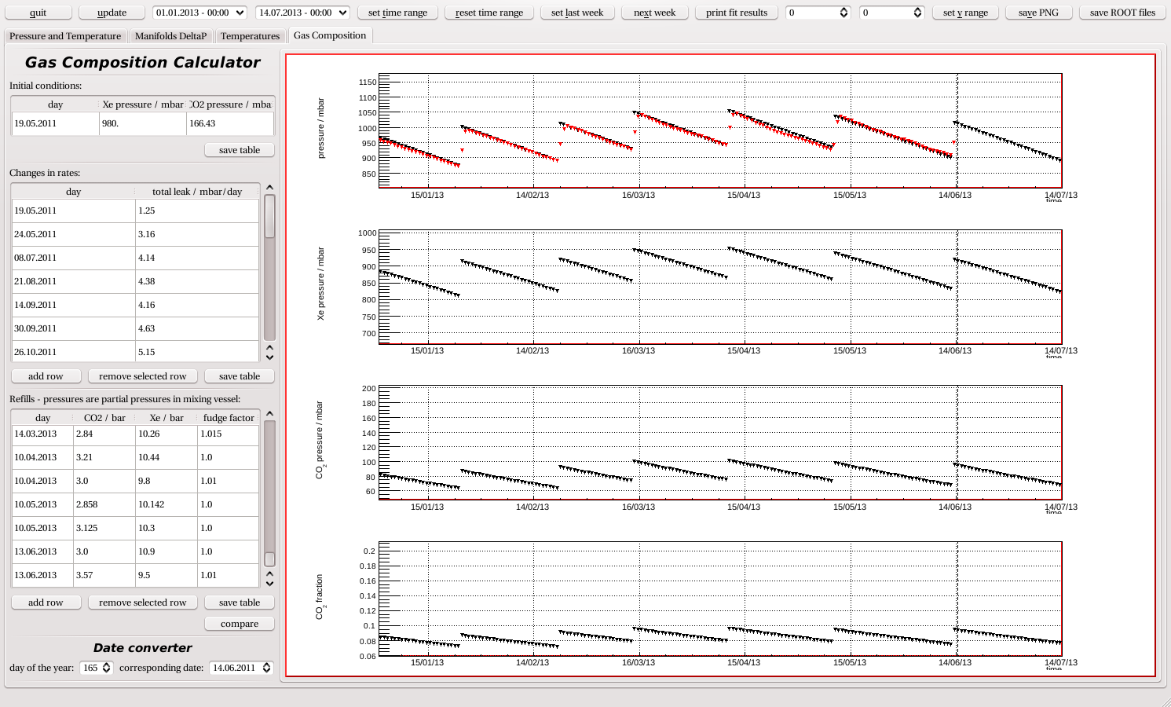
TRD Gas Refill - Preparation
Calculate the amount of gas to be filled; check actual gas composition in
TRD-PressureMonitor and in text file
~/RUN/COMMANDING/TRDGAS/Gas_Refills/gas_composition_history.txt
Example: 13th June 2013:
Set the date to the one of day 2 of Refill

Slide 5
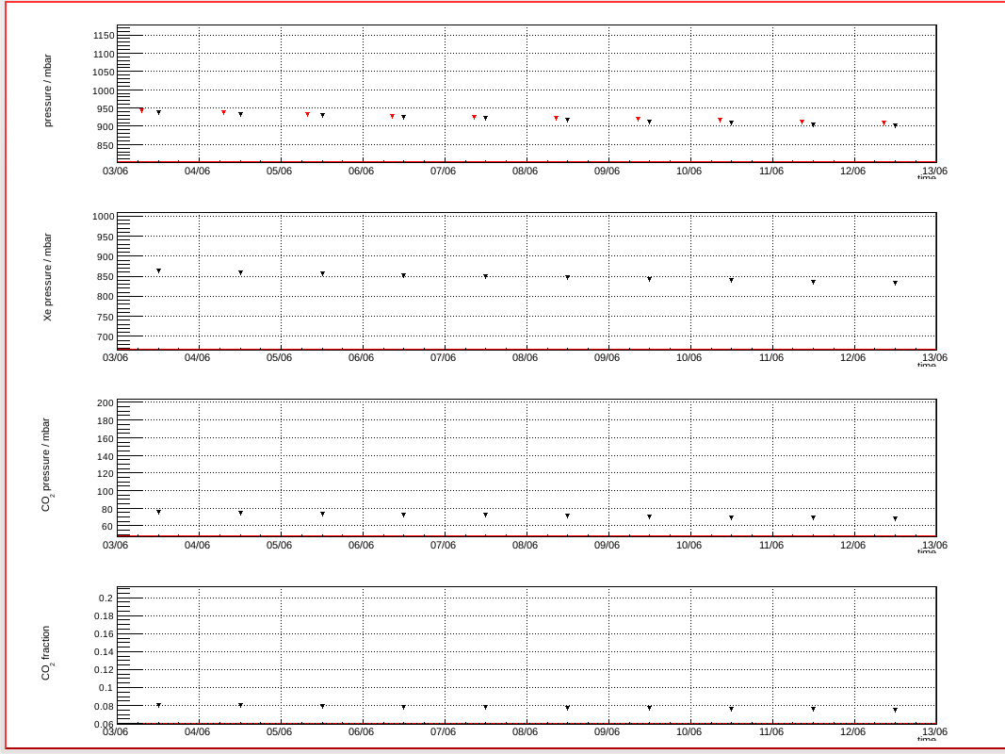
TRD Gas Refill - Preparation
TRD-PressureMonitor: check actual gas composition; Example: 13th June 2013:
Measured total
pressure: 905 mbar
Xe @ 835 mbar,
(in TRD, calculated)
CO₂ @ 68 mbar,
(in TRD, calculated)
7.51% CO₂
(in TRD, calculated)

Slide 6
TRD Gas Refill - Preparation
Calculate the amount of gas to be filled using TRD-PressureMonitor
Example: 13th June 2013:
Add two rows
Edit rows to date of injections
Edit CO₂ / Xe to target values (usually 3/10)
Edit fudge factor to be 1.0 for first injection
and 1.01 for second (to make black curve
match red one)
Save table
Use updated predicted values (black points)
in plots to find new partial pressures
(like on previous slide for actual status)

Slide 7
TRD Gas Refill - Preparation
Example: 13th June 2013: Use updated predicted values (black points) to find new partial pressures
Predicted total pressure:
1019 mbar
Xe @ 927 mbar,
(in TRD, calculated)
CO₂ @ 92 mbar,
(in TRD, calculated)
9.03% CO₂
(in TRD, calculated)

Slide 8
TRD Gas Refill - Preparation
TRD-PressureMonitor: Example: 13th June 2013:
Total pressure in TRD 905 mbar @ 7.51% CO₂ (Xe @ 835 mbar, CO₂ @ 68 mbar)
Using previous slide, find new partial pressures:
Xe @ 927 mbar, CO₂ @ 92 mbar → 1019 mbar @ 9.03 % CO₂ in TRD
How to get the predicted values in TRDPressureMonitor Calculator:
For each injection:
Xe = Fudge Factor ∙ (target PXe – (Xe-fraction ∙ Ptot in Vmix,Vess after injection))
/ (V_{TRD} + V _{Mix,Vess})
Xe = 1.15 (10000 mbar – ((10/13)∙1000 mbar)) / (230 + 1) L = 46 mbar
CO₂ = (target CO₂ pressure – (CO₂ -fraction ∙ Ptot in Vmix,Vess after injection))
/ (V_{TRD} + V _{Mix,Vess})
CO₂ = (3000 mbar – ((3/13)∙1000 mbar)) / (230 + 1) L = 12 mbar
Amount to be transferred in 2 refills: Xe = (835 + 2 ∙ 46) mbar = 92 mbar,
CO₂ = (68 + 2 ∙ 24) mbar = 24 mbar

Slide 9
TRD Gas Refill - Preparation
TRD-PressureMonitor: Example: 13th June 2013:
Get CO₂ fraction out of total pressure in mixing vessel after last refill:
CO₂ fraction = 23.3 % in V_{MixVes} (see page 4 of previous refill worksheet day 2)
Calculate rest partial pressures in V_{MixVes} before starting mixing
10th May 2013: Total pressure in V_{MixVes} = 1300 mbar (use TRDGas-M)
→ Xe: 1300 mbar ∙ (1.0 - 0.233) = 997 mbar,
CO₂: 1300 mbar ∙ 0.233 = 303 mbar
Want 10 bar of Xe and 3 bar CO₂ to be injected twice, so need to add,
13th June 2013:
Xe: (10000 – 997) mbar = 9003 mbar
CO₂: (3000 – 303) mbar = 2697 mbar
If target values reached after first injection and end up with 1000 mbar in the mixing vessel, → Xe: 10/13 (1000 mbar) = 769 mbar; CO₂: 3/13 (1000 mbar) = 231 mbar
To reach again 10 / 3 ratio in the mixing vessel, the amount of Xe & CO₂ pressure:
Xe: (10000 – 769) mbar = 9231 mbar
CO₂: (3000 – 231) mbar = 2769 mbar

Slide 10
TRD Gas Refill - Preparation
In reality target values will never be reached, so after first injection recalculate everything using actual values. Example: 13th June 2013
Xe: (997 + 9900) mbar = 10897 mbar; CO₂: (303 + 2700) mbar = 3003 mbar
→ CO₂ fraction = 21.6 % and P_{MixVes} = 1000 mbar
→ Xe: 784 mbar; CO₂: 216 mbar
Amount which was transferred to the TRD:
Xe = 1.15 (10897 mbar – 784 mbar) / (230 + 1) L = 50 mbar
CO₂ = (3003 mbar – 216 mbar) / (230 + 1) L = 12 mbar
The goal was to transfer 10/3 + 10/3, in first mixing got 10.897/3.003 so for next
injection it is needed:
Xe: (20000 – 10897) mbar = 9103 mbar
CO₂: (6000 – 3003) mbar = 2997 mbar
Since gas still remains in the mixing vessel, the amount to be added is:
Xe: (9103 – 784) mbar = 8319 mbar
CO₂: (2997 – 216) mbar = 2781 mbar

Slide 11
TRD Gas Refill - Preparation
In reality target values will never be reached, so after 2nd injection re-calculate everything using actual values for record keeping purposes.
Example: 13th June 2013
Xe: (784 + 8700) mbar = 9484 mbar; CO₂: (216 + 3350) mbar = 3566 mbar
→ CO₂ fraction = 27.3 % and P_{MixVes} = 1075 mbar
→ Xe: 782 mbar; CO₂: 294 mbar
Amount which was transferred to the TRD:
Xe = 1.15 (9484 mbar – 782 mbar) / (230 + 1) L = 43 mbar
CO₂ = (3566 mbar – 294 mbar) / (230 + 1) L = 14 mbar
So after both mixings/injections, the total amount in TRD was:
Xe: (835 + 50 + 43) mbar = 928 mbar
CO₂: (68 + 12 + 14) mbar = 94 mbar
→ 1022 mbar @ 9.2 % CO₂ total in the TRD

Slide 12
TRD Gas Refill - Preparation
The name of the text file you generated should look like this:
TRD_Refill_##_Day#.txt. Below, {filename} = ##_Day#
E.g. April 1 2014: TRD_Refill_26_Day1.txt
Transform the text file into postscript format with
trd@pcpoc25 yyyy_mm_dd $ ../refill2ps {filename}
Check the result with ghostview (is paging o.k.?)
trd@pcpoc25 yyyy_mm_dd $ gv TRD_Refill{filename}
Print the file and fill in where marked during the refill process.
On the following pages the actions are described, too.
If any deviation appears between the file TRD_Refill{filename}
and this description, call expert.
If no expert is available stick to the file TRD_Refill{filename}.

Slide 13
TRD Gas Refill – Step 0
TRD-Gas: Preparation of Gas Refill
Requirements:
TRD-SidePanel and Box-C Temperature > 5°C
| TXe vessel - Tmix vessel | < 5 degrees C
(Note: TXe vessel is plot 90, red/magenta, Tmix vessel is plot 94, brown)
Call Thorsten (phone ##s on pg. 2)
Step 0:
Prepare Commanding for TRDGAS from GUI (TRDGAS-C)
[trd@pcppc24 example_dir] cd ~/RUN
[trd@pcppc24 example_dir] Gas_Refill_Start.sh
DO NOT TOUCH THE MOUSE OR KEYBOARD UNTIL IT’S FINISHED!!!
This will start all the programs you need. However, the next few pages show the individual commands in case something fails.

Slide 14
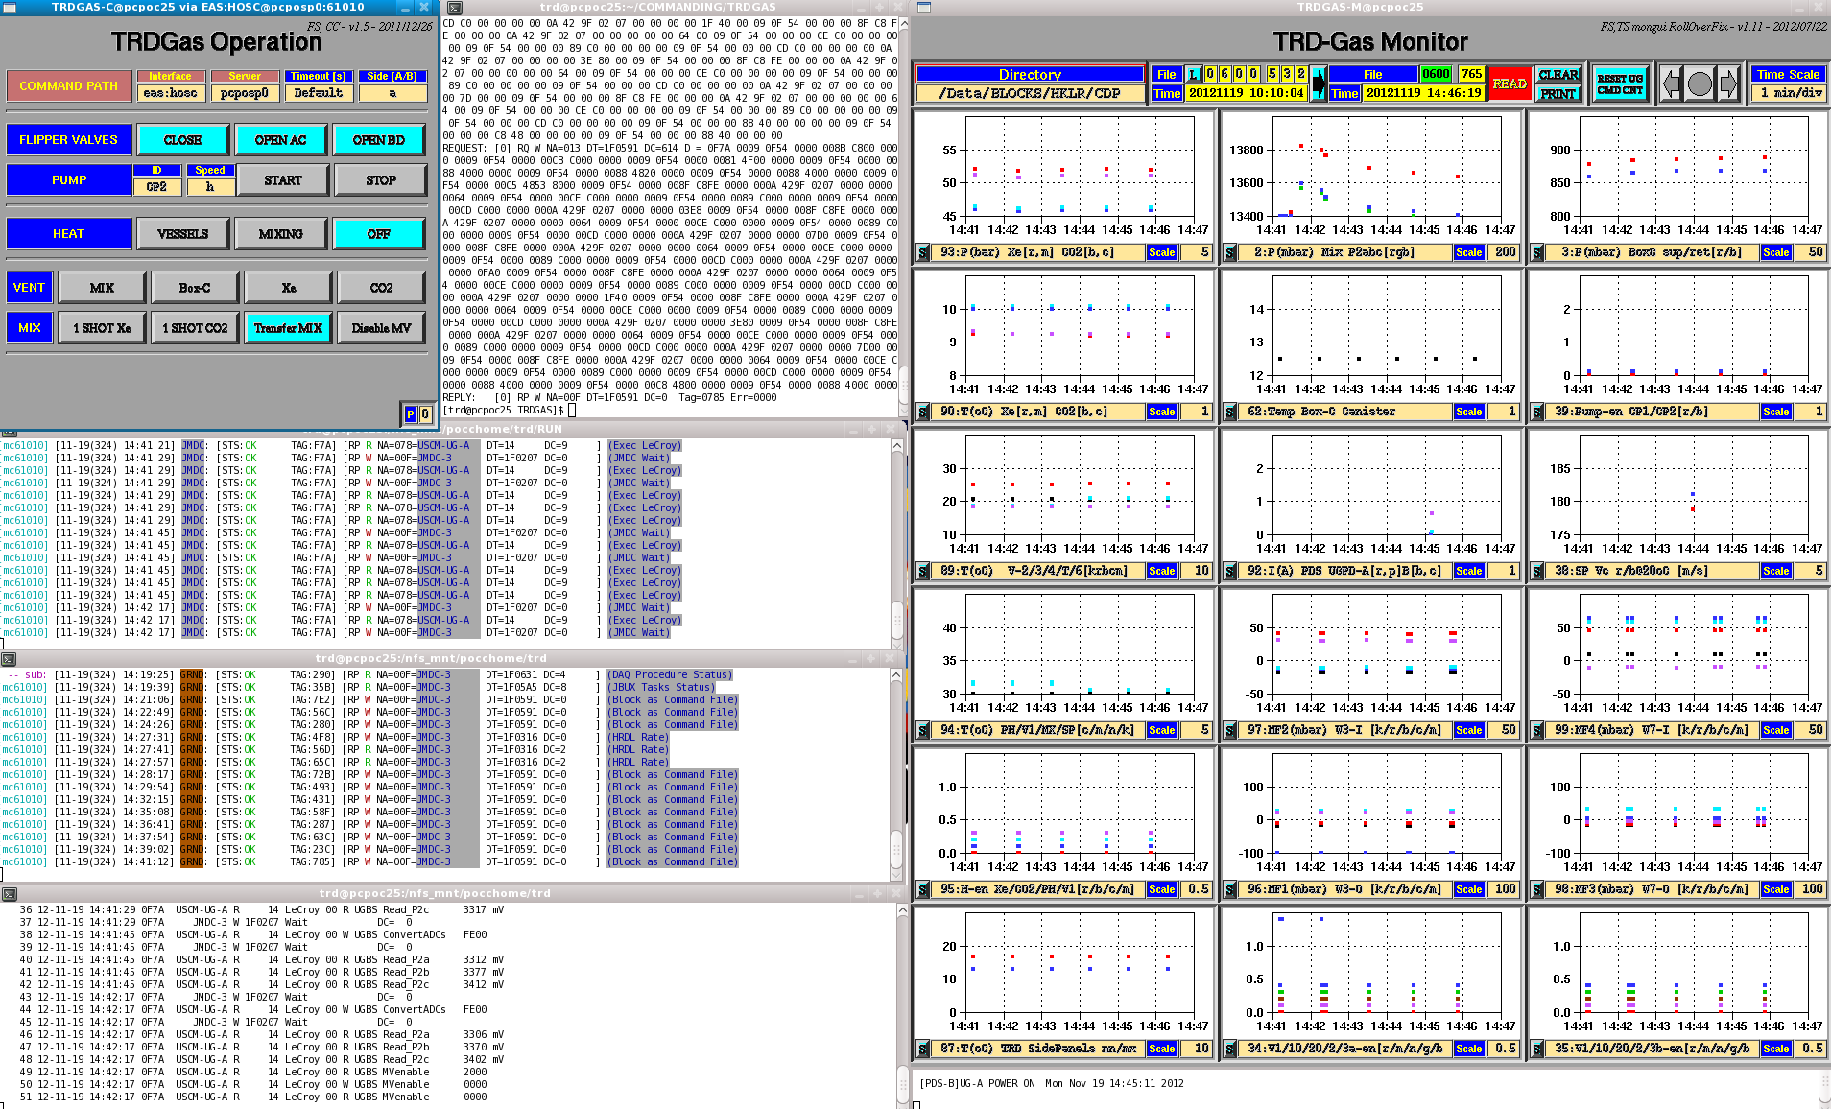
TRD Gas Refill: Screenshot right screen
Start TRDGAS-M with option “C” (“C” forces command file replies to ~/RUN/
OUTPUT/TRDGAS-M/UGcmdLog/UnixTime_CmdFile.log)
• trd@pcpoc25 RUN$ TRDGAS-M-GasRefill C
Check (ls –l) that TRDGAS-M-GasRefill is writing CmdFile replies to ~/RUN/
OUTPUT/TRDGAS-M/UGcmdLog/UnixTime_CmdFile.log

Slide 15
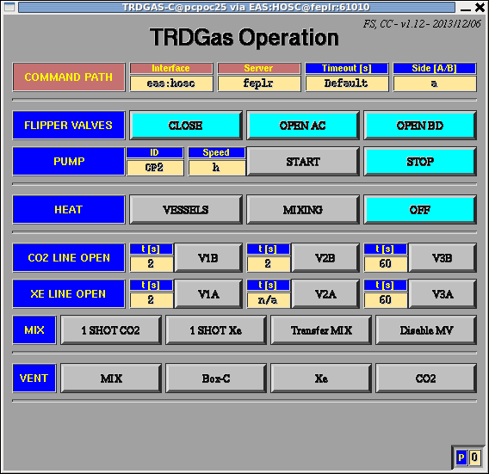
TRD Gas Refill – Step 0
Start TRDGAS-C:
trd@pcpoc25 ~$ cd RUN
trd@pcpoc25 RUN$ set-command-path eas:hosc feplr
trd@pcpoc25 TRDGAS$ TRDGAS-C eas:hosc feplr
Ask LEAD to get commanding from TRD station for TRD refill
Check command path
Set UG-Side to A

Slide 16
TRD Gas Refill – Step 0
TRD-Gas: Preparation of Gas Refill
Prepare 4 terminals for commanding and monitoring
1st terminal (this terminal is used for commanding you need to do during refill):
trd@pcpoc25 ~$ cd ~/COMMANDING/TRDGAS/
2nd terminal (to watch all commands sent to JMDC affiliated with the refill):
trd@pcpoc25 ~$ cd ~/COMMANDING/TRDGAS/
trd@pcpoc25 TRDGAS$ cmds_mon –m hosc | grep “TAG:F7A”
3rd terminal (to watch all ground commands sent to JMDC):
trd@pcpoc25 ~$ cd ~/COMMANDING/TRDGAS/
trd@pcpoc25 TRDGAS$ cmds_mon –m hosc –g
4th terminal (to watch for replies):
trd@pcpoc25 ~$ cd ~/COMMANDING/TRDGAS/
trd@pcpoc25 TRDGAS$ tail –f ~/RUN/OUTPUT/TRDGAS-M/UGcmdLog/UnixTime_CmdFile.log

Slide 17
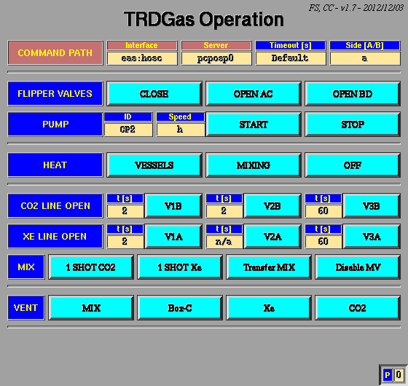
TRD Gas Refill: Screenshot right screen
1st terminal:
workspace
2nd terminal: ground to JMDC
3rd terminal: JMDC executes
4th terminal: replies (the ones
you‘ll be counting

Slide 18
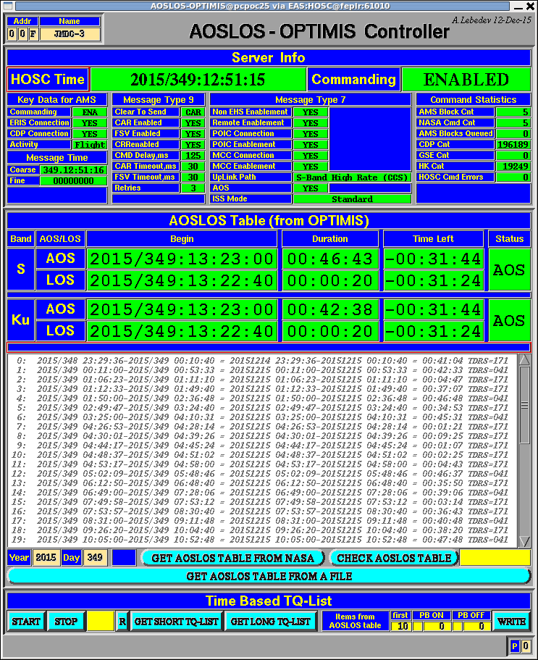
TRD Gas Refill – Step 0
Continue Step 0: Open AOSLOS monitor on left-hand screen:
To start the AOSLOS monitor:
cd ~/RUN
trd@pcpoc25 RUN$ AOSLOS-OPTIMIS eas:hosc feplr

Slide 19
TRD Gas Refill – Step 0
Click until you have the proper year and GMT day and click
[GET AOSLOS TABLE]
If you have ANY kind of LOS
(KU band or S band) as indicated by the RED squares.
Do not send commands for
the gas refill.
Once you have the proper table loaded:
MOVE THE AOSLOS Controller DOWN in the desktop until just the top half is visible to AVOID PUSHING EXTRA BUTTONS! THIS WOULD BE VERY BAD!!!

Slide 20
TRD Gas Refill – Step 1
Step 1: Heat PreHeater to prepare gas-mixing
Requirement: +35°C for Mixing Operation to satisfy NASA safety thermal interlock implemented in USCM-UG
(if temperature falls below +35°C, commands will fail with a reply that says ABORT)
PreHeater temperature limited to +54°C by thermostats
Time to reach +35°C from +20°C is approx. 30 minutes
Heat during steps 2-6 to reduce overall time for operations

Slide 21
TRD Gas Refill – Step 1
Step 1: Heat PreHeater to prepare gas-mixing
TRDGAS-C: Switch on Heaters for Mixing
4th terminal: UGcmdLog: Check for 9 replies in 1s
TRDGAS-M: Reset UG CMD CNT after 9 replies
94: Temp. PH & V1 (cyan/magenta) rise from ambient
95: H-En PH & V1 from 0 to 1

Slide 22
TRD Gas Refill – Step 2
Step 2-5: Assure that Flipper Valves are open: (Flipper valves see p. 73-76, TRD-ACC-TAS-Shifterguide)
Step 2: Open AC Flipper Valves
TRDGAS-M: 87: TRD SidePanel Temperatures > 0°C
TRDGAS-C: FLIPPER VALVES: [OPEN AC]
4th terminal:
UGcmdLog: Check for 77 replies in 6s
and TRDGAS-M: Reset UG CMD CNT

Slide 23
TRD Gas Refill – Step 3
Step 3: Open BD Flipper Valves
(Flipper valves see p. 73-76, TRD-ACC-TAS-Shifterguide)
TRDGAS-M: 87: TRD SidePanel Temperatures > 0°C
TRDGAS-C: FLIPPER VALVES: [OPEN BD]
4th terminal:
UGcmdLog: Check for 77 replies in 6s
and TRDGAS-M: Reset UG CMD CNT

Slide 24
TRD Gas Refill – Step 4
Step 4: Start Circulating Gas to verify all FVs are open
TRDGAS-M: 94: Spiro Temperature > +5°C
TRDGAS-C: PUMP: {CP2} {h} [START]
(Pump @ Half Speed)
4th terminal: UGcmdLog: Check for 58 replies in 20s
TRDGAS-M: Reset UG CMD CNT
3: Psup increase by 250 mbar
3: Pret decrease by 250 mbar

Slide 25
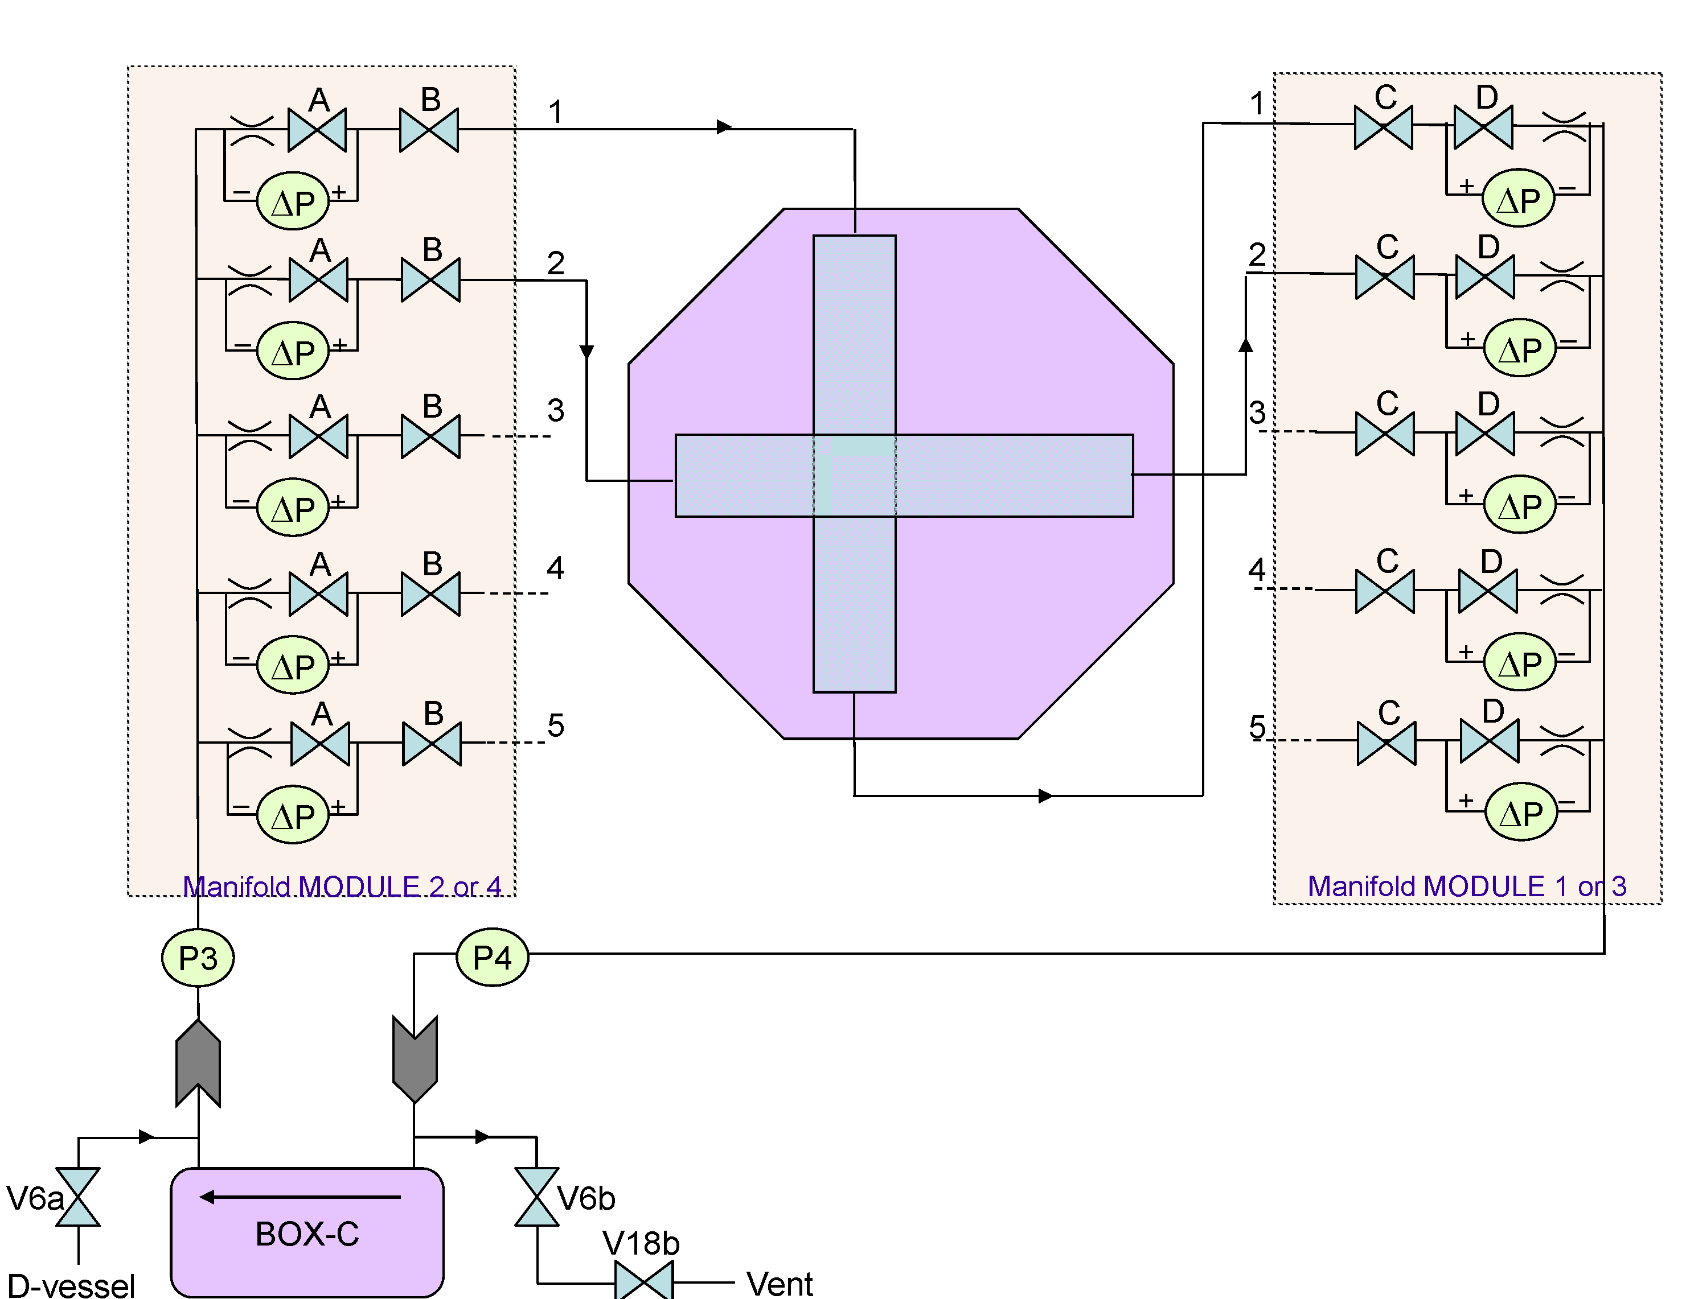
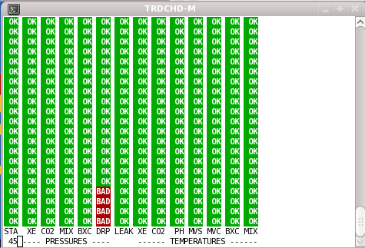
TRD Gas Refill – Step 4
Step 4: Start Circulating Gas to verify all FVs are open
TRDGAS-M: 97, 99: Inlet MFdPs drop to -250 mbar
96, 98: Outlet MFdPs rise to +300 mbar
Wait until pressure stable (5-10 minutes)
TRDCHD-M: DRP will turn red “bad” until
pressure stable

Slide 26
TRD Gas Refill – Step 5
Step 5: Stop Circulating Gas
TRDGAS-C: PUMP: [STOP]
4th terminal:
UGcmdLog: Check for 60 replies in 20s
TRDGAS-M: Reset UG CMD CNT
3: Psup, Pret back to values before pumping
96, 97, 98, 99: all MFdPs back to 0 (± 50) mbar
TRDCHD-M: DRP will turn red “bad” until
pressure stable

Slide 27
TRD Gas Refill – Step 6
Step 6: Heaters for Mixing
If Temp.PH has dropped below 35 DegC
Heater ON: TRDGAS-C: HEAT: [MIXING]
UGcmdLog: Check for 9 replies in 1s
Heater OFF: TRDGAS-C: HEAT: [OFF]
UGcmdLog: Check for 3 replies in 1s
TRDGAS-M: Reset UG CMD CNT
ON: 95: H-En PH & V1 from 0 to 1
94: Temperatures PH & V1 rise
OFF: 95: H-En PH & V1 from 1 to 0
94: Temperatures PH & V1 drop

Slide 28
TRD Gas Refill – Step 7
Step 7: Filling of Mixing Vessel with Xe & CO₂
There are two ways to fill the mixing vessel:
a) Use the GUI
for Xe use: fill buffer volume
Half Shot {2} [V1A] {10} [V3A]
{60} [V3A]
Long Shot {10} [V1A] {10} [V3A]
{60} [V3A]
for CO₂ (Full Shot) use
for CO₂ (Half Shot) use commands, see next page

Slide 29
TRD Gas Refill – Step 7
Step 7: Filling of Mixing Vessel with Xe & CO₂
b) Send commands (BETTER TO USE THE GUI):
> cd ~/RUN/COMMANDING/TRDGAS
> set-command-path eas:hosc feplr
For CO₂:
> ./UG_EXEC.csh A HSHC_20S (half shot)
Only for completeness, only needed if there is no GUI
> ./UG_EXEC.csh A 1SHC_60S (full shot)
> ./UG_EXEC.csh A OV1B_2S (open first valve for 2 s)
> ./UG_EXEC.csh A OV2B_2S (open second valve for 2 s)
> ./UG_EXEC.csh A OV3B_60S (open third valve for 60 s)
For Xe (remember, the second valve is stuck open→don’t touch it! Use the GUI!):
> ./UG_EXEC.csh A OV1A_2S (open first valve for 2 s)
> ./UG_EXEC.csh A OV3A_3S (open third valve for 3 s)
> ./UG_EXEC.csh A OV3A_10S (open third valve for 10 s)
> ./UG_EXEC.csh A OV3A_60S (open third valve for 60 s)
With Xenon we usually start with a shot of 2--3-60, and then continue with shots of 2--60, until the end.

Slide 30
TRD Gas Refill – Step 7
Step 7: Filling of Mixing Vessel with Xe & CO₂
Using the GUI:
Start with CO₂:
1 Shot CO₂
Pmix increases from value before mixing till
desired value. Example 23rd January 2013:
TRDGAS-M:
2: Pmix increase from 1 bar to 1.8 bar
92: PDS-UGPD at 1.5 A (only read every 5 min)

Slide 31
TRD Gas Refill – Step 7
CO₂ mixing:
Repeat Step 7a) until Pmix at desired value and document steps in log file:
Example 23rd January 2013:
Pmix_{CO2} = 3.5 bar after 5 times 1 Shot CO₂
TRDGAS-M:
2: Pmix increase from 1.8 bar to 3.5 bar
92: PDS-UGPD at 1.5 A

Slide 32
TRD Gas Refill – Step 7
Step 7: b) Filling of Mixing Vessel with Xe
(Vessel valves see p. 75-76, TRD-ACC-TAS-Shifterguide)
Using the GUI :
Use only valve V1A and V3A due to the
problem of valve V2A (stuck open)
1st step: Open V1A for 2s
2nd step: Open V3A for 10s and then for 60 s
For bigger steps (cold case), open V1A for 10 s and V3A for 10s followed by 60s.
Pmix increases from value before mixing till
desired value. DO NOT EXCEED 14 bar!!!
Example 23rd January 2013:
TRDGAS-M:
2: Pmix increase from 3.5 bar to 13.5 bar
92: PDS-UGPD at 1.5 A

Slide 33
TRD Gas Refill – Step 7
Xe mixing:
Repeat Step 7b) until Pmix at desired value and document
steps in log file:
Example 23rd January 2013:
Pmix_{Xe} = 13.5 bar after
3 times: V1A open for 10 s and
V3A for 10s followed by 60s
2 times: V1A open for 2s, V3A open for 10s followed by 60s
1 times V1A open for 2s, V3A open for 10s

Slide 34
TRD Gas Refill – Step 7
Fill in the log file:
initial Xe: _____ CO2: _____ ______ ______ ______
Rpt Gas P/bar VLV-OPEN-TIME/s, Exec-Time ----P-MIX/mbar----- CMD Replies
V1 V2 V3 P2a P2b P2c
# 1 ___ _____ ___,_____ ___,_____ ___,_____ ______ ______ ______ ____________
# 2 ___ _____ ___,_____ ___,_____ ___,_____ ______ ______ ______ ____________
# 3 ___ _____ ___,_____ ___,_____ ___,_____ ______ ______ ______ ____________
.
.
Calculate the final partial pressures:
CO2 __________ + ___________ = __________ bar
Xe __________ + ___________ = __________ bar
And update history file:
~/COMMANDING/TRDGAS/Gas_Refills/gas_composition_history.txt
And update ELOG and Pressure Monitor

Slide 35
TRD Gas Refill – Step 8
Step 8: Initiate Transfer Sequence
Ask LEAD to Get JMDC flash directory (“Get Directory” button in JMDC-C controller).
Terminal Output from TRDGAS-M:
=============================================================
JMDC-0F Flash-Directory UG-entries from Sat Apr 30 14:44:22 2011
BoF --FileName-- Length crc
39 UGA_GCCL.cmd 1744 +
102 UGB_GCCL.cmd 1744 +
121 UGA_HVXE.cmd 100 +
131 UGA_TMX0.cmd 1320 +
186 UGA_TMX4.cmd 1320 +
239 UGA_TMX7.cmd 1320 +
276 UGA_TMX2.cmd 1320 +
277 UGA_TMX3.cmd 1320 +
311 UGA_TMX5.cmd 1320 +
373 UGA_TMX6.cmd 1320 +
382 UGA_HVES.cmd 112 +
393 UGA_TMX9.cmd 1848 +
453 UGA_TMX1.cmd 1320 +
471 UGA_HMIX.cmd 112 +
485 UGA_TMX8.cmd 1320 +
==============================================================

Slide 36
TRD Gas Refill – Step 8
Step 8: Initiate Transfer Sequence
a) (this step can be skipped when you are sure that JMDC is ok, i.e. if UGA
command files exist -- see previous page)
Upload Command-Files to JMDC-MCT-Flash (one by one):
trd@pcpoc25 TRDGAS$ Write_UG_CmdFile_to_MCT_JMDC_Flash.csh A TMX#
(where this command must be issued 10 times, replacing # with the corresponding number 0..9)
trd@pcpoc25 TRDGAS$ Write_UG_CmdFile_to_MCT_JMDC_Flash.csh A HMIX
Check to make sure that the command files ended up in the JMDC flash (see previous slide)

Slide 37
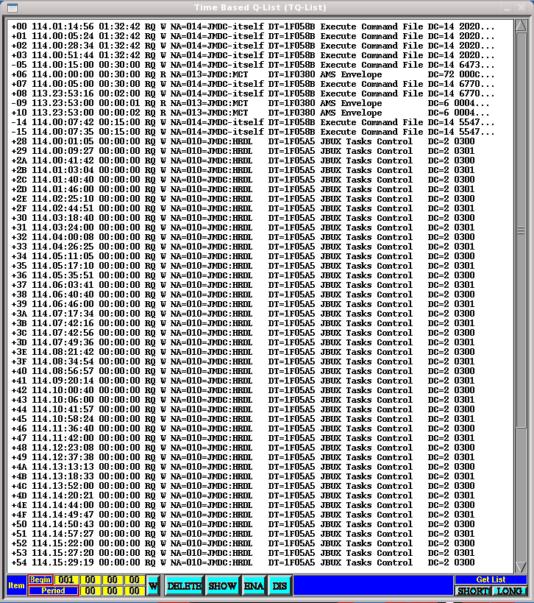
TRD Gas Refill – Step 8
b) Ask LEAD to “Get Short TQ-List” to read content of Time-Based-Qlist on JMDC-MCT:
When there is AOS, ask LEAD to “Get the SHORT TQ LIST”.
They will push the [SHORT] button in the bottom right and this list will update.
What you want to check is if the items 20-35 are already taken. The item number is on the far left side. In this example, 28+ are used, so we would have to use different item numbers. The point is to be careful not to write over something which is currently scheduled.

Slide 38
TRD Gas Refill – Step 8
c) Choose a command file that does not overlap with the currently used item numbers. The current options are (where the item numbers will be 20-35, 40-55, etc):
UGA_TRD_REFILL_TQ_20_35_HMIX.cmd
UGA_TRD_REFILL_TQ_40_55_HMIX.cmd
UGA_TRD_REFILL_TQ_60_75_HMIX.cmd
UGA_TRD_REFILL_TQ_80_95_HMIX.cmd
UGA_TRD_REFILL_TQ_A0_B5_HMIX.cmd
UGA_TRD_REFILL_TQ_C0_D5_HMIX.cmd
UGA_TRD_REFILL_TQ_E0_F5_HMIX.cmd
Note that for the second injection we don’t use the steps to turn the heaters on, so those options are:
UGA_TRD_REFILL_TQ_20_31.cmd
UGA_TRD_REFILL_TQ_40_51.cmd
UGA_TRD_REFILL_TQ_60_71.cmd
UGA_TRD_REFILL_TQ_80_91.cmd
UGA_TRD_REFILL_TQ_A0_B1.cmd
UGA_TRD_REFILL_TQ_C0_D1.cmd
UGA_TRD_REFILL_TQ_E0_F1.cmd

Slide 39
TRD Gas Refill – Step 8
d) Upload Commands into Time-Based_QList:
TRDGAS-M: 94: Spiro Temperatures > +5°C
Ask LEAD to:
-stop the Run
-set RunTag for “TRD Non-Nominal”
-restart the Run
trd@pcpoc25 TRDGAS$ UG_EXEC.csh A TRD_REFILL_TQ_20_35_HMIX
(or for second injection: trd@pcpoc25 TRDGAS$ UG_EXEC.csh A TRD_REFILL_TQ_20_31 )
Write down T0: T0 is time when TRD-REFILL was sent

Slide 40
TRD Gas Refill – Step 8
d) Check if all 18 items are entered
Correctly in TBQL:
ASK LEAD to “Get Short TQ-List”
to read content of Time-Based-Qlist on
JMDC-MCT
In this case we asked for Items: 17 … 28 with
Start-Times +10 min, +22 min, … ,
+3h 22 min
If entries are not correct ask LEAD to
delete them and repeat
from Step 8c

Slide 41
TRD Gas Refill – Step 8
Watch the pressure drop in the mixing vessel with
TRDGAS-M: 2: Pmix decreasing
(18 Transfers)

Slide 42
TRD Gas Refill – Step 9&10
Step 9: Hand back control to LEAD for next 3.5h
Step 10: Check replies (every 12 min 110 CommandFile replies for TMX0…..8; 154 for TMX9)
If pressure drop is less than required, repeat step TMXi manually
> UG_EXEC.csh A TMXi with “i” replaced by 0..8
Pmix has to be below 1.8 bar before Step TMX9 (last one) is executed,
(if not, have LEAD disable TMX9 and repeat TMX8 by hand then do TMX9)
CMD Time #Replies Pmix Ref. Val. (bar)
______ 13.7
TMX0 ___________ _______ ______ 13.0 reset UG CMD CNT
TMX1 ___________ _______ ______ 12.2 reset UG CMD CNT
. . . . . .
. . . . . .
. . . . . .
TMX9 ___________ _______ ______ 0.9 reset UG CMD CNT

Slide 43
TRD Gas Refill - Step 11
Step 11: Increase TRD HV
Increase TRD HV by XXX V and check Gain Stability
Calculate HV step for signal adjustment (the worksheet does this automatically now, but for reference we’ll keep this here):
HV adjustment: 1000 mbar / 880 mbar = +13.6 % Density increase
→ Gain / (1.04)^(13.6) = Gain / 1.74
CO2 – fraction +1.2%
→ Gain / (1.08)^(1.2) = Gain / 1.10
Total Gain drop: 1.88 → HV: ln(1/1.88)/ln(0.99) = 62.8 V
NOTE: the 0.99 is because you get 1% per Volt, the 1.04 is for 1% density change, and 1.08 is for 1% CO₂ fraction change.
So if the calculated adjustment is ~63V, one then needs to adjust that number by two things:
+8 for the pump running at half speed (since we will leave the pump on overnight)
X, which is whatever the normal HV adjustment would be at that moment (use the GainMonitor to fit the plot, as usual: (let’s use -2Vhere, just for example).
So the HV adjustment by 62.8 V + ( 8 V -2 V )= 68.8 V
(For Step 15) When the pump is turned off on Day 2 we subtract the same (8-2)V – ZV where Z is however much the adjustment is at THAT point (like step b)—there have been at least 12h since the previous adjustment. So for example say the new adjustment is now -1V, we’d adjust by -(8-2)V -1V = -7V.

Slide 44
TRD Gas Refill – Second Mixing and transfer
After first Mix & Transfer:
For second Mix & Transfer wait for 12 minutes of pumping after TMX9
REPEAT Step 5 – 10
Transfer of x liters
2nd Mixing 2nd transfer
After second Mix & Transfer continue
with step 12

Slide 45
TRD Gas Refill – Step 12
Step 12: Circulate gas at full speed to assure closing of BoxC-Relief- Valve, Wait until pressure is stable (5 min)
TRDGAS-M: 94: Spiro Temperature > +5°C
TRDGAS-C: PUMP: {CP2}{f}{START}
4th terminal:UGcmdLog: check for
58 replies in 20s
TRDGAS-M: Reset UG CMD CNT
3: Psup increase by 300 mbar
3: Pret decrease by 400 mbar
97,99 Inlet: MFDPs drop to -300 mbar
96,98 Outlet: MFDPs increase to 400mbar

Slide 46
TRD Gas Refill – Step 13
Step 13: Continue gas circulation at half speed for 12h to homogenize gas gain
TRDGAS-M: 94: Spiro Temperature > +5°C
TRDGAS-C: PUMP: {CP2}{h}{START}
4th terminal:UGcmdLog: check for
58 replies in 20s
TRDGAS-M: Reset UG CMD CNT

Slide 47
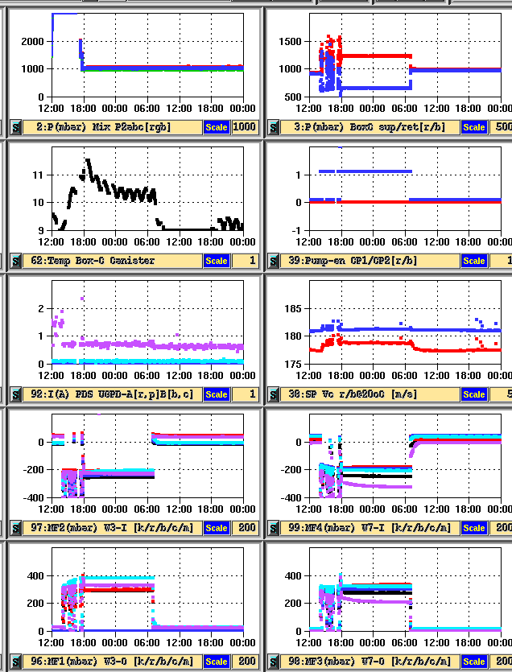
TRD Gas Refill – Step 13
Step 13: Continue gas circulation at half speed for 12h
to homogenize gas gain
TRDGAS-M: Reset UG CMD CNT
3: Psup increase by 200 mbar
3: Pret decrease by 300 mbar
97,99 Inlet:
MFDPs drop to -200 mbar
96,98 Outlet:
MFDPs increase to 300mbar

Slide 48
TRD Gas Refill – Step 14
Step 13 cont.: Inform LEAD that TRD Gas Refill commanding is complete,
RunTag to be changed to “Science Run (with pump on)”
Circulation of gas will continue (pump running @ half speed)
for ≈ 12h
Step 14:
Update information in file
~/COMMANDING/TRDGAS/Gas_Refills/gas_composition_history.txt

Slide 49
TRD Gas Refill – Step 15
Step 15: Stop Gas-Circulation
TRDGAS-C: PUMP: [STOP]
4th terminal: UGcmdLog:
Check for 60 replies in 20s
TRDGAS-M:
Reset UG CMD CNT
3: Psup, Pret back to values before pumping
96, 97, 98, 99: all MFdPs back to 0 (± 50) mbar
TRDCHD-M: DRP will turn red “bad” until
pressure stable

Slide 50
TRD Gas Refill – Step 15
Step 15: Stop Gas-Circulation
3: Psup, Pret back to values before pumping
96, 97, 98, 99: all MFdPs back to 0 (± 50) mbar
TRDCHD-M: DRP will turn red “bad” until pressure stable
adjust HV by ~ -7 V (See pg 43, step 11) so that MPV ≈ 60 ADC
When turning DAQ back on after HV adjustment, ASK LEAD to increment RunTag to “Science Run (nominal)”
Inform LEAD that TRD Gas Refill commanding is complete

