Slide 1
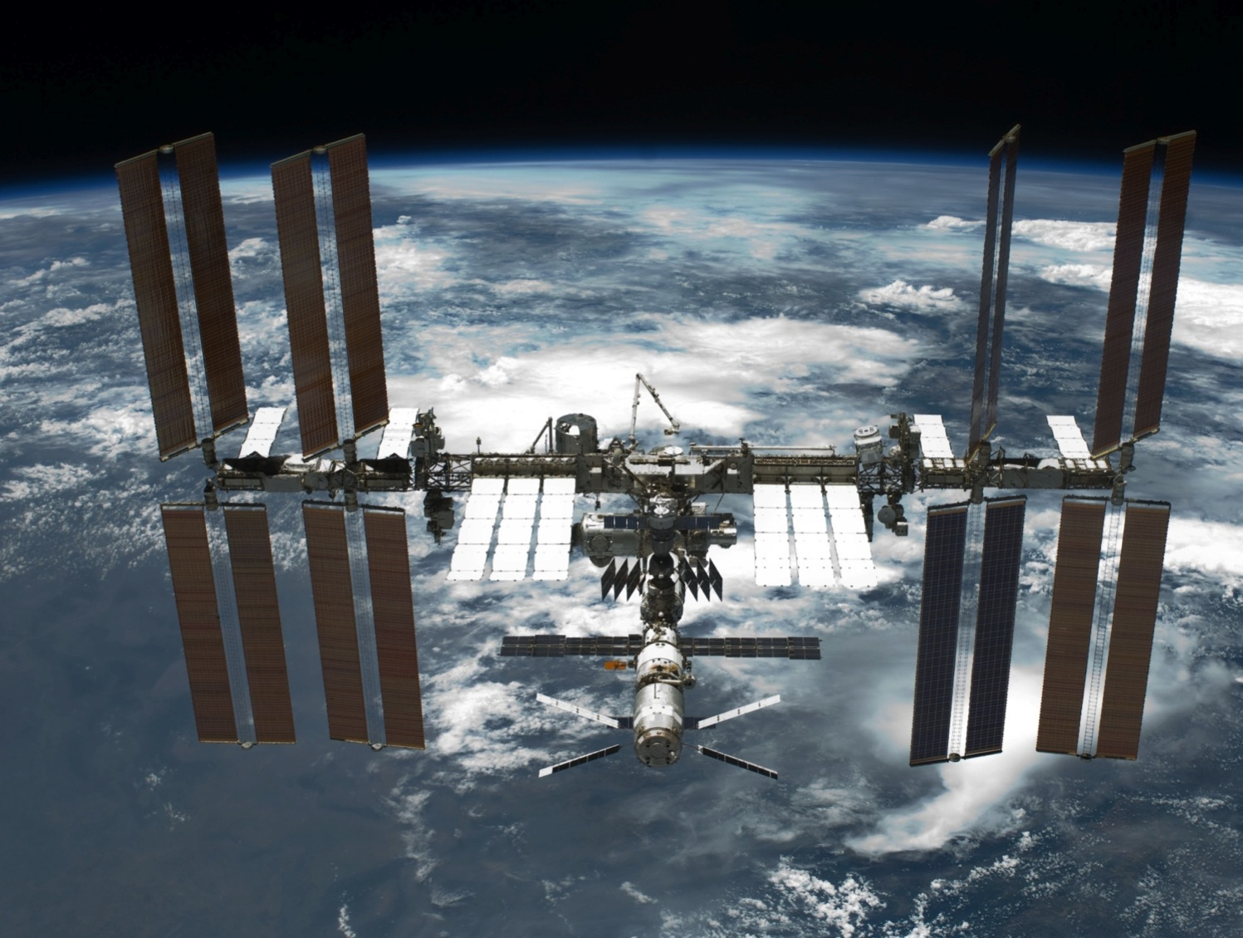

AMS-02 TRD
Thomas Kirn
RWTH Aachen University
CERN, November 28th

Slide 2
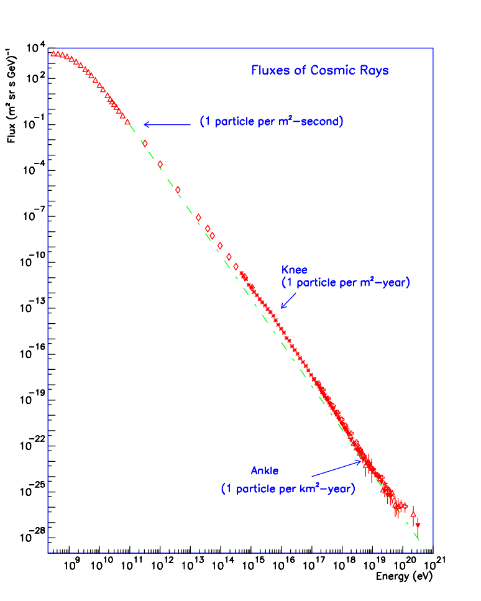
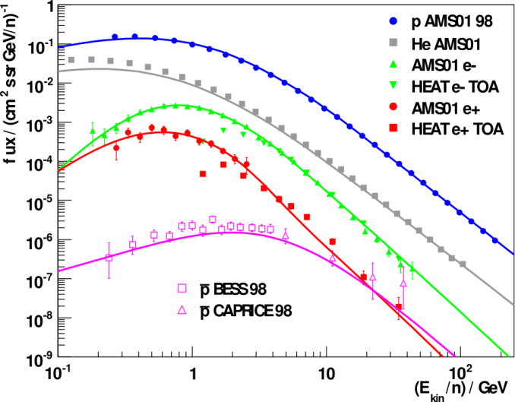


Cosmic Ray Fluxes
CREAM
TRACER
ATIC
E^{-2.7}
E^{-3.0}
Auger
JEM-EUSO
CROS
HEAT
BESS
PAMELA
AMS
Cosmic Ray Composition:
Protons 88 %
Helium 10 %
e⁻ 1 %
e⁺ 0.1 %
Antiprotons 0.01 %
E^{-2.7}
GeV TeV PeV EeV ZeV

Slide 3
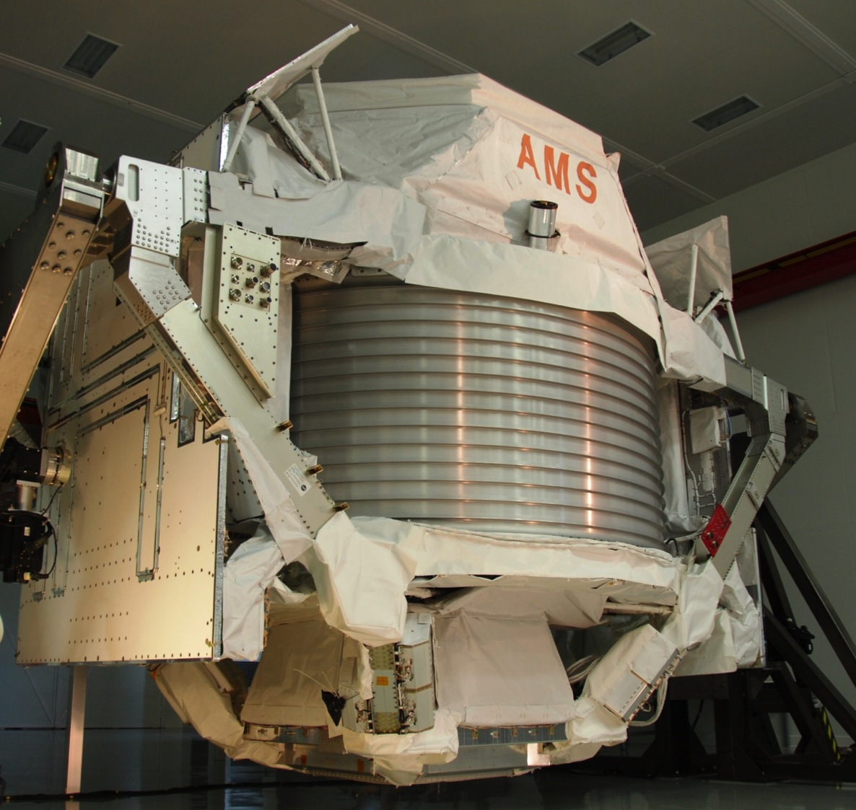
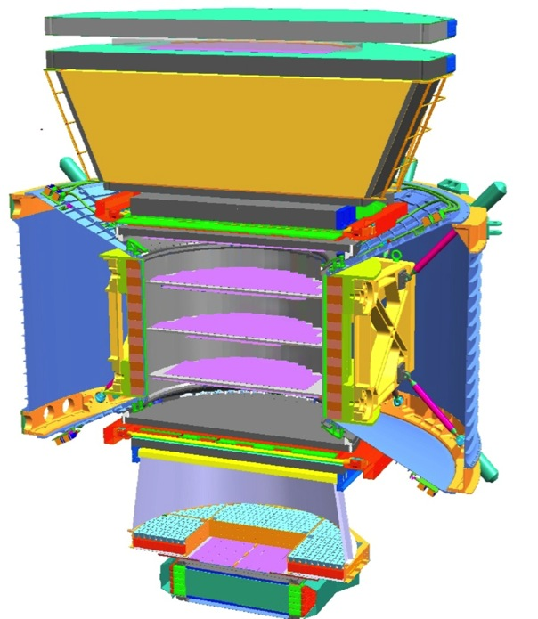

AMS-02 – A TeV Particle Spectrometer
5m x 4m x 3m
7.5 tons
Upper Tracker
Silicon layer
1
TRD
TRD
TOF
Upper TOF 1, 2
2
3-4
5-6
Tracker
7-8
Permanent
Magnet
Inner Tracker
7 Silicon layers
TOF
RICH
9
ECAL
Radiators
TOF 3, 4
ISS Lifetime extended
until at least 2020 / 2028
(March 2010)
→ Switch to AMS-01
permanent magnet
(B=0.14T)
→Tracker reconfigured
→ 'external' layers
RICH
Lower Tracker
1Silicon layer
ECAL

Slide 4
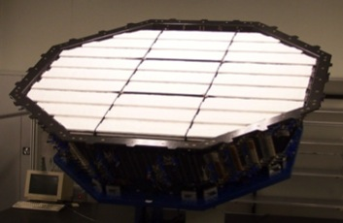
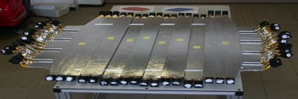
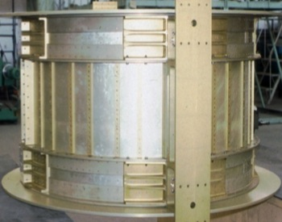
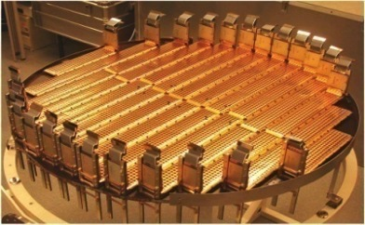
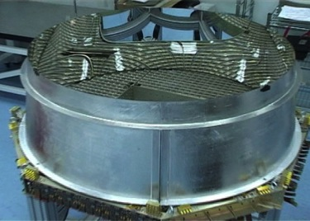
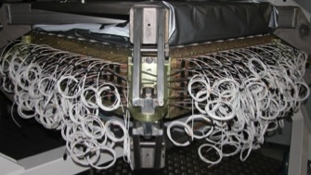
AMS-02 – A TeV Particle Spectrometer
TRD
Separation e±:p
Particles and nuclei are defined by their
charge (Z) and energy (E ~ P)
TOF
Z, E
1
TRD
Magnet
± Z
Silicon Tracker
Z, P
TOF
2
3-4
5-6
Tracker
7-8
TOF
RICH
Z, E
ECAL
E of e±, γ
RICH
9
ECAL
Z, P are measured independently by
the Tracker, RICH, TOF and ECAL

Slide 5
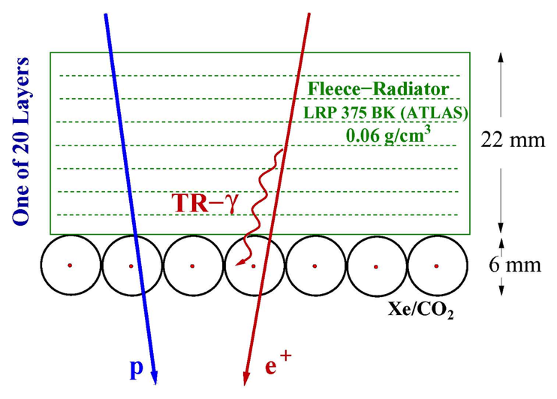
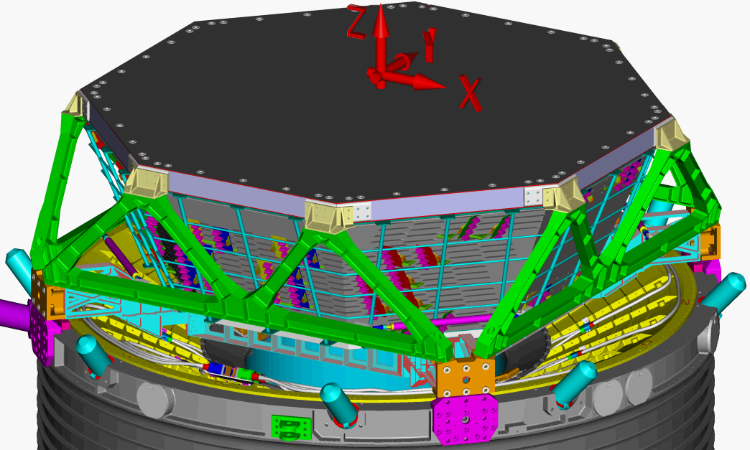
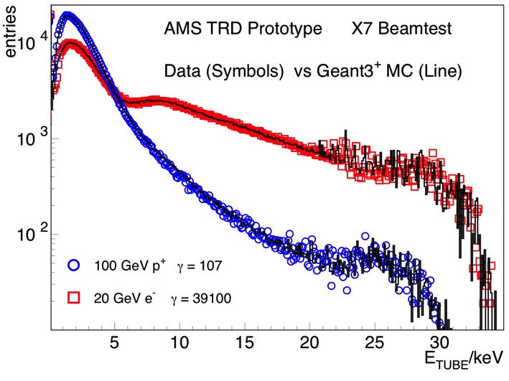
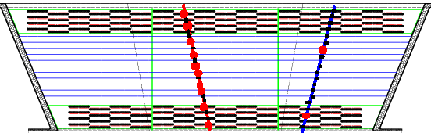
AMS-02 – Transition Radiation Detector (TRD)
Choosen configuration for 60 cm height:
20 Layers each existing of:
  22 mm fibre fleece
  Ø 6 mm straw tubes (Xe/CO₂ 80%/20%)
Non-bending plane: 2x4 layers
Bending plane: 12 layers
p⁺ rejection >10² 1-300 GeV 0.5m²sr

Slide 6
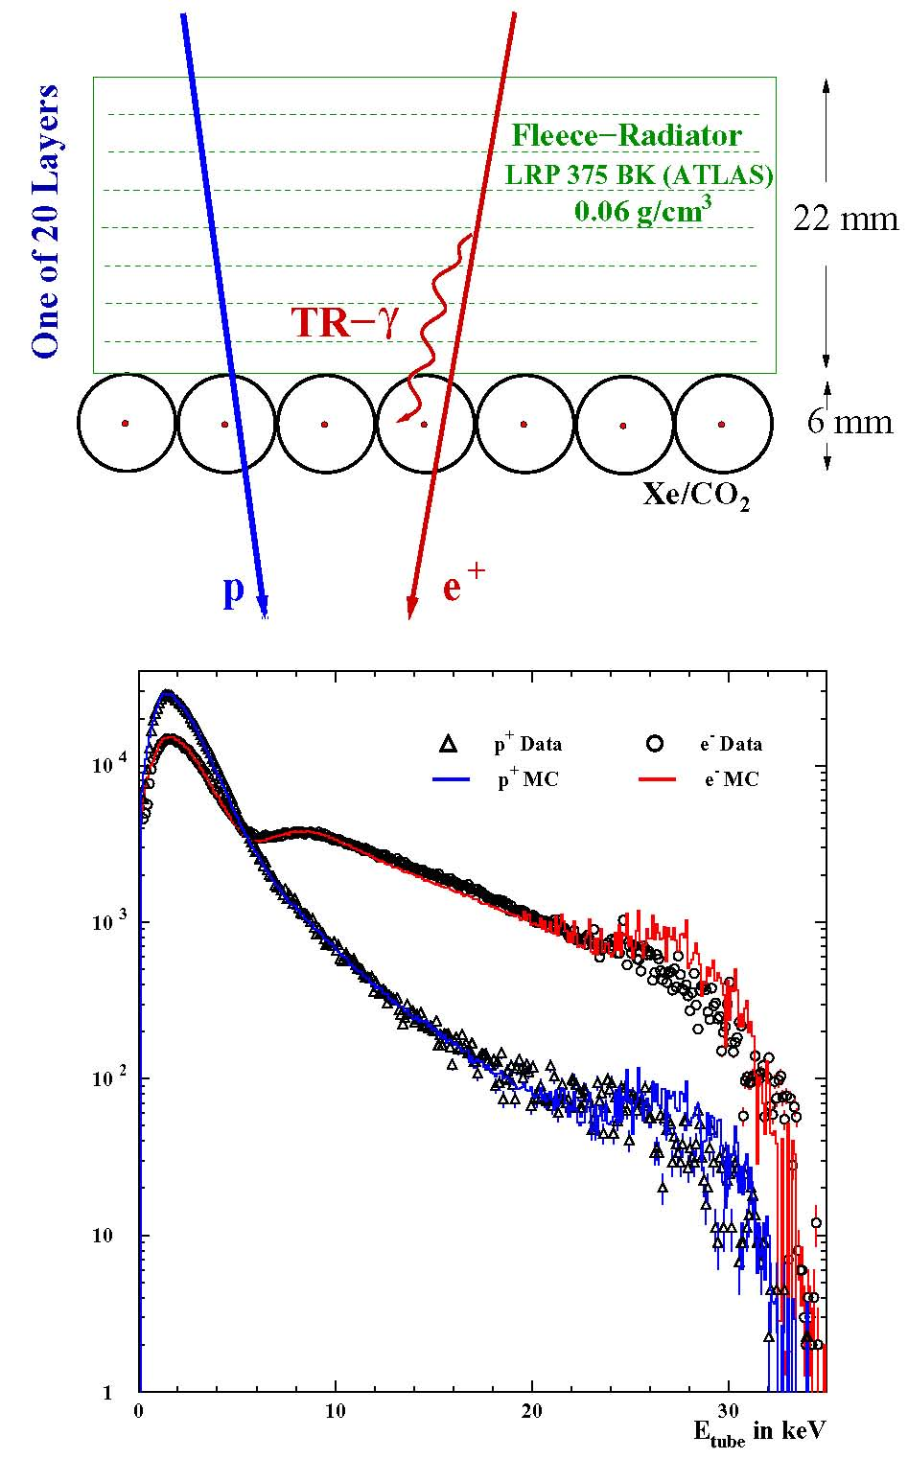
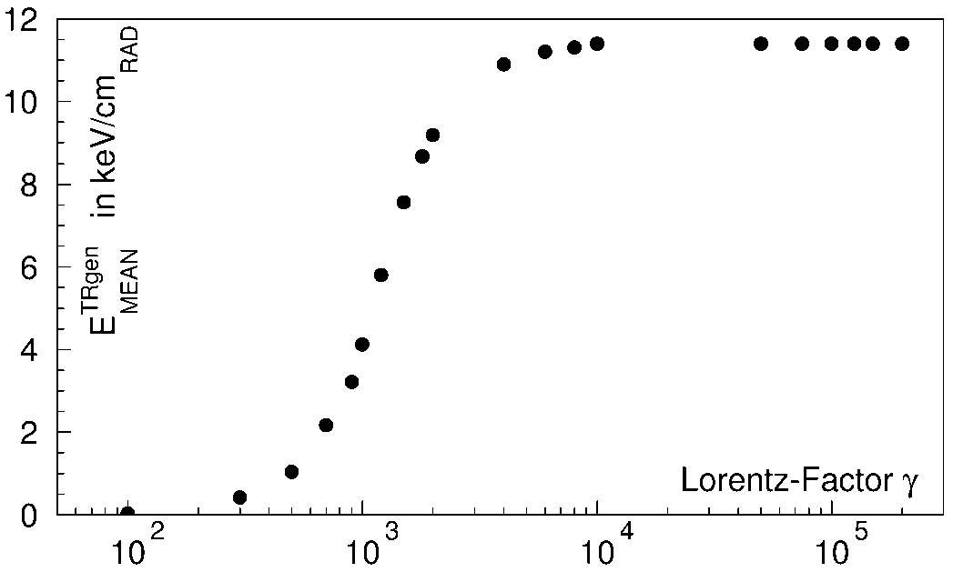
AMS-02 - TRD

Slide 7
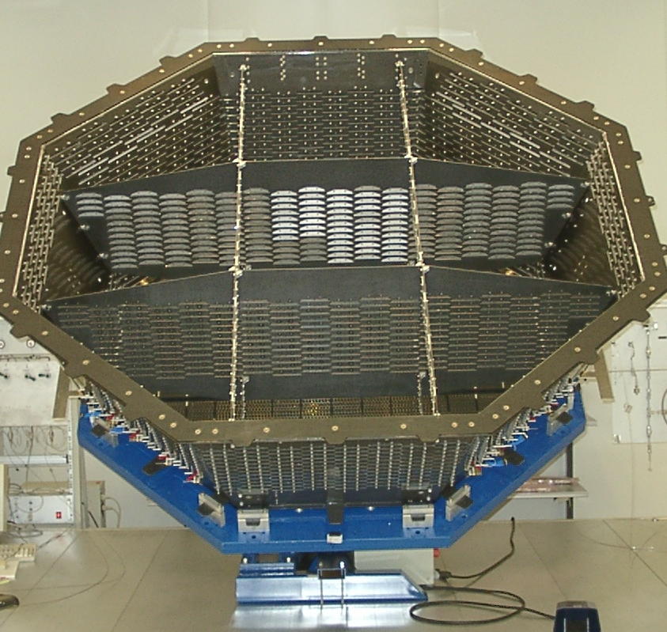
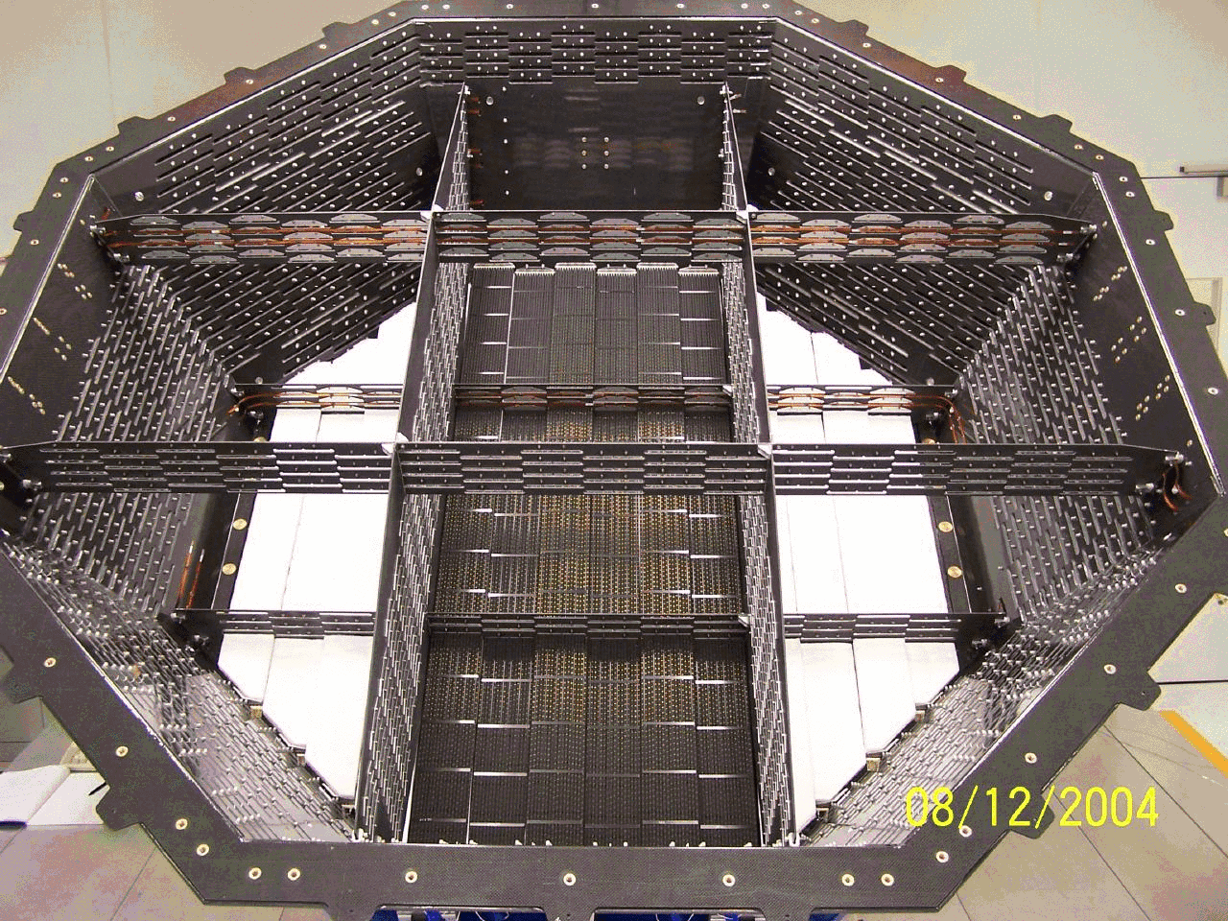
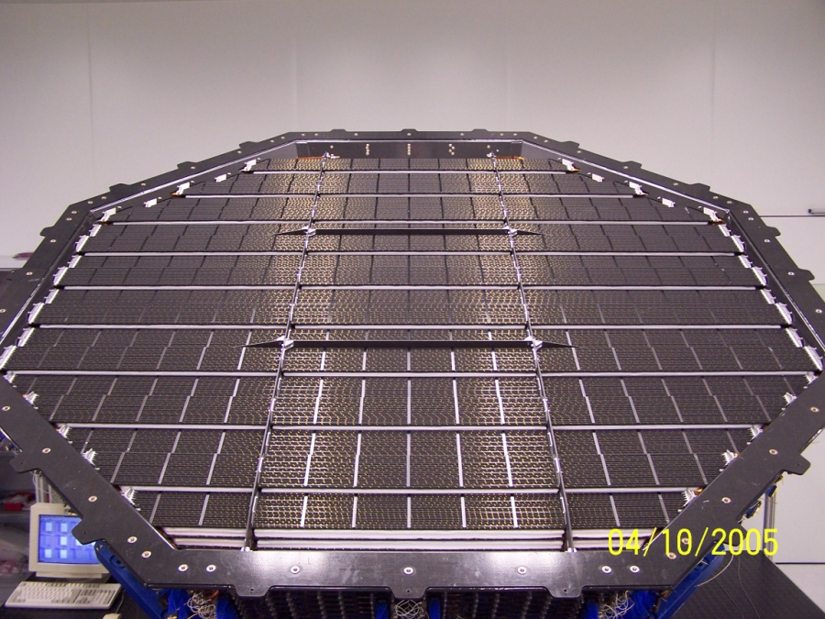
AMS-02 – Transition Radiation Detector (TRD)
Straw Modules in layer 1 and 2
Straw Modules in layer 20

Slide 8
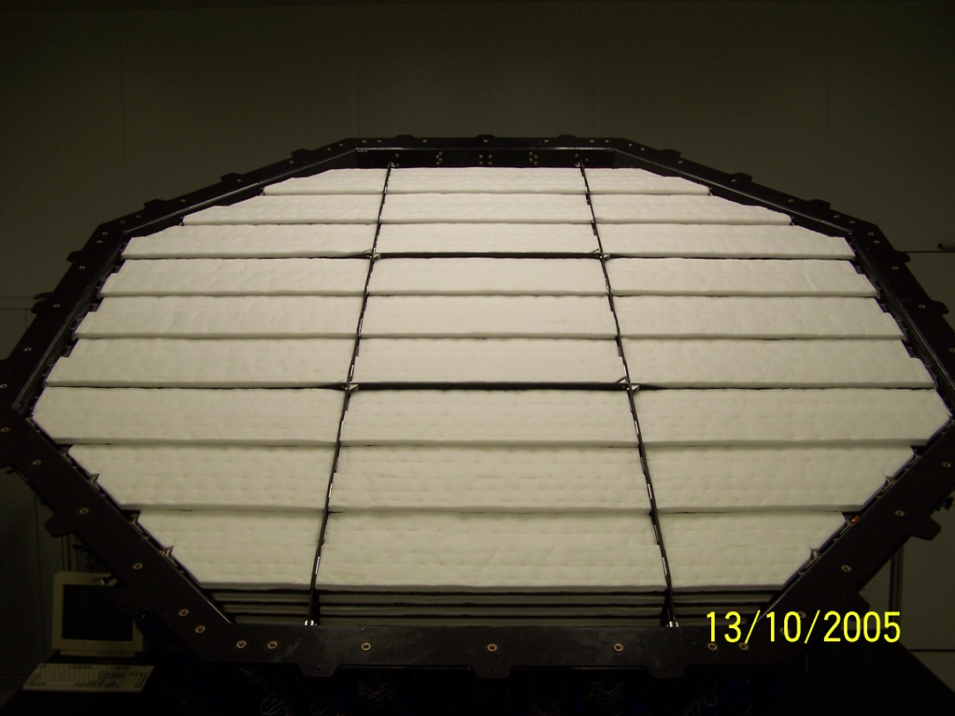
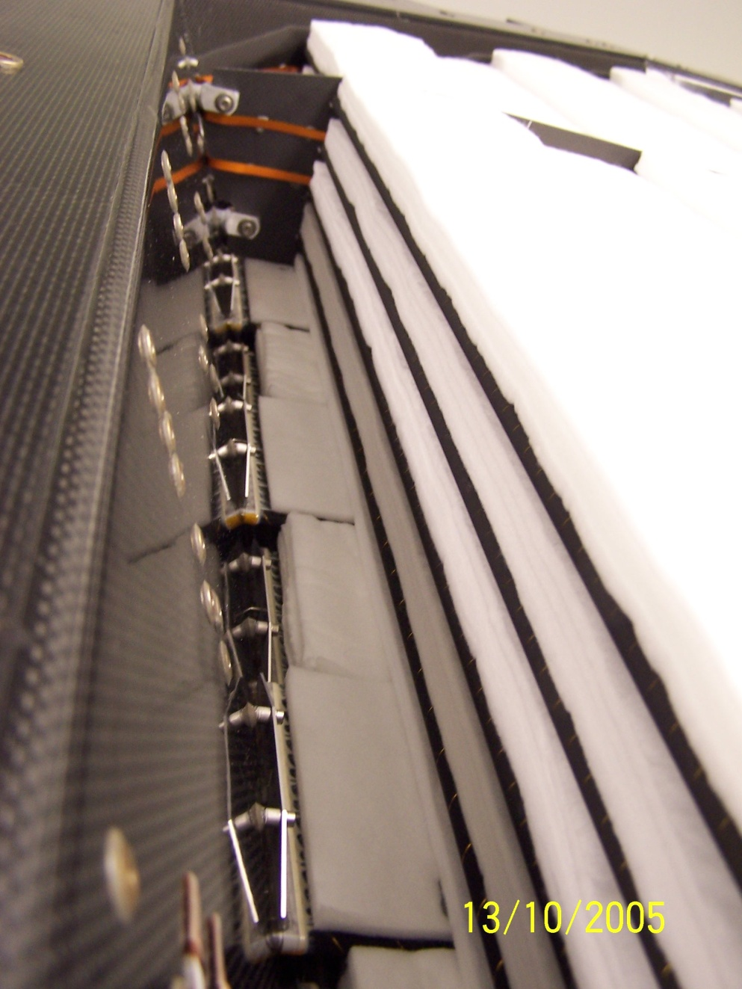
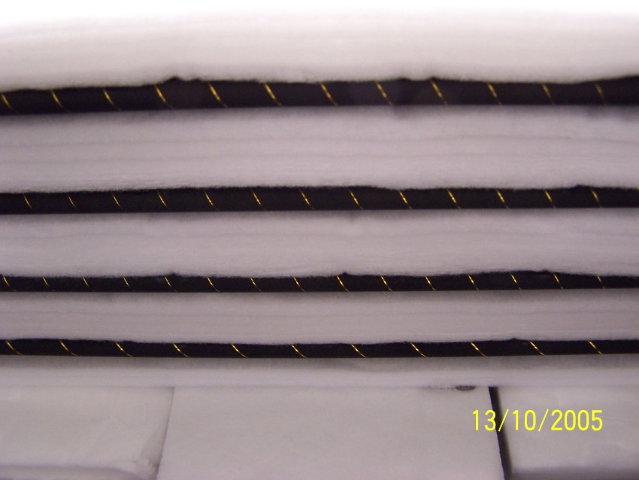
AMS-02 – Transition Radiation Detector (TRD)
Layer 20 with radiator on top

Slide 9
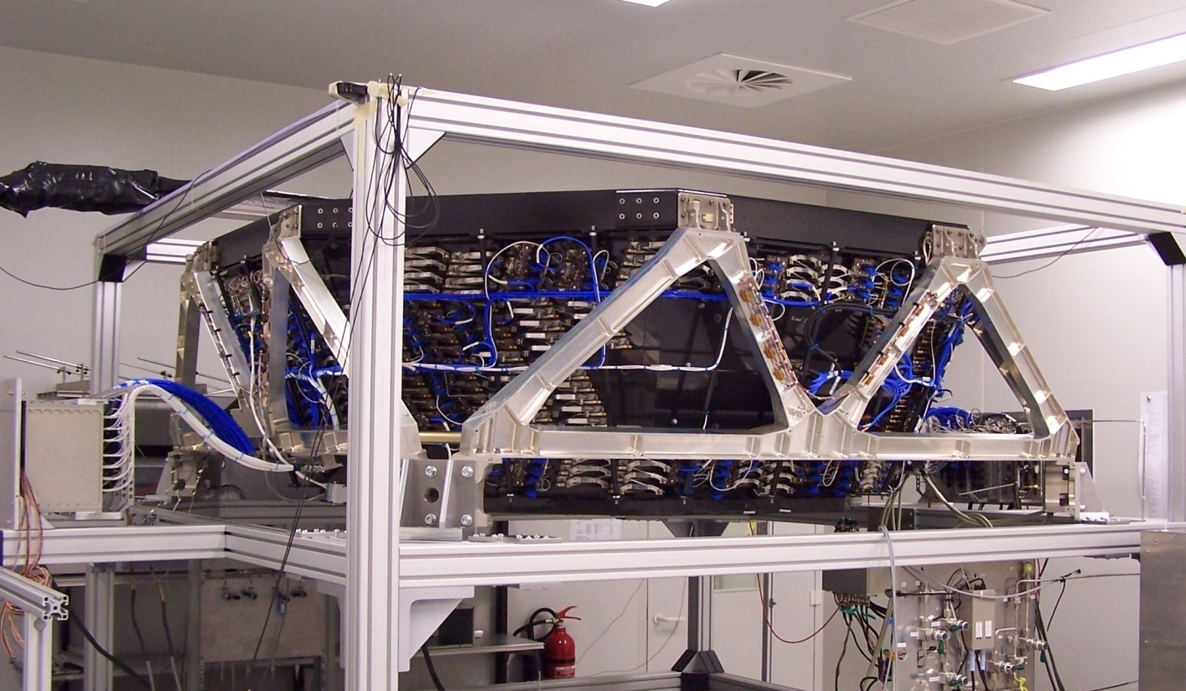
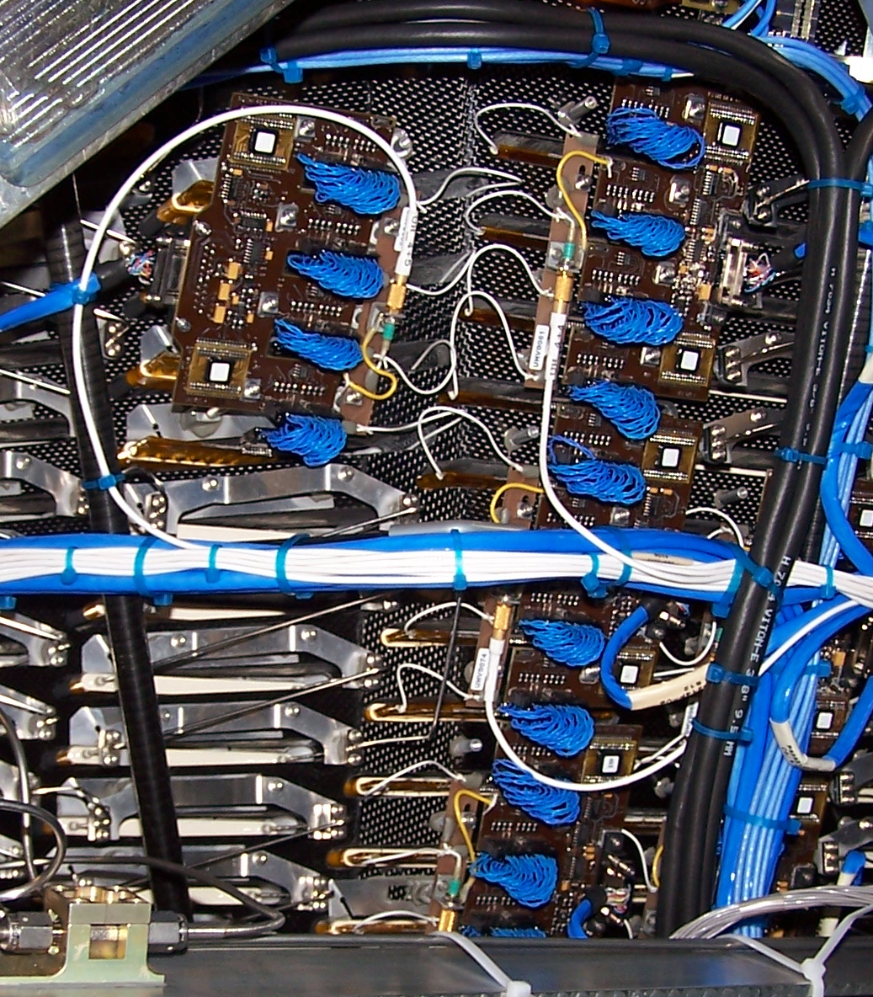
AMS-02 TRD
4 Straw Modules → 1 Readout Group
328 Modules → 82 Readout Groups

Slide 10
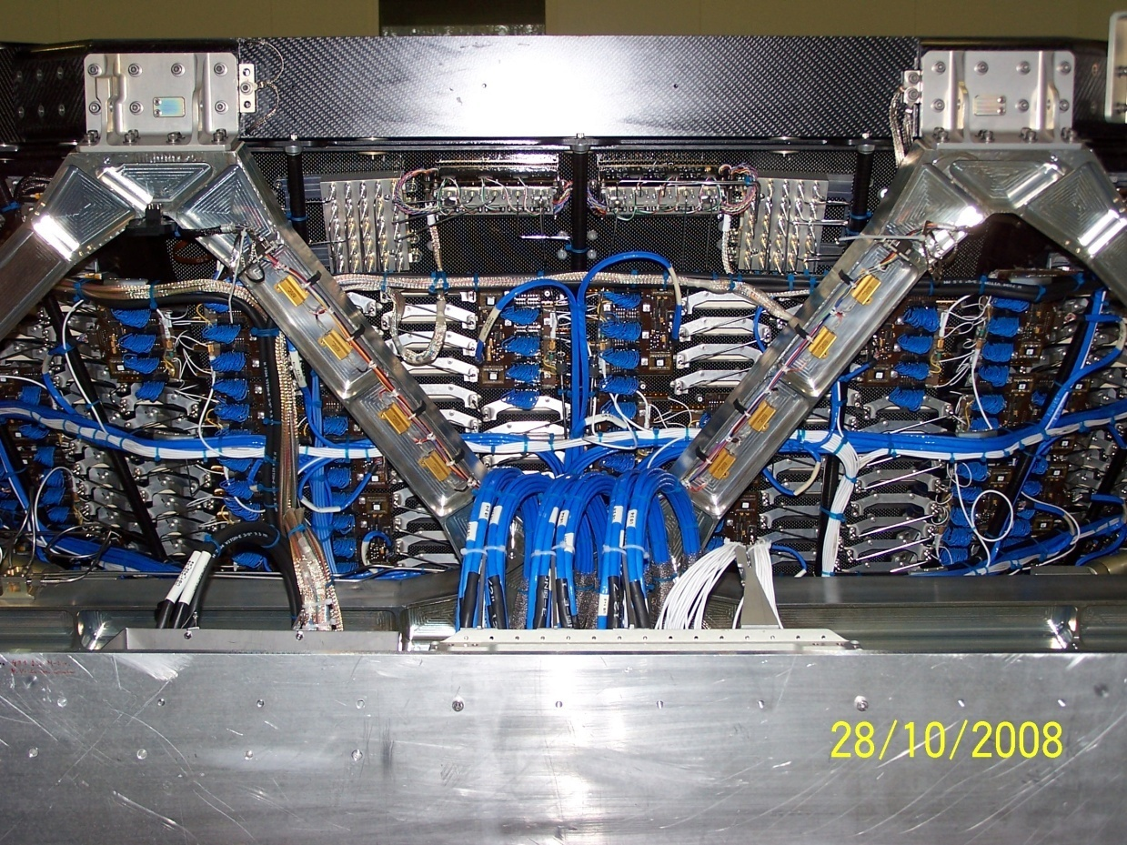
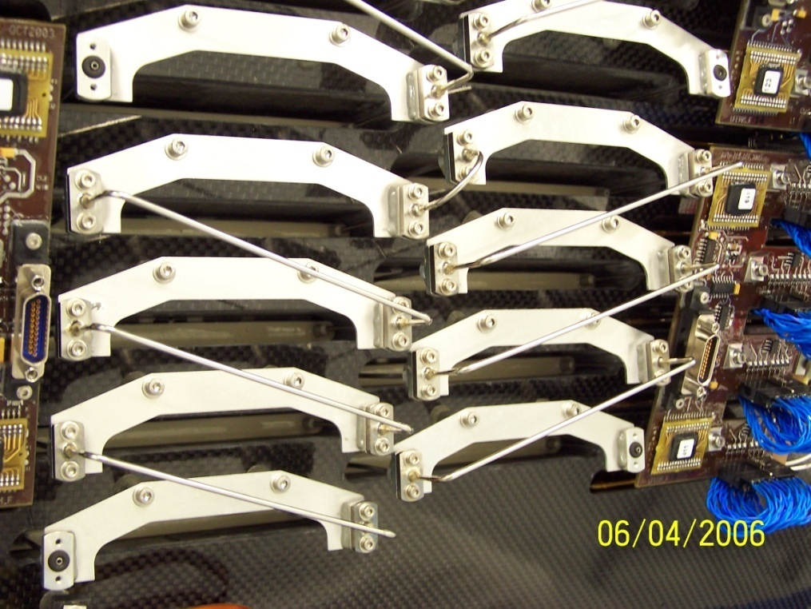
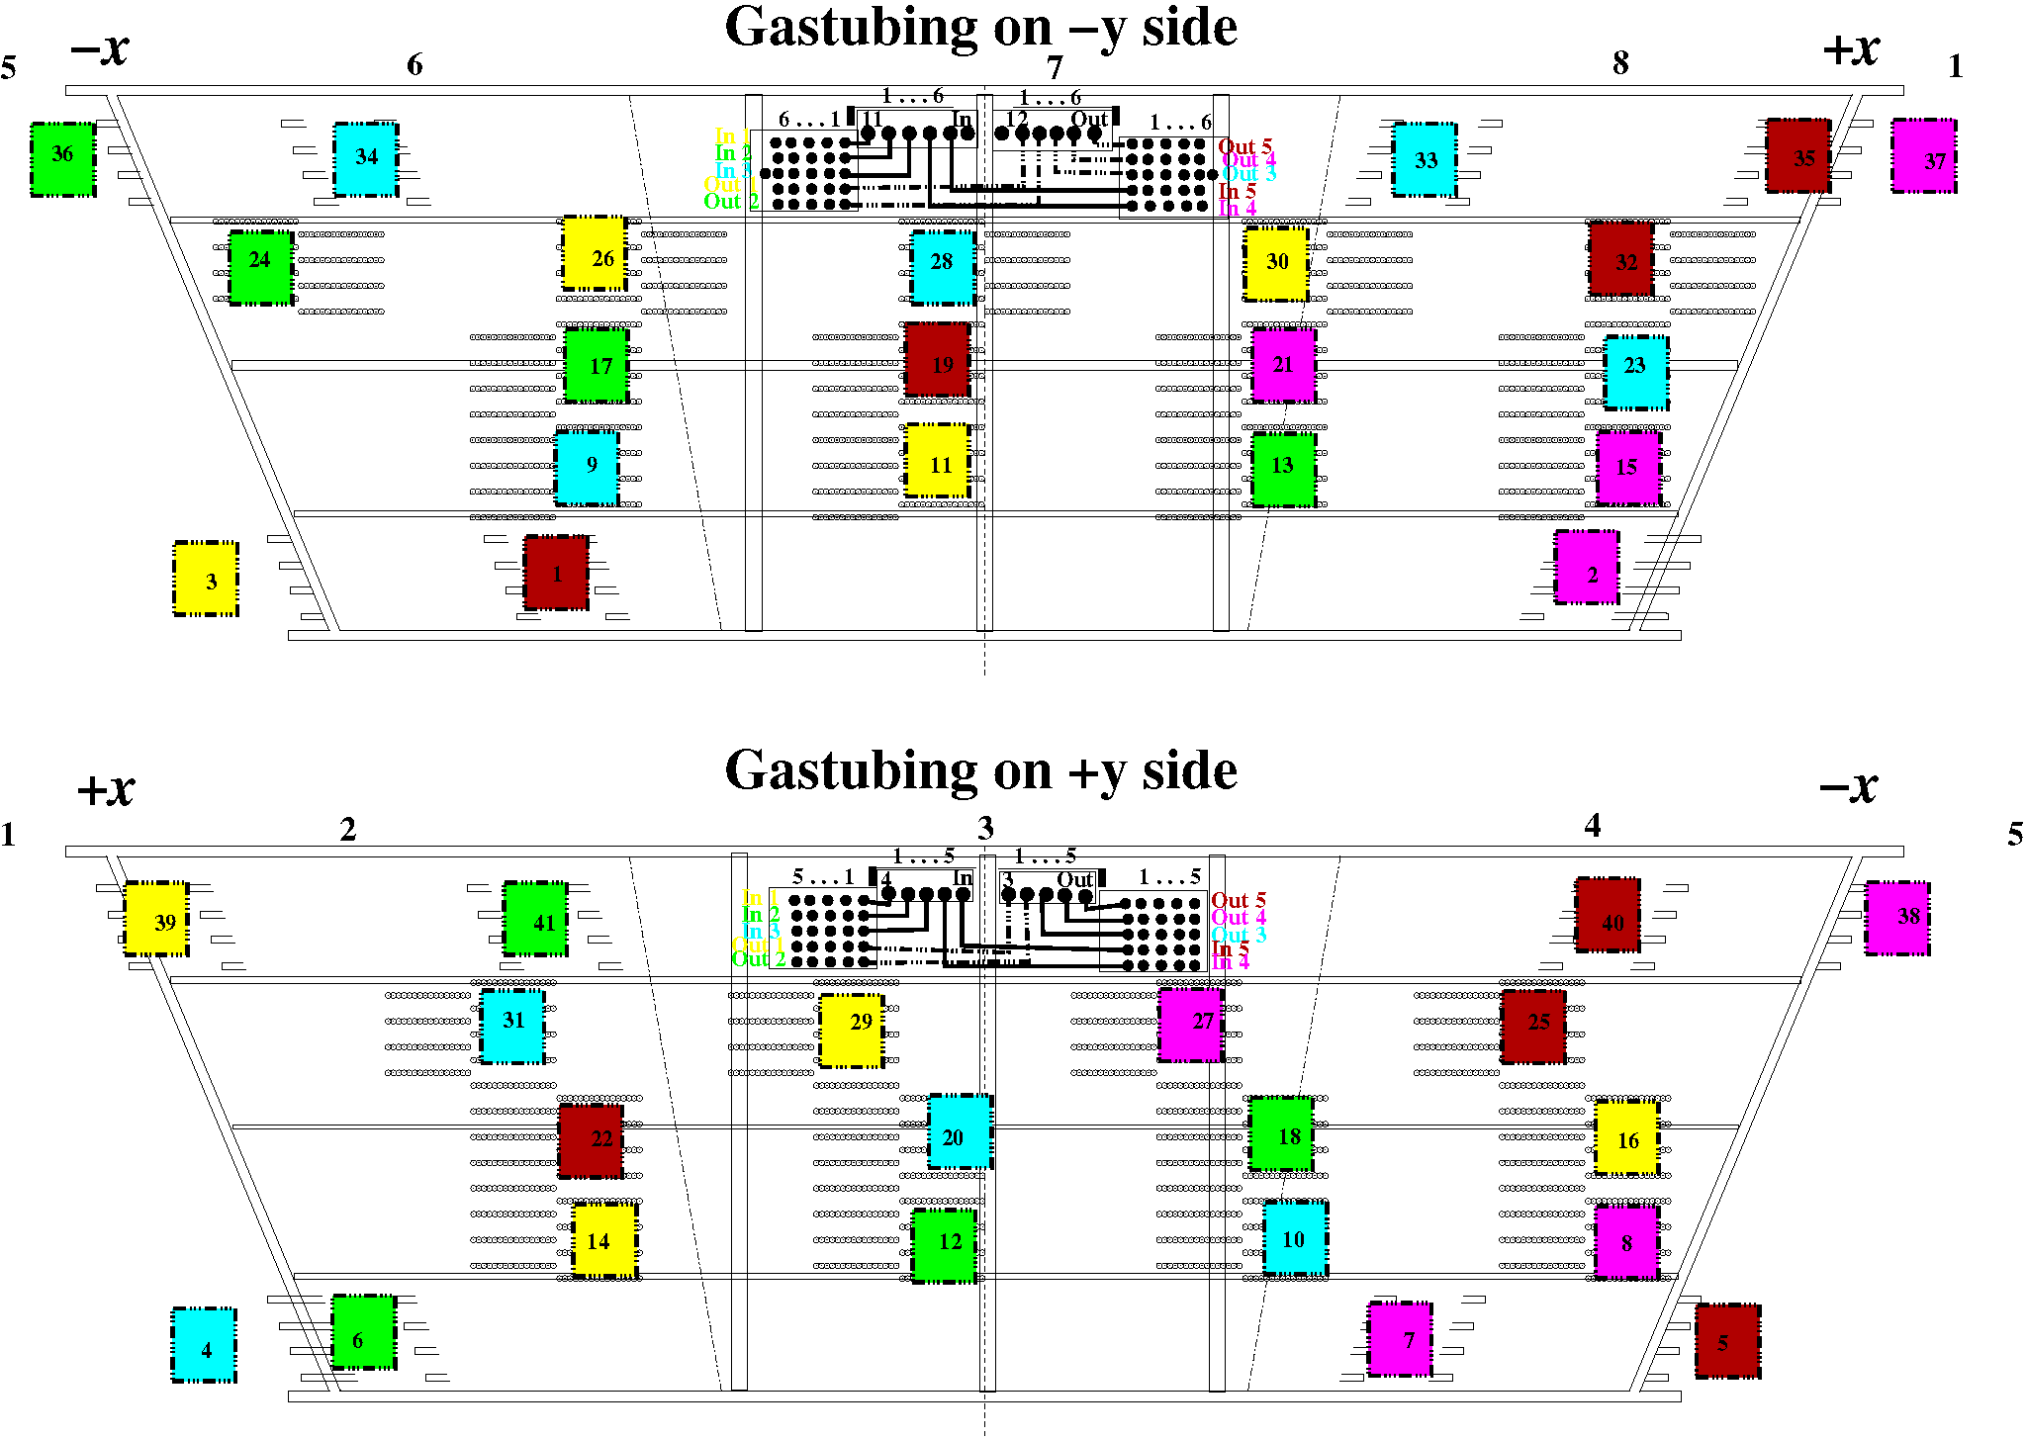
AMS-02 TRD
8 Straw Modules → 1 Gas Tower
41 Gas Towers → 10 Gas Circuits
41 Gas Towers

Slide 11
AMS-02 TRD: Gas System

Slide 12

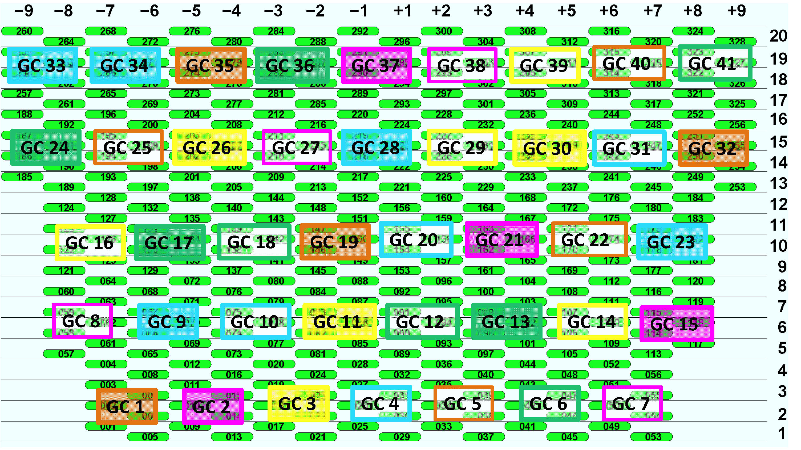
AMS-02 TRD
8 Straw Modules → 1 Gas Tower → 41 Gas Towers

Slide 13
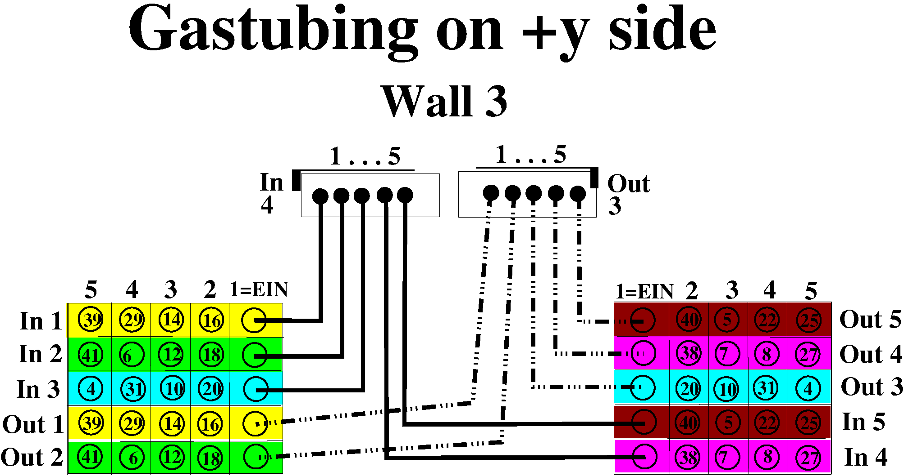
AMS-02 TRD
41 Gas Towers → 10 Gas Circuits
MF 2
MF 1

Slide 14
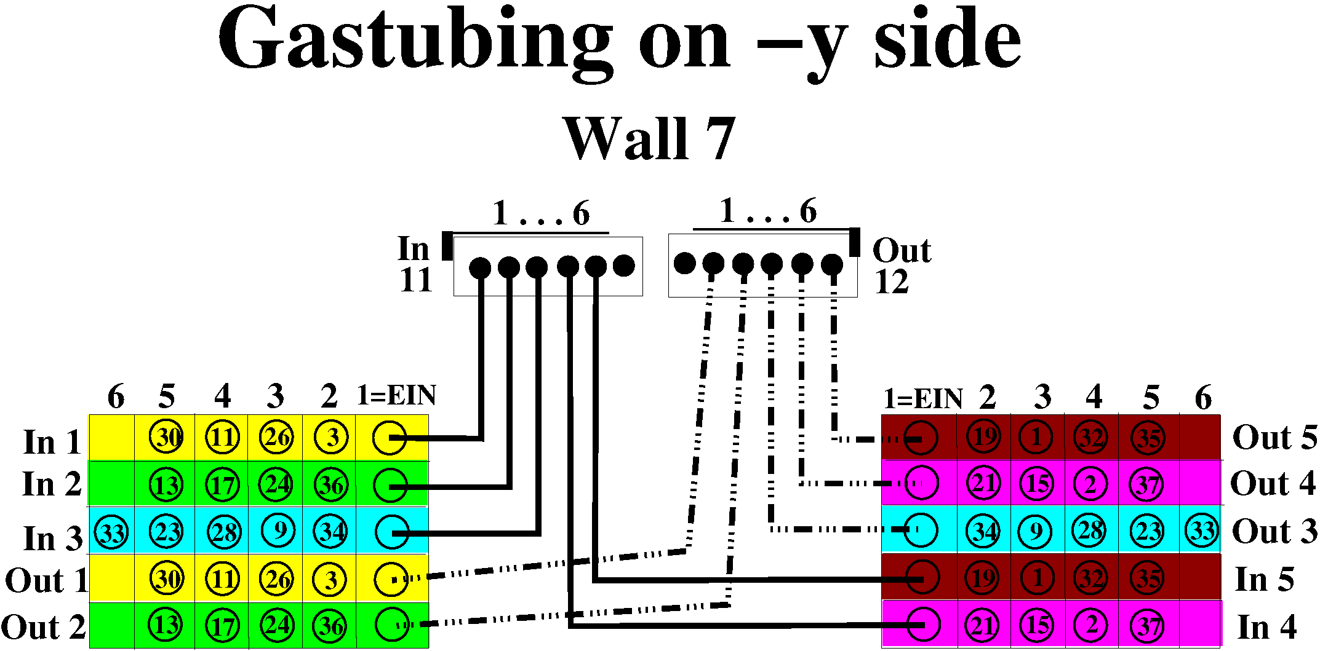
AMS-02 TRD
41 Gas Towers → 10 Gas Circuits
MF 4
MF 3

Slide 15
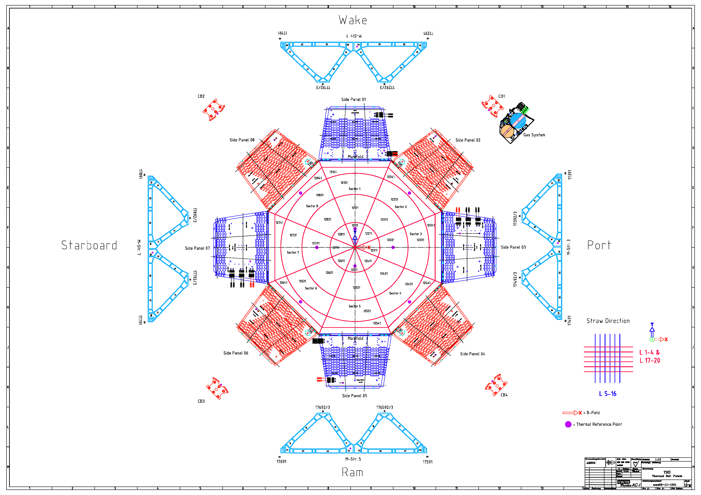
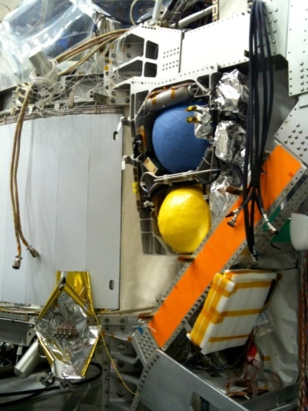
AMS-02 TRD Gassystem

Slide 16

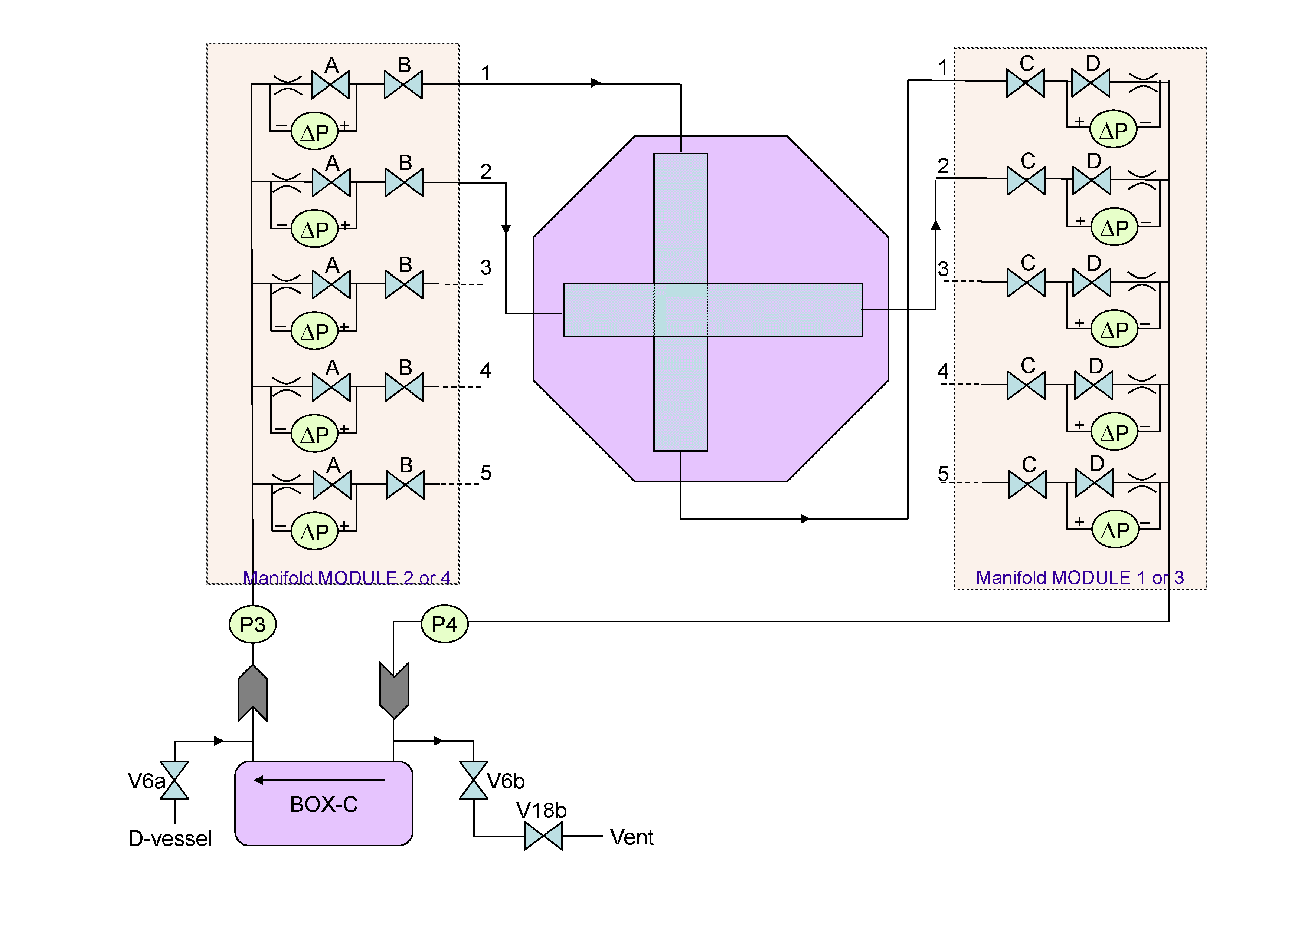
AMS-02 TRD Gassystem

Slide 17
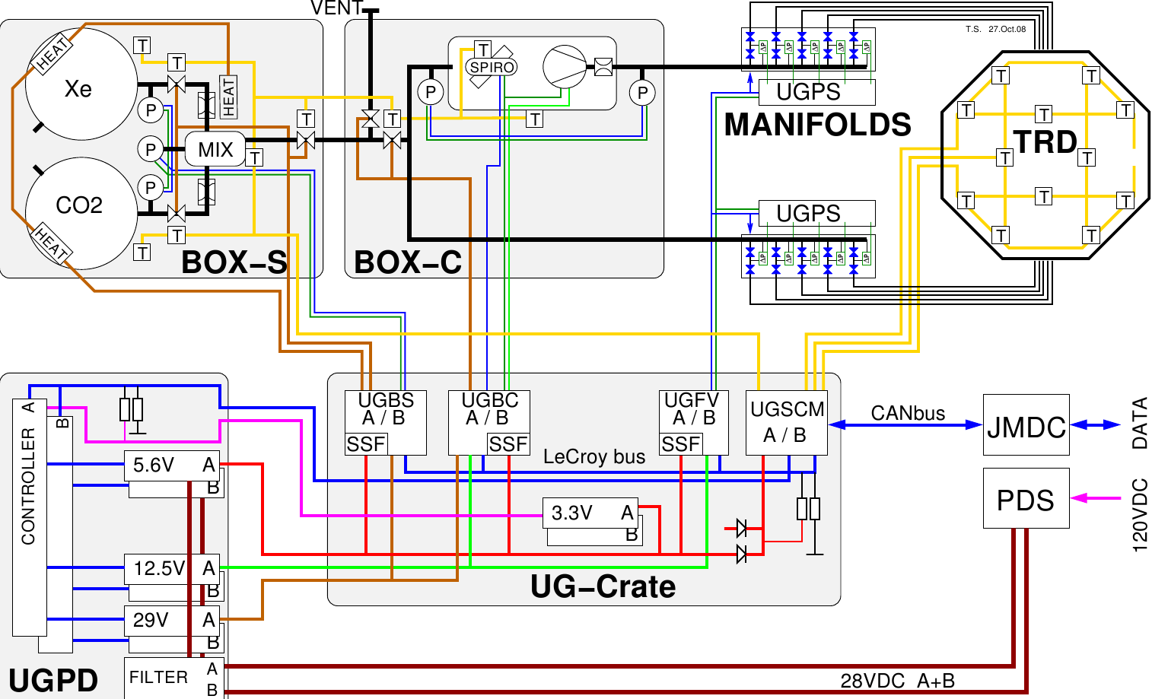
AMS-02 TRD Gassystem
48 kg
5 kg

Slide 18
AMS-02 TRD: Radiator

Slide 19

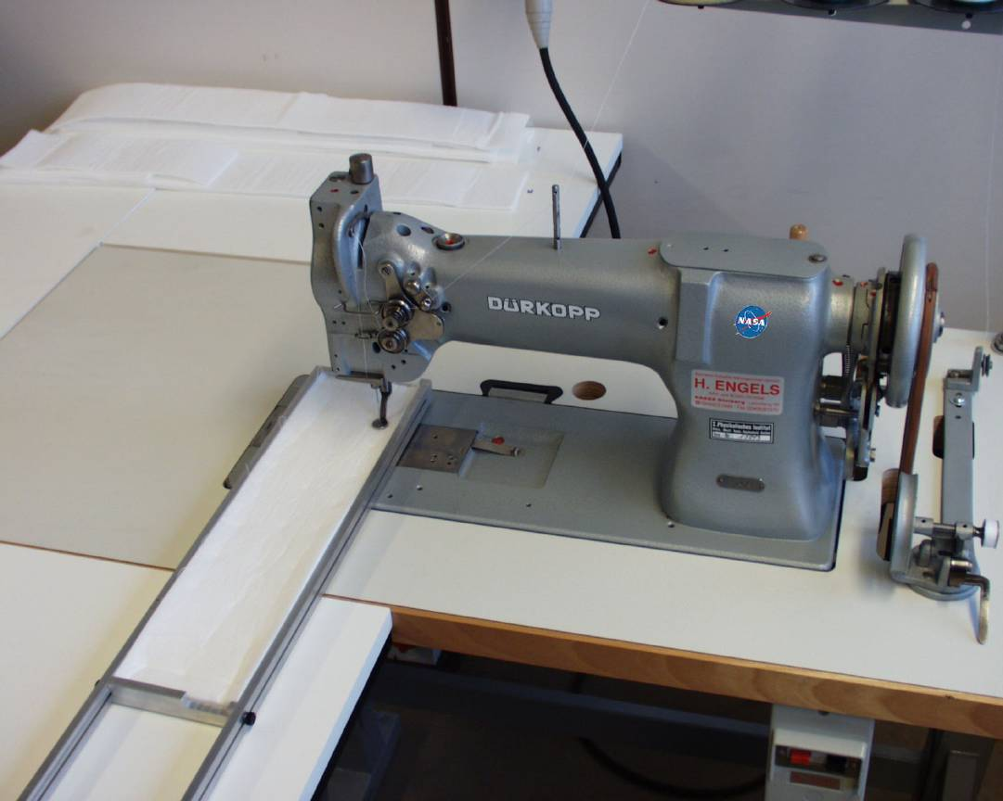
AMS-02 TRD: Radiator
Radiator LRP 375 BK:
Polyethylene/Polypropylene fibers
Effective fiber diameter: 10 μm
Radiator thickness: 22 mm
Density: 0.06 g/cm³
Cleaning with Dichlormethane CH₂Cl₂
→ dM/dt ≈ 10⁻¹² g/s/cm²
4000 individual pieces cut to length
Inst. f. Organic Chemistry
Dichlormethan (CH₂Cl₂)

Slide 20
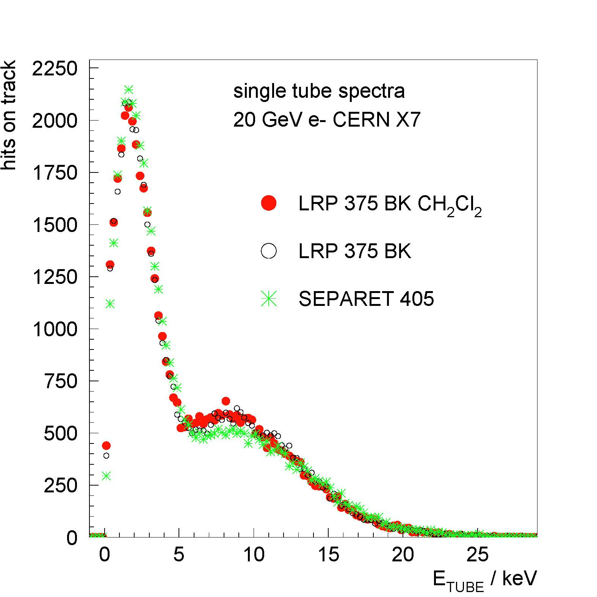
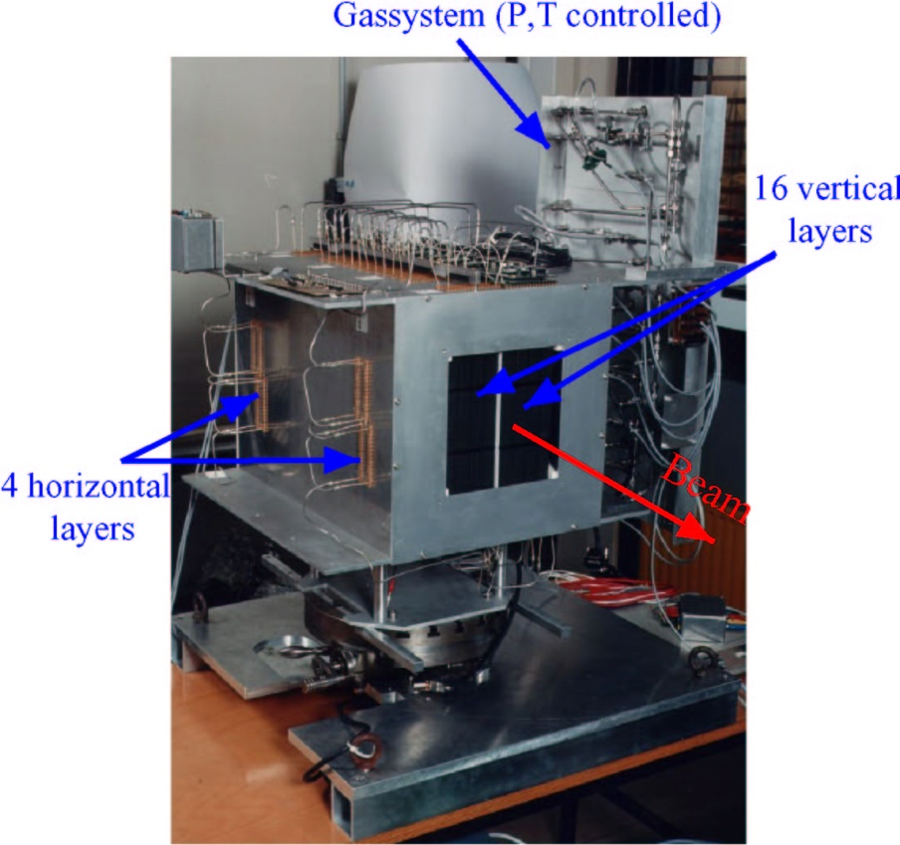
AMS-02 TRD: Radiator

Slide 21
AMS-02 TRD: Straw Modules

Slide 22
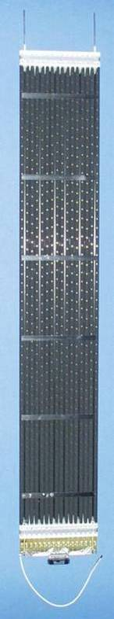
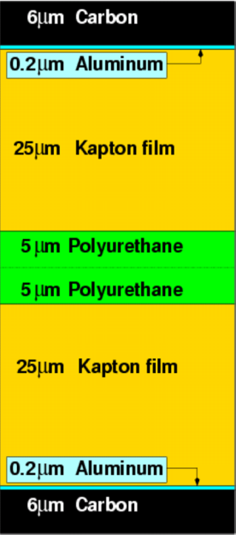

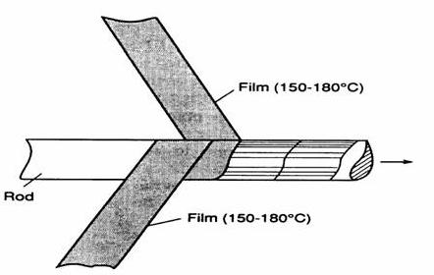
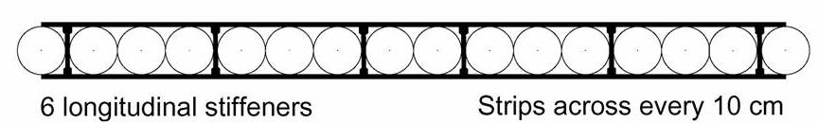
AMS-02 – TRD:
Straw Modules
Straw tube proportional counter modules:
Straw tubes: 72 μm multilayer aluminium kapton foil,
Ø 6 mm , 0.8 ÷ 2.0 m length
Wire: tungsten anode wire, 30 μm Ø, tension ≈ 100 g
Gas mixture: Xe / CO₂ (80% / 20%) → to be optimized
Operating HV ~ 1460 V → Gasgain of ~ 3000
1 Module → 16 Straws, 100 μm mechanical accuracy
328 Modules → 5248 Straws

Slide 23
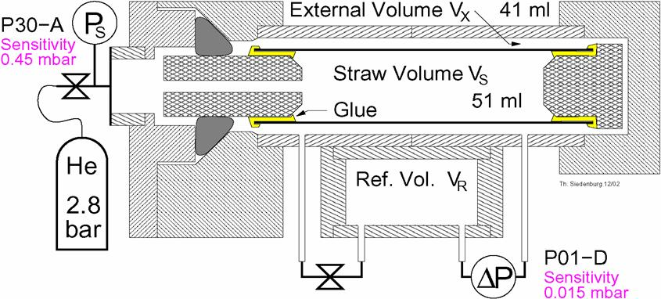
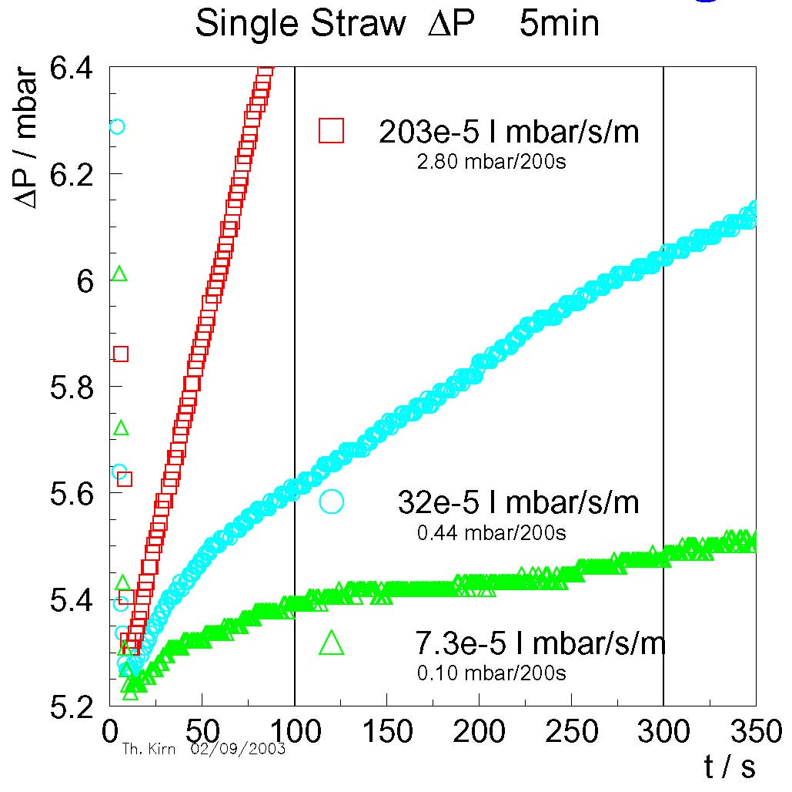
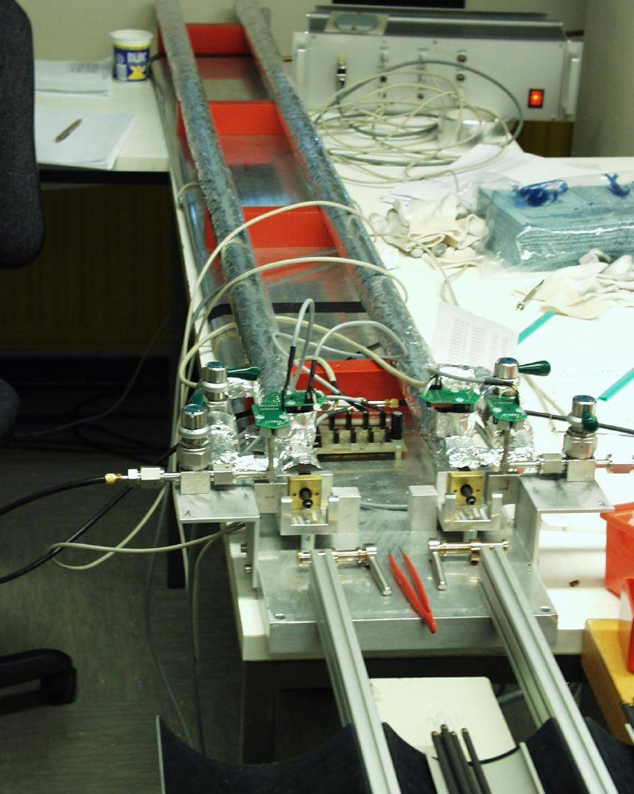
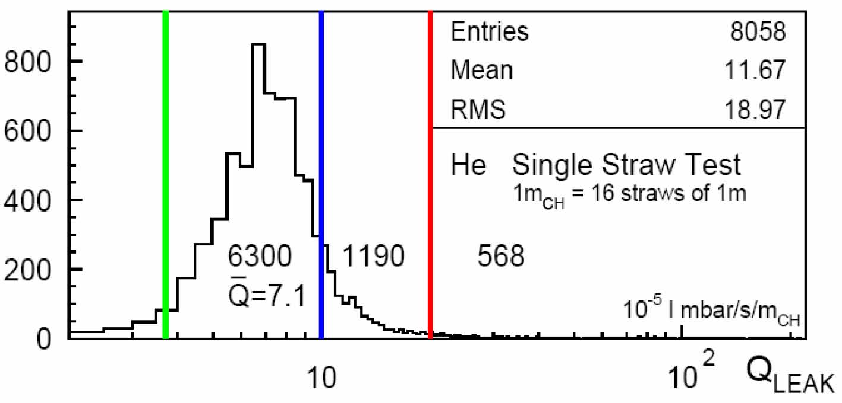
AMS-02 TRD:Gastightness

Slide 24
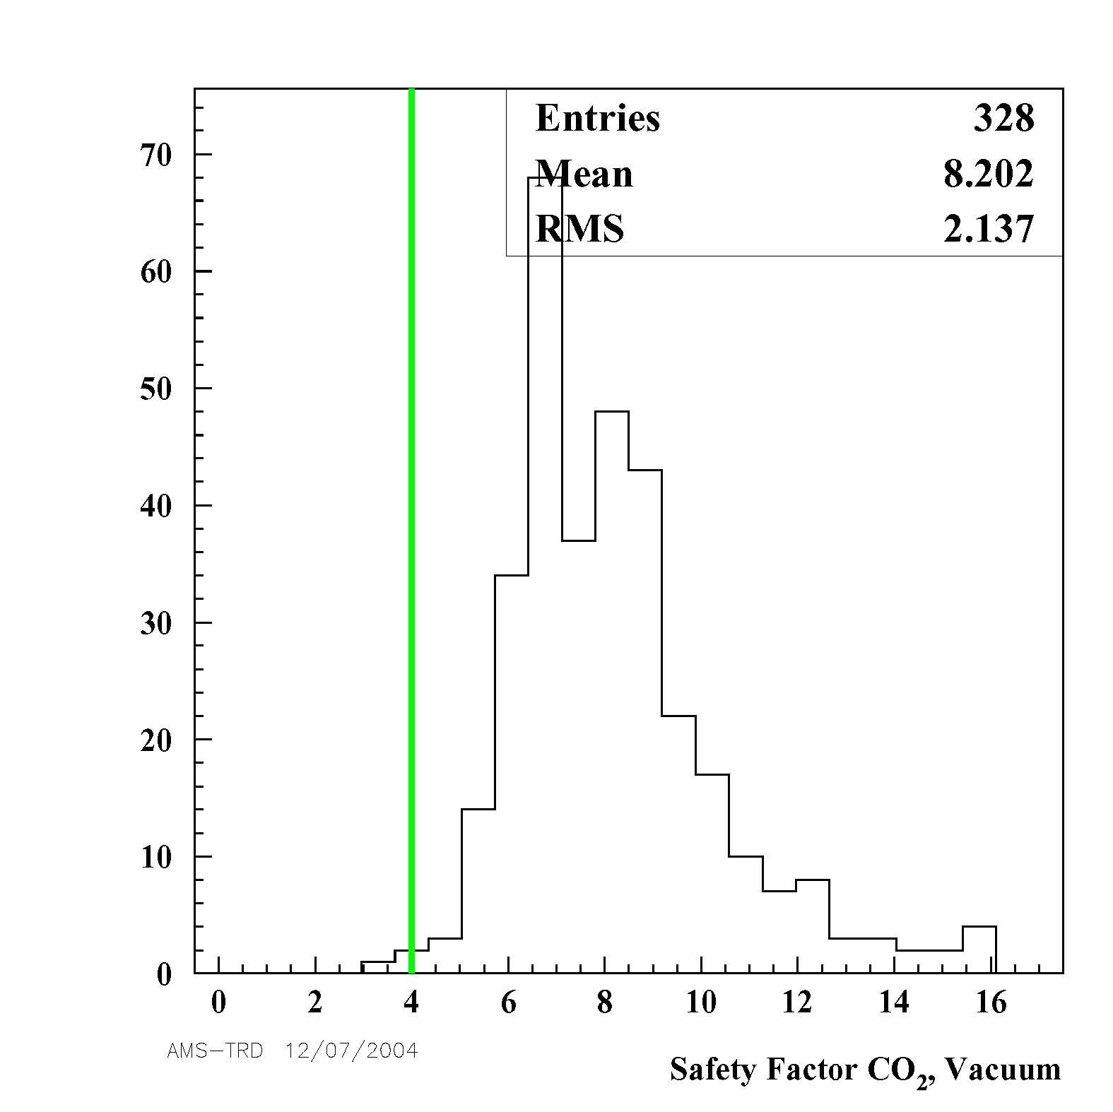
AMS-02 TRD: Straw Module Gastightness
→ 8·3y = 24y @ ISS
CO₂ Leaktest in Vacuum Straws @ 1bar
1m_{CH} = 16 straws of 1m [+2 endpcs] Typ. Module [1.5m] : 3.1 · 10⁻⁵ l mbar/s/m_{CH} ≡ SF 8.2
Gas Tightness measured in safety factors SF, SF=1 → 25.3∙10⁻⁵ l mbar/s/m_{CH}

Slide 25
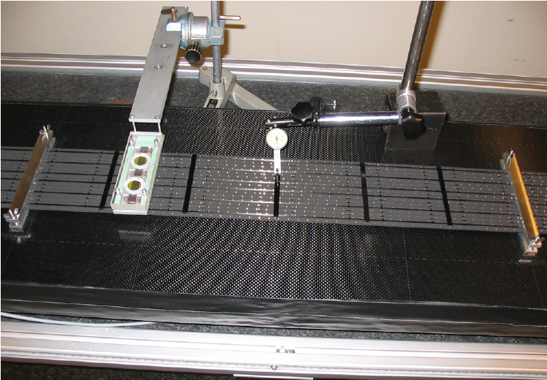
AMS-02 TRD: Straw Modules;
Wire displacement detection by
Fe⁵⁵ – Gasgain-Measurement
for controlled shimming
Fe⁵⁵
Measurement gauge
Shim
Shim

Slide 26
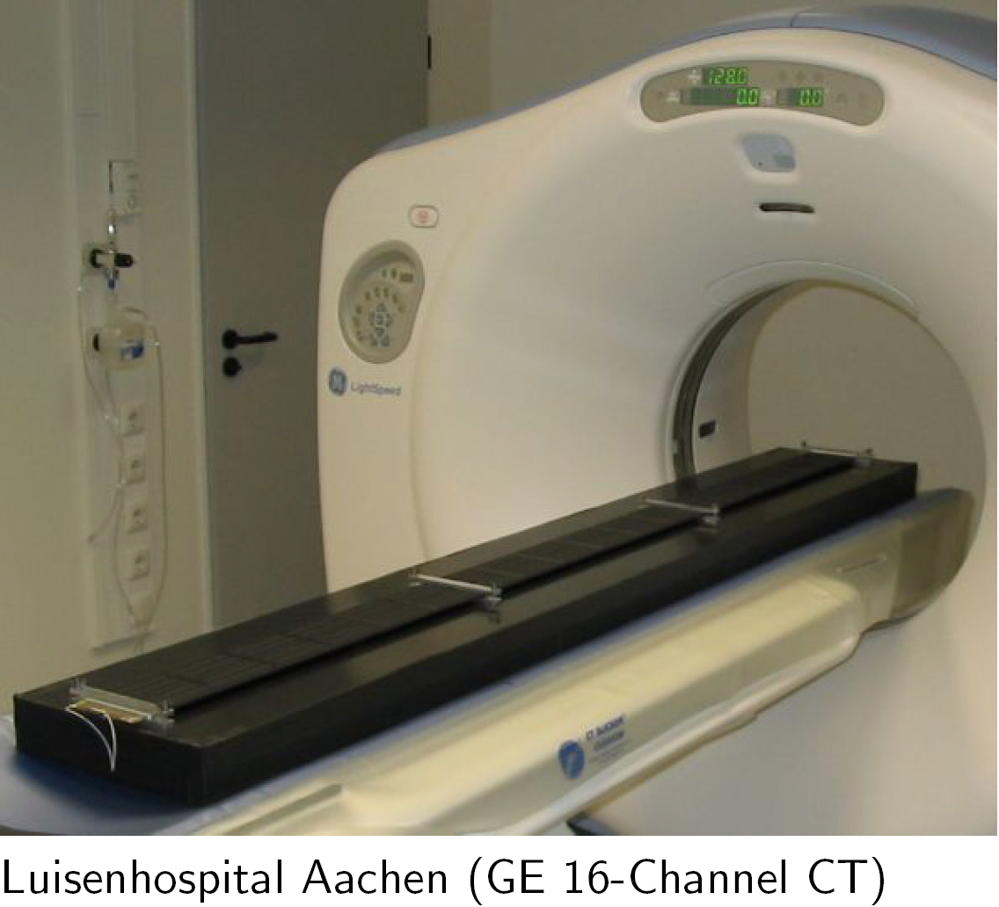
AMS-02 TRD: Straw Modules,
Wire displacement detection,
Computer Tomography X-Ray
Dicom Image File

Slide 27
AMS-02 TRD: Straw Modules,
Wire displacement detection by Computer Tomography X-Ray
Controlled Shimming of +200μm y-direction in middle of module

Slide 28
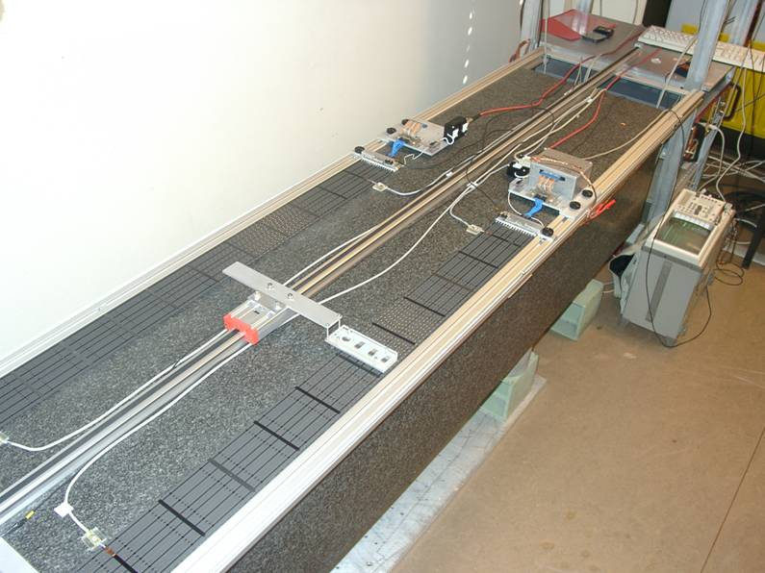


AMS-02 TRD: Fe⁵⁵ – Gasgain-Measurements of 328 Flight Straw Modules

Slide 29



AMS-02 – TRD Straw Modules
Start TRD Integration
September 2004
End TRD Module Integration
October 2005
Module Production
on Granite Table
Module Integration
in Flight Octagon

Slide 30

AMS-02 TRD: Straw Modules: Space Qualification Tests

Slide 31



AMS-02 TRD: Space Qualification Tests
No significant changes in:
Gasgain
Gastightness
→ Straw Modules space qualified

Slide 32



AMS-02 TRD: Straw Module Longterm Tests
1 Gasgroup → 8 Modules
Fe⁵⁵ – Monitoring
Pressure-Drop Measurements
Mass-Spectrometer Measurements
Stable Operation for 2 years

Slide 33

AMS-02 – TRD: Performance, 20 Layer Prototype
Gassystem (p,T controlled)
Beamtest @ CERN 2000
PS (T9) & SPS (X7, H6):
Recorded events: 3·10⁶
Particles: e⁻, μ⁻, π⁺ 10 - 100 GeV
Protons 10 - 250 GeV
Beam
4 horiz. layers
16 vert. layers

Slide 34


AMS-02 – TRD: Performance, 20 Layer Prototype
Tube Intercalibration
Gasgain-Density-Corr.
Fe⁵⁵ Energy Calibration

Slide 35
AMS-02 – TRD: TRD Spectra with Geant 3⁺ MC
dE/dX in thin gas-layers V. Ermilova, NIM A 145 (1977) 555
TR gener. and absorp. M. Cherry, Phys.Rev.Lett. D 10 (1974) 3594
Implement. V. Saveliev (HERA-B) G.M. Garibian, NIM A 125 (1975) 133

Slide 36

AMS-02 – TRD: Performance, 20 Layer Prototype
■ AMS TRD
40 GeV Beam

Slide 37
AMS-02 TRD: Frontend Electronic
UFE-Boards

Slide 38
AMS-02 – TRD: Front End Electronic
VA-Chip Multiplexed Pulsheight Readout

Slide 39




AMS-02 – TRD: Production of UFE-board (FM)
+
358 VA Chips Tests
Select 202 Chips
101 Production of 4 Types PCB
Series of
Space Qualification
Tests
TVT → 3D Vibration
→ Coating → TVT
Functional Tests
Integration

Slide 40


AMS-02 – TRD: Space Qualification Tests of UFE-board (FM)
Random Vibration
X,Y and Z-Direction
a_{RMS} = 6.8g, 20-2000 Hz for 120 sec
Functional test without failure
1st TVT
Temperature : -40ºC … +80ºC
Pressure : 1×10⁻⁵ mbar
Functional test without failure
2nd TVT
Same as 1st TVT condition
Conformal Coating

Slide 41

AMS-02 – TRD: Thermal Profile of TVT Test for FM-UFE-Boards
: Gain Calibration Points
Operating Temperature (-20 ~ +50 ºC)

Slide 42

AMS-02 – TRD: UFE-Board Noise Measurement after TVT Test
Noise = 1.5 ADC == ENC = 4000 e⁻
Common mode noise corrected

Slide 43

AMS-02 – TRD: UFE-Board Gain Calibration @ +50°C

Slide 44

AMS-02 – TRD: UFE-Board Gain Calibration @ -50°C

Slide 45

AMS-02 – TRD: UFE-Board Gain versus Temperature
Every channel has to
be calibrated within
operating temperature.

Slide 46


AMS-02 – TRD: FM-UFE-Board Pedestal & Noise Distribution
Pedestal Distribution :
~ 10% of full range
Noise RMS Spread :
~ 4%

Slide 47


AMS-02 – TRD: FM-UFE-Board Gain & Nonlinearity Distribution
Gain RMS Spread :
~ 3%
Nonlinearity
~ 2E-04 [ADC/fC]

Slide 48

AMS-02 – TRD: Integration of FM-UFE-Boards on Octagon Wall 1

Slide 49

AMS-02 – TRD: Integration of FM-UFE-Boards on Octagon Wall 2

Slide 50

AMS-02 – TRD: Integration of FM-UFE-Boards on Octagon Wall 3

Slide 51

AMS-02 – TRD: Integration of FM-UFE-Boards on Octagon Wall 4

Slide 52




AMS-02 – TRD: Integration of FM-UFE-Boards on Octagon Walls
5
6
7
8

Slide 53

AMS-02 TRD: Straw Module+Frontend-Readout,
Corona Discharges

Slide 54


AMS-02 TRD: Corona Discharge Test
Straw Module UTE-board
HV-Distribution (UHVD) board
Epoxy Potting
HV cables
Conformal Coating
HV plug/receptacle

Slide 55

AMS-02 TRD: Corona Discharge Test
VA2
2nd VA
Octagon-Like Al. Panel
UHVD
To UDR2
UHVD
VA2
1st VA
UFE
Complete Single HV & Readout Unit

Slide 56


AMS-02 TRD: Corona Discharge Test
TRD 4 layers straw modules
UFE
UHVD
HV Plug/Receptacle
HV Cables

Slide 57



AMS-02 TRD: Corona Discharge Test
ArCO₂, 1 l/h
With Kapton Screening of UTE-boards no Corona discharges observed!

Slide 58


AMS-02 TRD: ElectroMagnetic Interference Test
Octagon-Like Housing
4 straw modules + UFE-Readout
EMI Test @KMW Co. Munich
According to
“Space Station Electromagnetic Emission and Susceptibility Requirements for the Electromagnetic Compatibility”
SSP30237 paragraphs RS02, RS03, and RE02
Multilayer Insulation Screen
Electric field sensor
Wave : Horizontal / Vertical Polar.
Frequency range : 10 kHz ~ 1 GHz
Electric Field : 5 ~ 100 [V/ m]
EMI emitter

Slide 59

AMS-02 TRD: ElectroMagnetic Interference Test
Freq. =10 kHz ~ 200MHz
|E|_{rms} = 5 [V/m] w. V.P.
Noise VP = 1.782 +- 0.0159[ADC]
200MHz ~ 1GHz, 70 [V/m]
Noise ^{VP} = 1.808 +- 0.0279[ADC]
Noise HP = 1.781 +- 0.0333[ADC]
14kHz ~ 20MHz, 50~100[V/m]
Noise VP = 1.82 +- 0.0332[ADC]
Sweeping Freq. =14 kHz ~ 30MHz
|E|_{rms} = 20 ~ 100[V/m] w. V.P.
Noise ^{VP} = 1.839 +- 0.0554[ADC]
Sweeping Freq. =30MHz ~ 1GHz
|E|_{rms} = 20 ~ 100[V/m] w. V(H).P.
Noise V&H = 1.804 +- 0.0613[ADC]

Slide 60

AMS-02 TRD: ElectroMagnetic Interference Test
Acceptable Limit Line for Full TRD
Acceptable Limit Line for one UFE
Before shielding
After appropriate shielding of cables

Slide 61
AMS-02 TRD DAQ

Slide 62




AMS-02 TRD DAQ
328 Modules → 82 Readout Groups
2 FM U-Crates, 2 FM UPD-Crates

Slide 63

AMS-02 TRD DAQ

Slide 64


AMS-02 TRD DAQ
Space requirements issued by NASA :
Electromagnetic Interference
Electromagnetic Compatibility
Mechanical Vibration
Thermal Vacuum Test
TRD Power Consumption
UFE (20W) + UCrate (41W) + UPD (36W)
≈ 100W

Slide 65

AMS-02 TRD DAQ

Slide 66

AMS-02 TRD DAQ

Slide 67

AMS-02 TRD DAQ

Slide 68

AMS-02 TRD DAQ

Slide 69

AMS-02 TRD DAQ

Slide 70

AMS-02 TRD DAQ

Slide 71

AMS-02 TRD DAQ

Slide 72

AMS-02 TRD DAQ

Slide 73

AMS-02 TRD DAQ

Slide 74
AMS-02 – TRD M-Structure, Heating

Slide 75

AMS-02 – TRD M-Structure Heating

Slide 76

AMS-02 – TRD M-Structure, Heating

Slide 77

AMS-02 – TRD M-Structure Heating

Slide 78

AMS-02 – TRD M-Structure Heating

Slide 79

AMS-02 – TRD M-Structure Heating

Slide 80

AMS-02 – TRD M-Structure Heating

Slide 81

AMS-02 – TRD M-Structure Heating

Slide 82

AMS-02 – TRD M-Structure Heating

Slide 83

AMS-02 – TRD M-Structure Heating

Slide 84

AMS-02 – TRD M-Structure Heating

Slide 85

AMS-02 – TRD M-Structure Heating

Slide 86



AMS-02 – TRD Thermostats Space Qualification

Slide 87

AMS-02 – TRD Flight Integration, System Test

Slide 88

AMS-02 – TRD Flight Integration,
Gastightness @ RWTH Aachen Cleanroom
He-dp/dt-Measurements of
individual straw modules
during production:
q_{Wall 7} = 1.56*10⁻² l mbar/s
q_{Wall 3}= 1.53 * 10⁻² l mbar/s
→ Safety Factor 8 for CO₂

Slide 89

AMS-02 – TRD
TRD Delivery to CERN October 2007

Slide 90


AMS-02 – TRD Flight Integration,
Gastightness @ AMS Cleanroom CERN
Ar/CO2- (80%/20%) dp/dt-Measurements
of whole TRD after delivery to CERN
end of 2007:
q_{CO2}= 0.29 * 10⁻² l mbar/s
Comparison Measurement dp/dt in air:
He ↔ CO2 Factor of 2
Factor 5 20% to 100 % CO2
q_{He} = 3.09*10⁻² l mbar/s
→ TRD gastight

Slide 91

AMS-02 – TRD Flight Integration,
Gastightness @ AMS Cleanroom CERN
Ar/CO2- (80%/20%) dp/dt-Measurements
of whole TRD after pre- & de-integration
End of 2008:
q_{CO2}= 0.29 * 10⁻² l mbar/s
Comparison Measurement dp/dt in air:
He ↔ CO2 Factor of 2
Factor 5 20% to 100 % CO2
q_{He} = 3.09*10⁻² l mbar/s
→ TRD gastight

Slide 92

AMS-02 – TRD
TRD Flight Integration July 2010

Slide 93
AMS-02 @ CERN Cleanroom

Slide 94


AMS-02 @ ESTEC, Noordwijk
AMS-02 inThermal Vacuum Chamber
No major issues

Slide 95


AMS-02 @ ESTEC, Noordwijk
Electromagnetic Interference Test:
  Emission
  Susceptibility/Immunity
AMS-02 in EMI Chamber
EMI emission profile:
  Range 30 Hz – 50 MHz
  Limit set by Nasa not exceeded
EMI susceptibility (not shown):
  Interference at 80 MHz (TDCs)
  No major issues

Slide 96



AMS-02 – Test Beam H8 CERN
8-20 Aug 2010
e± Energy Resolution: 2.5-3%
Energy

Slide 97



AMS-02 Transport CERN to KSC
Arrival of US Air Force C5 Galaxy
at Geneva – 25 Aug 2010
February 2011
AMS-02 in the Space Station Processing Facility (SSPF), ready for installation into the Space Shuttle
Extended data taking periods to verify detector performance

Slide 98

AMS-02 in Endeavour Payload Bay, Closing of Doors

Slide 99

AMS-02 - STS 134 Launch
16th of May

Slide 100

AMS-02 - TRD: First Slow Control Data

Slide 101

AMS-02 - Start Data Taking 09:35 CDT, May 19th 2011

Slide 102


Slide 103

AMS-02 - Start Data Taking 09:35 CDT, May 19th 2011
AMS-02 - Trigger Rate
More than 15 Billion Triggers recorded

Slide 104

AMS-02 TRD

Slide 105

AMS-02 TRD
TRD Hits per event

Slide 106

AMS-02 TRD - Occupancy

Slide 107

AMS-02 TRD - Occupancy
AMS TRD Occupancy
5246/5248 Channels within specification.

Slide 108

Pedestal
AMS-02 TRD – Amplitude/Noise
Noise
Amplitude on track

Slide 109

AMS-02 TRD – Temperature Monitoring
Max ~19°C
Mean ~15°C
Min ~11°C

Slide 110


AMS-02 TRD – Temperature Monitoring

Slide 111

AMS-02 TRD – Temperature Monitoring
ºC
TRD inside temperature
ΔT = 1 °C
May 23 to June 1

Slide 112


AMS-02 TRD – Pressure Monitor
Total leak rate of 4.2 mbar/day:
→ CO₂: (1.5 + 0.125*2.7) mbar/d = 1.84 mbar/day
Volume* leak rate = 230 l ∙ 1.84 mbar/day = 422.6 l mbar / day
→ 0.764 g /day = 8.85 μg / s (before launch 6 μg / s )
Total storage: 5kg
→ CO₂ lasts for 17.9 years > ISS Lifetime

Slide 113

AMS-02 TRD Raw Data, before 1st Calibration
AMS TRD Proton Spectrum
Single Straw
HV
1580V
HV -20V

Slide 114

AMS-02 TRD Raw Data, before 1st Calibration
HV
-100V
HV
1580V
HV -20V

Slide 115

AMS-02 TRD Raw Data, before 1st Calibration
AMS TRD Proton Spectrum
Single Straw
HV
-100V
HV
1580V
Gas Refill,
HV +50V
HV -20V

Slide 116

AMS-02 TRD after 1st Calibration

Slide 117

AMS-02 TRD after 1st Calibration, He-Sample
Helium (Z=+2, 10.0 GeV/c < P < 20 GeV/c)
Day 138 - 220

Slide 118


Slide 119

AMS-02 TRD Response to Protons, Helium, Electrons
Use ToF, Tracker and ECAL to define clean single track proton, helium
and electron samples
Protons
Helium
Single Straw Spectrum
Electrons
Helium
frequency
Electrons
Protons

Slide 120



AMS-02 TRD Proton Rejection
Protons
Electrons
He ?
P = 3 - 50 GeV
6200 @ 90%
80% Efficiency, Proton Rejection = 32541 (33302) Cut at 0.48
90% Efficiency, Proton Rejection = 6208 ( 6328) Cut at 0.53

Slide 121

AMS-02 TRD Proton Rejection

Slide 122

AMS-02 TRD Proton Rejection
All
ECAL-BDT
3D-Shower Shape
TRD
Electrons
TRD-LLH & ECAL-BDT
Positrons

Slide 123
AMS-02 TRD
Slow Control and Data Monitoring

Slide 124




TRD/TRDGas-System Monitoring Programs

Slide 125

TRD/ACC/TAS-Standard Shift

Slide 126

List of TRD/TRDGas Programs
Electronics Monitoring:
TRD Status Monitor (TRD-S)
Pedes_Canvas
UDR_HK_Canvas
Read_block_files
UHV Status Monitor (UHV-S)
Gas Monitoring:
TRDGAS Monitor (TRDGAS-M)
TRDGAS Status Monitor (TRDGAS-S)
TRD Pressure Monitor (Pressure Monitor)
Detector Monitoring:
TRD Data Monitor (TRD-M)
TRD-DTS Monitor (TRDDTS-M)
TRD-GainMonitor (TRD-GainMonitor)

Slide 127
TRD-ACC-TAS SHIFTER:
TRDGas Standard Monitoring Shift
Start-up of AMS-Activation:
AMS Power-Step-1 from CMD Post
- Initializes TRDGAS Crate (UG)
- Configures and starts UG CtrlTsk
- Activates UG Q-List items 7A/7B
HV ON: CMD asks if TRD Gas is ok
Standard Shift Activity:
• No TRDGAS commanding in standard shift
• Adjust TRD HV once per day by a 3V step (MOP-ADC value ≈ 60)
details see pages 131-133
Check: TRDGAS monitor data available
All plots in TRDGAS-M update
• Check: Pressures and Temperatures in range
TRDGAS-S is updating regularly

Slide 128
TRD-ACC-TAS SHIFTER:
TRDGas Emergency Actions
Emergency Actions from TRD Post CALL EXPERT ASK for Commanding
- Xe/CO2 Vessel High Pressure (>175/100bar) UG Heaters DISABLE
- Xe/CO2 Vessel High Temperature (>+60°C) UG Heaters DISABLE
- Xe/CO2 Vessel Low Temperature (<-20°C) HEAT VESSELS (UG-A)
- Xe/CO2 Vessel Low Temperature (<-40°C) HEAT VESSELS (UG-B)
Requires UGPD-B powered and all DC/DC on
- Xe/CO2 Vessel Low Temperature (<-50°C) Turn AMS into sun
Mixing Vessel High Pressure (>13bar) VENT MIX
- Box-C High Pressure (>1500mbar) VENT Box C
TRD High Pressure (>1300mbar) Flipper Valves CLOSE
- TRD Low Pressure (< 900mbar) Flipper Valves CLOSE
ask CMD: TRD HV OFF
TRD-SidePanel High Temperature (>+40°C) Flipper Valves CLOSE
Ask CMD to disable TRD 120V Heaters (PDS 120V Heater #3)
- TRD-SidePanel High Temperature (>+50°C) ask CMD: TRD StandBy
Option: ask CMD for AMS StandBy last Option: Turn TRD away from sun
- TRD-SidePanel Low Temperature (<+5°C) Flipper Valves CLOSE
Ask CMD to switch ON TRD 120V Heaters A & B (PDS 120V Heater #3)
- TRD-SidePanel Low Temperature (<-20°C) Turn AMS into sun

Slide 129
TRD-ACC-TAS SHIFTER:
TRD Standard Monitoring Shift
• Check: TRD data monitor (TRD-M, Pedes_Canvas.ps, UDR_HK_Canvas)
• Check: TRD Temperatures in range (TRDGAS-S and TRD Sidepanels)
Emergency Actions from TRD Post CALL EXPERT ASK for Commanding
TRD HV Trip! ASK Command to stop DAQ
  Go to TRD-HV
  reset HV by pressing
  button `HV On´

Slide 130
TRD-ACC-TAS SHIFT SETUP

Slide 131


Screen 1 Left (TRD/GAS)

Slide 132
Screen 1 Right

Slide 133

Screen 2 Right

Slide 134

Screen 3 Right!

Slide 135

Screen 4 Right!

Slide 136

Screen 5 Right!

Slide 137
TRD Monitoring:
TRD Status Monitor (TRD-S)
  Pedes_Canvas
  UDR_HK_Canvas
Read_block_files
TRD Data Monitor (TRD-M)
TRD-DTS Monitor (TRDDTS-M)
GainMonitor (GainMonitor)

Slide 138
Configuration of TRD-S
Find Last File
(left click)
Load for reading
(left click)
Read continously
(right click)
Set X to 2
left-click ↑ number
right-click ↓ number
Set Directory to
Data/BLOCKS/SCIBPB/RT
and
Data/BLOCKS/HKLR/CDP
Check:
Every box green,
HV value match the settings,
browser for warnings/errors

Slide 139
TRD-S
JMDC
QList
DAQ and
SC Status
BLOCK
Files
Commands
from ground
All information from TRD Readout is analyzed and summarized
in overall status for shift taker

Slide 140
Screen-3: Additional Tools for TRD Experts
UHV Status Monitor:
Go to RUN directory and open programm:
  cd ~/RUN
  UHV-S &
Set to current directory and file
Use to check single channel HV values for A/B-Side
Set Directory to
Data/BLOCKS/HKLR/CDP

Slide 141

Pedes_Canvas.ps
Calibration of each of the 5248 Straw-Tubes
Upper left: Actual Pedestal values in ADC channels
Upper Right: Difference between actual and default Pedestal values
Lower Left: Actual Noise values in ADC channels
Lower Right: Difference between actual and last Pedestal values
Noise should show usual pattern
(all but 2 channels green for A-Side Power,
also slightly higher noises on end/front of segment for B-Side Power)

Slide 142

UDR_HK_Canvas.ps
Upper: Actual Occupancy (number of hits in each of the 5248 straws)
Lower: Actual Amplitude (Median, Pedestal corrected) values in ADC channels
for each of the 5248 straws
Occupancy plot should not show any unusual high or low channels
Amplitudes should be fairly homogenous

Slide 143
TRD-DTS Monitor – TRDDTS-M
A total of 404 Dallas Sensors on 40 strips are read out by USCM-UG-A/B (202 sensors – 20 strips – 7 busses respectively)
The Label contains Layer-Number L01..L20, Tower-Number T-9..T+9 and position along chamber in decimeters [XY]-10..[XY]+10
Some sensors on the strips are located outside of the octagon volume (near the connector patch-panel). For those sensors the naming scheme is as follows: Layer-Number P01..L20, Wall-Number W1..W8 (W1 = +X, W3=+Y, W5=-X, W7=-Y, Wall-Half[+-][XY]

Slide 144
Time of last
update
On any sensor:
Left click -> get sensor
information
Right click-> get histogram of
sensor temperature
(close histogram
again using the
‘Return’ button!)
Change color range

Slide 145

Usage: TRD-DTS Monitor– TRDDTS-M
Each button represents the approx. location of 1A & 1B sensor
A left-/right-click on a button shows detailed information/ Temp.history of the sensor
‘Last update’ supposed to stay green in ‘Read’-mode
Color palette adjustable left-/right-click on maxor min button increases/decreases respective limit by 1
On bottom right the active readout side is shown – in case both readouts are available one can select which one shall be displayed
Different views available (click on ‘Name’ button on bottom)

Slide 146

GainMonitor
Gain Monitor:
The HV of the TRD has to be adjusted every day to minimize the gas
gain variations.
The MOP should be at about 60 ADC counts.
For checking the evolution of the TRD signal gain, open a terminal, go to
RUN directory and open program:
  cd ~/RUN
  TRD-GainMonitor &
Take care that you do not hit any key
afterwards (causes hang-up)
Be patient, especially when you ask
for updating.

Slide 147
GainMonitor
Type in your
CERN AFS user name
Click on update
You are then prompted in the terminal window:
  Your_user_name@ams.cern.ch password:

Slide 148

GainMonitor
Click on unzoom for returning to complete data set
You can deduce the actual value by
estimating the slope.
(Be careful, data may be several hours old!)
You can enlarge the
scale by selecting an
interval on each axis

Slide 149
TRDGas Monitoring
TRDGAS Status Monitor (TRDGAS-S)
UG CHD (Critical Health Data)
TRDGAS Monitor (TRDGAS-M)
Pressure Monitor (Pressure Monitor)

Slide 150
TRD/TRDGas-System

Slide 151

TRDGas-System

Slide 152


TRDGAS Supply Vessel Limits
Supply Vessels: Pressure-Temperature dependency
Vessel: Xenon CO2 MIX
100% Fill Level: 48kg 5kg
Max.Op.Press. 175bar 100bar 14bar
Max.Des.Press. 207bar 220bar 20bar
Proof Press. 335Bar 330bar 40bar
Burst Press. 645Bar 440bar 80bar
Min.Des.Temp. -70°C -70°C
Max.Des.Temp. +65°C +65°C
Gas Freezing -110°C -55°C

Slide 153
TRDGAS Sensor Value Limits
UG-Supply-Current [92] Monitoring: 0.6A
Pump HalfSpeed: +0.1A
Heat Vessels:
Heat for Mix: +1.0A
Marotta Valve: +1.2A
BoxC Canister Relief Valve at Inlet: 1.7bar
TRD Pressure: 900-1300 mbar
Pump HalfSpeed: Psup +320mbar Pret -320mbar
MfdP [96..99]: 0 +- 20 mbar
Temp [89/94]: -20°C .. +55°C
NO BOX-S/C Marotta-Valve Operations below 0 °C
NO Pump Operation below +5°C [94-SP blk]
Temp UGSCM/UGPD [70] -15°C .. +45°C

Slide 154
Configuration of TRDGAS-S
Set Directory to
Data/BLOCKS/HKLR/CDP
Find Last File
(left click)
Load for reading
(left click)
Read continously
(right click)
Set X to 2
left-click ↑ number
right-click ↓ number
Every box should be green,
Temperature and Pressure values should be in the operating ranges,
check the browser for warnings or errors

Slide 155
TRDGAS-S
(dP_{(In)} – dP_{(out)}) / 2 = 0 ± 50 mbar
Temperatures:
All TRDGas
DTS-Sensors
Range:
-30°C to +50°C
Pressures TRDGas:
Xe/CO₂ / Mix. Vol.
Range:
Xe: <150 bar
CO₂ : < 80 bar
Mix.Vol.: < 4.6 bar
Pressures TRD:
BoxC
Range:
Pump off: 900 to 1500 mbar
Pump on half speed:
P3: 1220 to 1820 mbar
P4: 580 to 1180 mbar
SidePanel DTS-Sensors:
Ranges: +5°C to +40°C

Slide 156


UG CHD (Critical Health Data)
Bit Definition:
UG-CHD Bits from UG-CtrlTask
Monitor MultiCast Server:
$ TRDCHD-M -m MCC (Shuttle)
-m HOSC (ISS)
STA INV – not updated
-> UG-Task running ?
XE P 20.. 175bar
CO2 R 10.. 100bar
MIX E 0.. 13bar
BXC S 800..1200mbar
DRP S Pin-Pout = 0 / 650mbar
For CP off half
LEAK detected by UG-CtrlTask
XE T -30..+60degC
CO2 E -50..+60degC
PH M -15..+60degC
MVS P -15..+60degC
MVC E -15..+60degC
BXC R +5..+40degC
MIX T -15..+60degC

Slide 157

TRD-Gas Monitor Program: TRDGAS-M
Dir: selected interface
File: DDDD/NNN
right-click READ
PDS-UGPD current
from PDS
Other Data from UG
(1st DTSdata after 5min)
JMDC output in terminal

Slide 158

TRD-Gas Monitor Program: TRDGAS-M

Slide 159
TRD-Gas Monitor Program: TRDGAS-M

Slide 160
TRD-Gas Monitor Program: TRDGAS-M

Slide 161
TRD-Gas Monitor Program: TRDGAS-M

Slide 162
TRD-Gas Monitor Program: TRDGAS-M

Slide 163
TRD-Gas Monitor Program: TRDGAS-M

Slide 164
TRD-Gas Monitor Program: TRDGAS-M

Slide 165
TRD-Gas Monitor Program: PressureMonitor
Fit to temperature
corrected pressure
in chosen time range
Chose Time Range,
Start (Calendar) End
Set chosen
time range
Actualize data
Save 3 Canvas
As png-file

Slide 166


