Slide 1
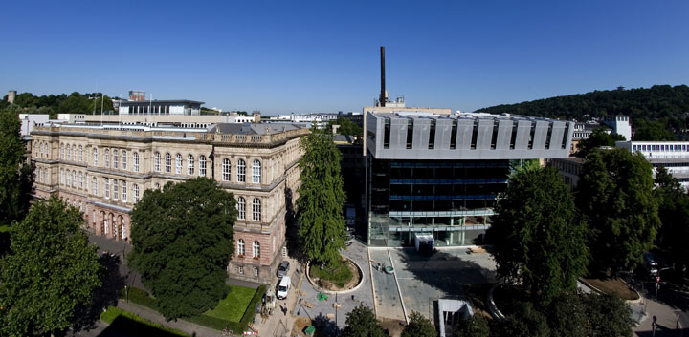
TRD Operations
AMS DOE Review Sep-2013
T. Siedenburg

Slide 2
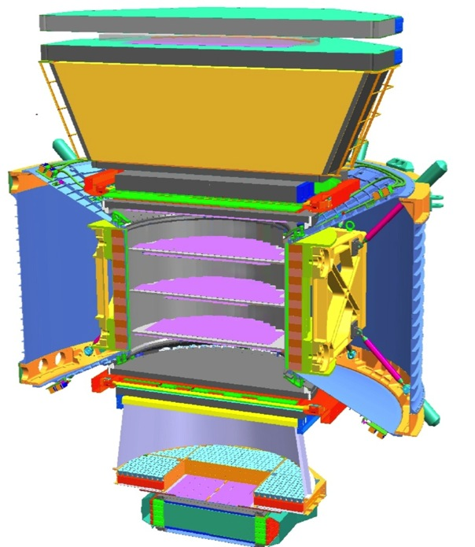
Transition Radiation Detector (TRD)
e
p
Nondestructive separation of light from heavy relativistic particles in addition to ECAL e.m. shower e / p: Transition Radiation Ions: Ionisation (dE/dX)
1


TRD





TRD











TOF

2
Transition Radiation (TR)
Rare soft gamma ray emission (5 keV)
when high energy charged particle crosses a material boundary
3-4
5-6
7-8
Tracker
Particle Momentum TR
Electron 0.5 GeV – 1 TeV YES Proton 0.5 GeV – 1 TeV NO
TOF
RICH
9
ECAL

Slide 3
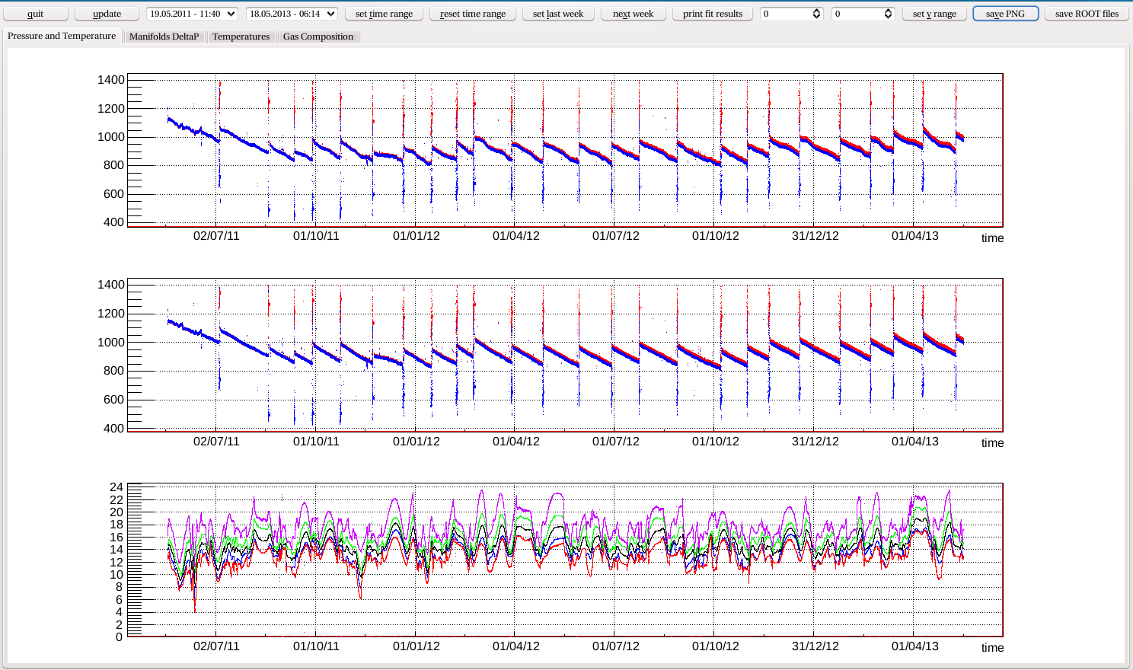
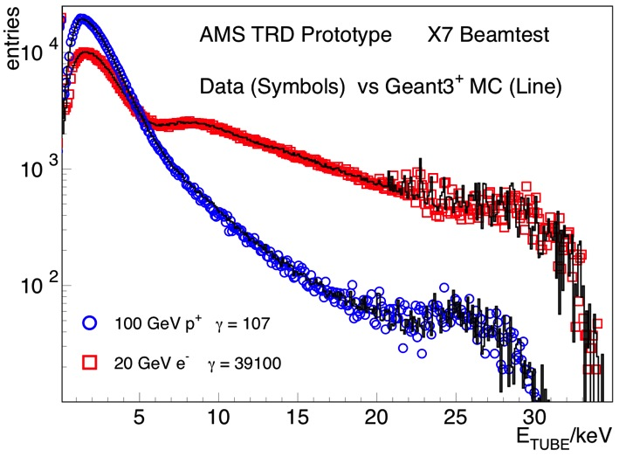
AMS TRD Design for optimal performance
Proven design for ground based TRDs μ-fiber fleece radiator Xenon gas TR photon absorber Xe-CO₂ proportional counters
Straw tubes (6mm Ø, 1-2m length)
Thin kapton walls (72 μm)
p
e
AMS TRD Prototype Beamtest Single Tube Spectra
Analogue pulseheight readout
20 layers radiator / modules for sufficient proton rejection
Orientation along X and Y for 3D particle tracking
dE/dX
TR
○□ Data
─ Simulation
100 GeV Protons
20 GeV Electrons

Slide 4
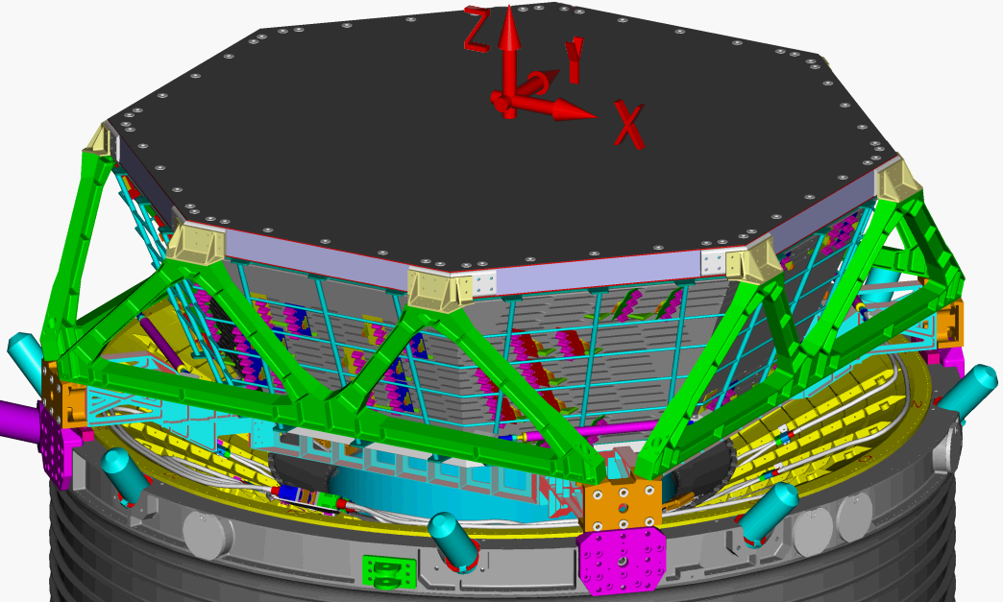
AMS TRD: Gas Straw Tube Detector for Space
Optimized for space environment
Selection of best straw tubes -
gastight to diffusion level in vacuum
Stable support to survive launch
Robust Gas Supply System - storage of consumables for > 20 y of operation
- flexible Xenon / CO₂ mixing
- segmentation to isolate potential leaks
Active environment stabilization to reduce
sensitivity to thermal environment (MIT, Burger)
Redundant monitor/control/DAQ electronics

Slide 5
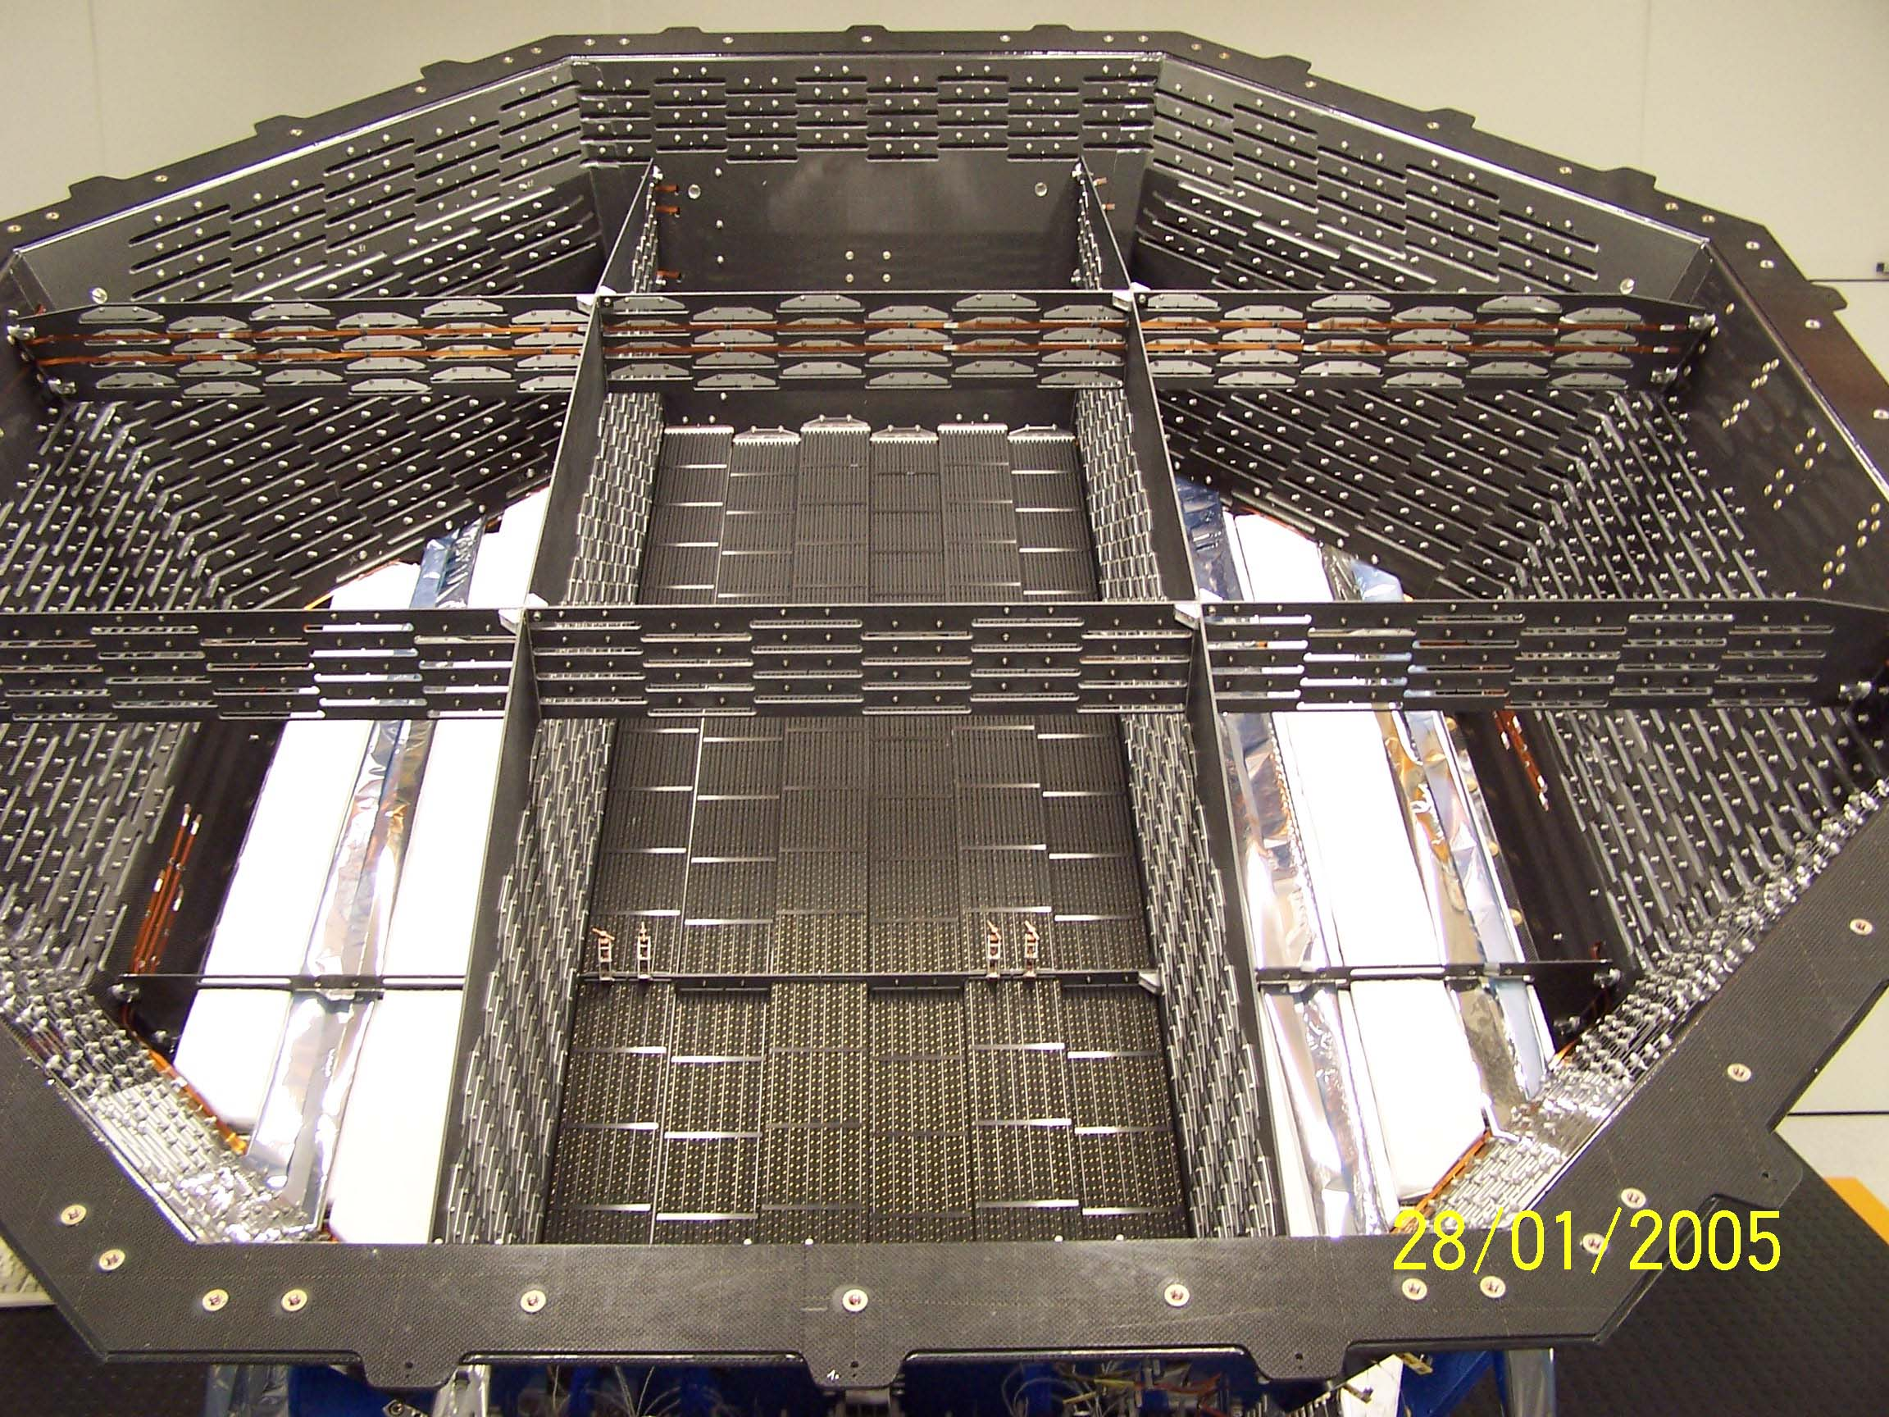
AMS TRD: Space Qualified Construction
Modules with 16 straw tubes
Carbon-fiber stiffeners
End pieces:
Gas In/Out HV / Signal
IN
GAS
SIG
OUT
60 cm Space Qualification Module
HV
Octagonal thermally stable
carbon-fiber support structure
for 328 modules in 20 layers.
Fleece radiator interleaved
4+4 layers in bending plane
12 center layers perpendicular
Mechanical accuracy 100 μm to assure wire is centered.
Verified with 3D measurement for all module support points.
TRD system instrumented with:
24 heaters 62 thermostats 82 HV distribution boards
82 AD readout boards 482 temperature sensors 9+20 pressure sensors
2m

Slide 6
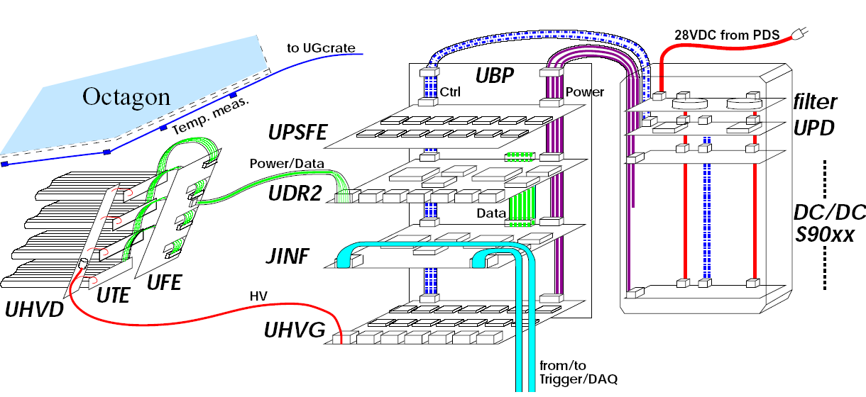
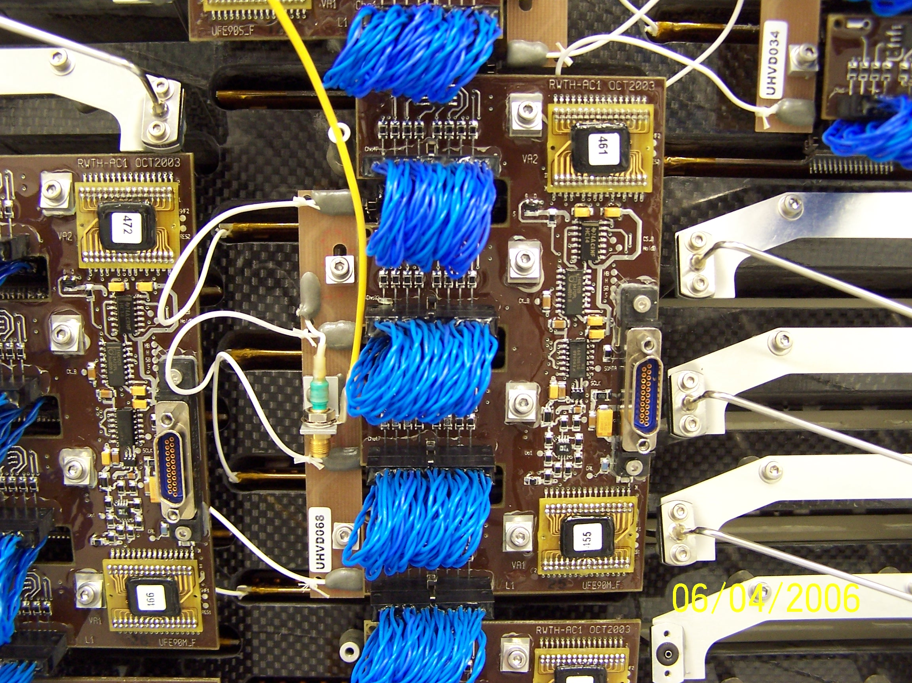
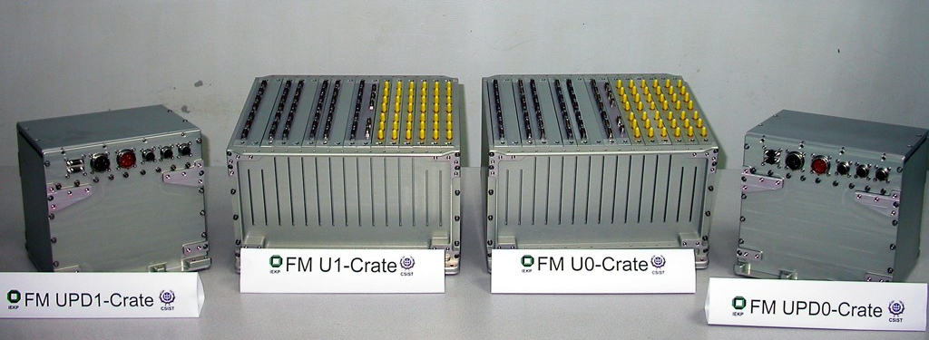
Low Power DAQ for 5248 channels
18 W
Power Supply
HV Distribution 64 Chan. FrontEnd RWTH Aachen
HV Supply Data-Reduction 10 kB →150 B/Evt
Common AMS Framework
Koutsenko, Kounine, Capell, Lebedev, Rozhkov (MIT)
ReadOut Crates, each with 14 twofold redundant boards
ReadOut1
ReadOut0
PowerSupply1
PowerSupply0

Slide 7
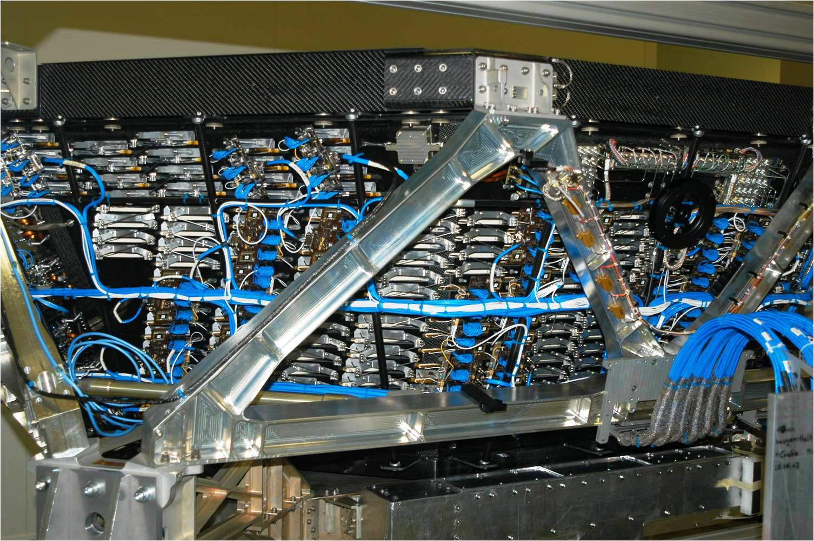
AMS TRD assembled for flight
1,5 m³ instrumented volume, 5248 channels in 20 layers Provides electron-proton separation and 3D tracking

Slide 8
TRD Gas System
Simplified schematics
CP
Supply System
Carbon overwrapped
Pressure vessels
Xenon: 49 kg
CO₂: 5 kg Mixing vessel
Solenoid valves
Heaters / Thermostats
Pressure sensors
Temperature sensors
Circulation System
Canister enclosure for
Circulation pumps
Spirometer
Solenoid valves
Heaters / Thermostats
Pressure sensors
Temperature sensors
Distribution System
4 Manifolds with
Solenoid flipper valves Differential pressure sensors
10 Gas groups of 23 l each
Gas mixing does not affect TRD data quality

Slide 9
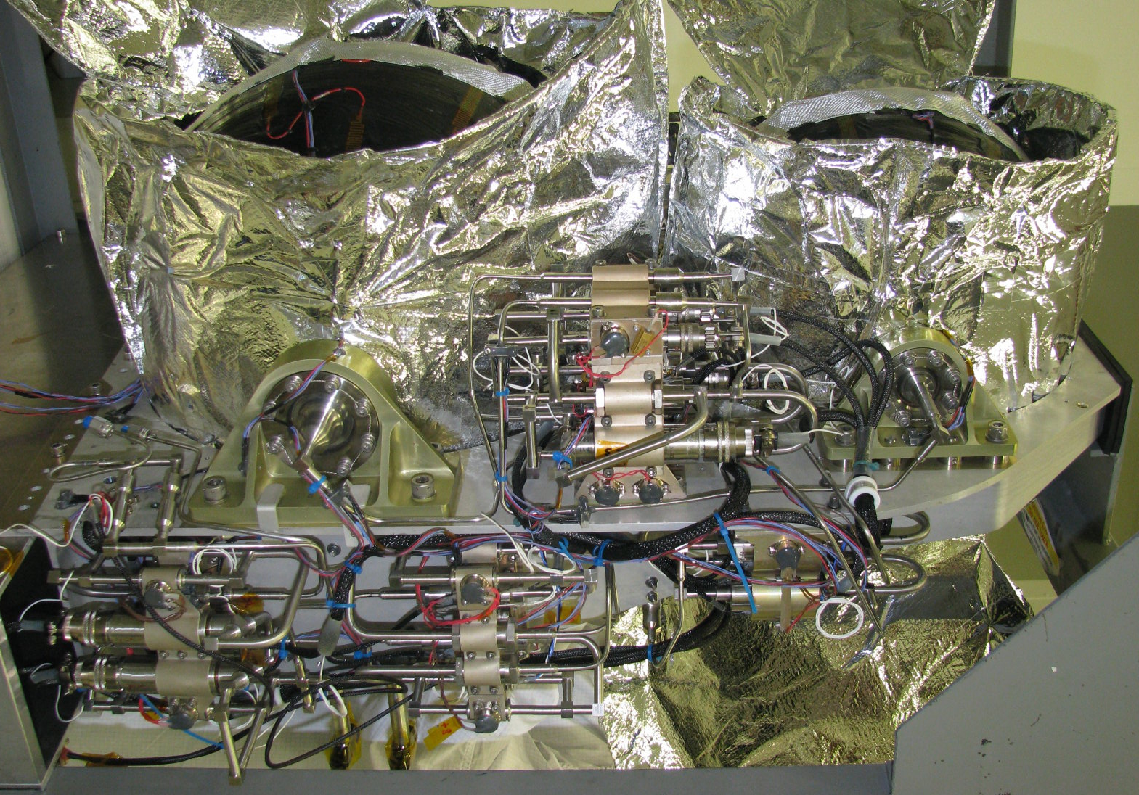
TRD Gas Supply System assembled for flight

Slide 10
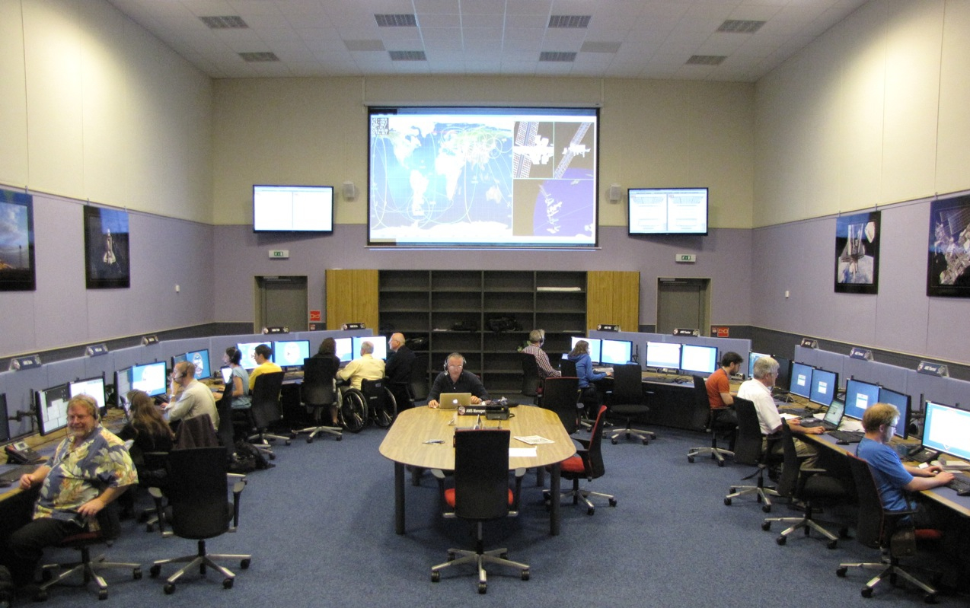
TRD Two Years of Operation Experience
For European night shift TRD monitoring covered
by ASIA POCC since Aug-2012
TRD Post at CERN POCC

Slide 11
TRD Two Years of Operation Experience
Primary Shift Objective: Safety
Keep the TRD within safe operation limits
- 24/7 monitoring of pressure and temperature sensors
High pressure supply vessels / mixing vessel / TRD straw tubes
- Prompt action in case of problems
Operate TRD heaters / valves / pumps
- Initiate preventive actions for expected low temperature environment
Dependent on ISS orbit beta, attitude and radiator/solar-array config. in coordination with AMS Thermal group (MIT, Burger)
Operate TRD heaters / valves / pumps
Request ISS solar-array / radiator operations

Slide 12
TRD Two Years of Operation Experience
GMT 2011-06-11 16:42
Temperature Sensors on TRD Modules
Verify functionality of TRD Heaters
Thermostat switching points 10/20 ºC
Correlate with AMS Thermal (MIT, Burger)
Offline data analysis: temperature(density)
dependent gain correction
TRD top view
18ºC
TRD Prototype BeamTest
S
1.0
10ºC
muons
Relative Signal S Relative Density D Ionis.: ΔS = -5·ΔD
1.00

Slide 13
TRD Two Years of Operation Experience
AMS Physics Shift Objective: Signal Quality
Keep the TRD signal response at optimal working point
- 24/7 monitoring of 5248 straw tube signals
Verification of signal baseline calibrations and signal homogeneity
Check TRD event size, which regularly increases in the South Atlantic Anomaly
Request AMS-LEAD to re-calibrate or re-initialize in case of problems
- 24/7 monitoring of 82 high voltage channels
Prompt reset of tripped HV channels
Switch off HV in case of severe data rate problems (e.g. high solar activity)
Daily adjustment of HV – coordinated with LEAD
- 24/7 monitoring of TRD gas tightness and gas composition
Prompt isolation of potentially leaky gas sections
Monthly refill of Xenon / CO₂ mixture – coordinated with LEAD and Thermal Group

Slide 14
TRD Two Years of Operation Experience
Daily TRD HV adjustment by TRD expert
Steady increase of TRD signal height due to gas-gain increase from diffusion gas losses
Compensate with HV adjustment adapted to signal response since previous adjust
62
From science data analysis
Proposed HV adj. -3V
*
Signal height
60
*
58
17
18
19
20
21
22-May-2013
Procedure involves manual AMS DAQ Stop and Restart with new TRD HV settings
Improved in Oct-2011 to take less than 5 minutes – since then performed daily
Complex multi-step procedure that occasionally fails –
Requires prompt recovery depending on reason and step of failure
Stable TRD Signal height since Nov-2011:
120
Signal height
60
May-19-2011
May-19-2013
0

Slide 15
TRD Two Years of Operation Experience
Gas Refill Objectives
Operate TRD at optimal conservative working point Keep sufficient margins for gas supply resources
small gas leak observed identified & quantified
1200
mbar
TRD Pressure
1000
800
May-19-2011 Date May-19-2013
20%
Stable 90/10 Xe/CO₂ Operation since June 2012
CO₂ Fraction
10%
TRD Gas losses: 4.5 mbar / day * 230 l (1.0 mbar/d CO₂ + 3.5 mbar/d Xenon)
Xenon CO₂ Diffusion Leak
8680 l 2630 l initial supply at 10ºC
465 l 200 l refills 5/11 – 5/13 monthly refill: 20 l Xe + 6 l CO₂
34 y 34 y lifetime with standard refills standard since June 2012

Slide 16
TRD Two Years of Operation Experience
Summary
Stable TRD operation since launch with no major failure
Daily HV adjustment to keep TRD signal constant since Nov-2011
Monthly TRD gas refill for stable 90/10 Xenon/CO₂ since Jun-2012
Adaptation of refill command sequences – valve opening times and actuations
To keep TRD fully operational at optimal performance requires
careful monitoring and adjustments from shift personel and experts

