Slide 1



LHCb Scintillating Fiber Tracker
8th Terascale Detector Workshop 2015,
Berlin,
5th March 2015
Presented by
Th. Kirn on behalf of the LHCb SciFi Tracker group

Slide 2
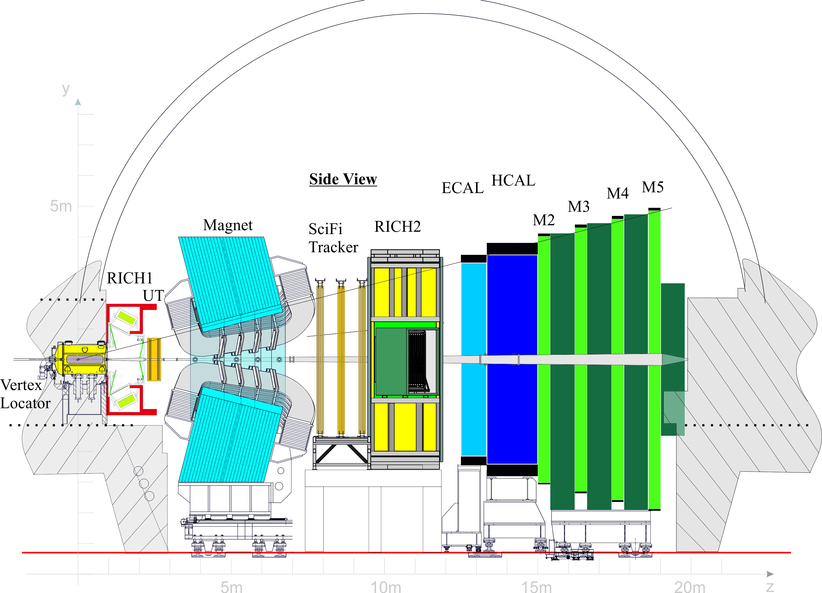
Outline
LHCb Upgrade
LHCb SciFi tracker
  Fibres
  SiPMs
  FE Readout
SciFi collaboration with 10 countries in 20 institutions

Slide 3
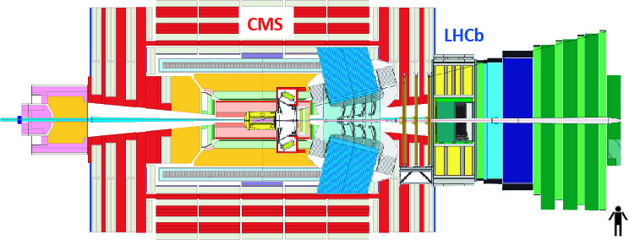
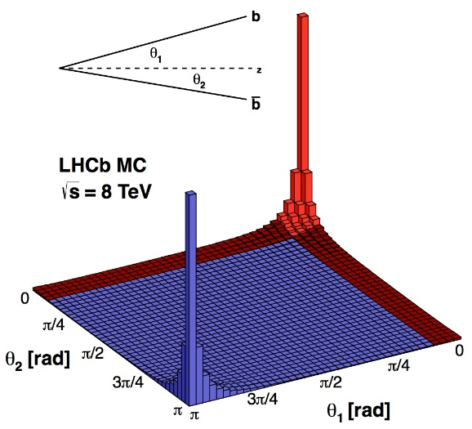
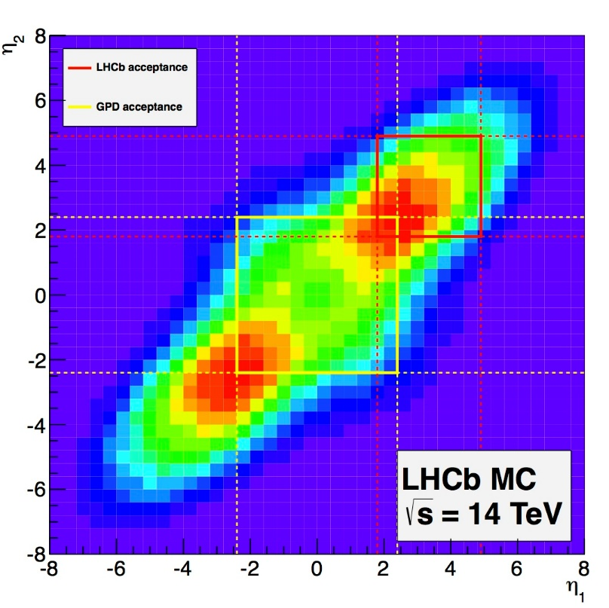
LHCb
Built for indirect searches for new physics via precision
measurements of quantum loop induced processes in the
b- and c-quark systems.
(Rare decays, Particle/anti-particle asymmetry)
B-mesons are produced in the forward direction at the LHC
(1.8 < η < 4.9 for LHCb and |η| < 2.4 for the GPD
Limitations:
Physics measurements limited by statistical uncertainties,
not systematic
Statistics are limited by the 1MHz hardware trigger rate
and detector occupancy

Slide 4
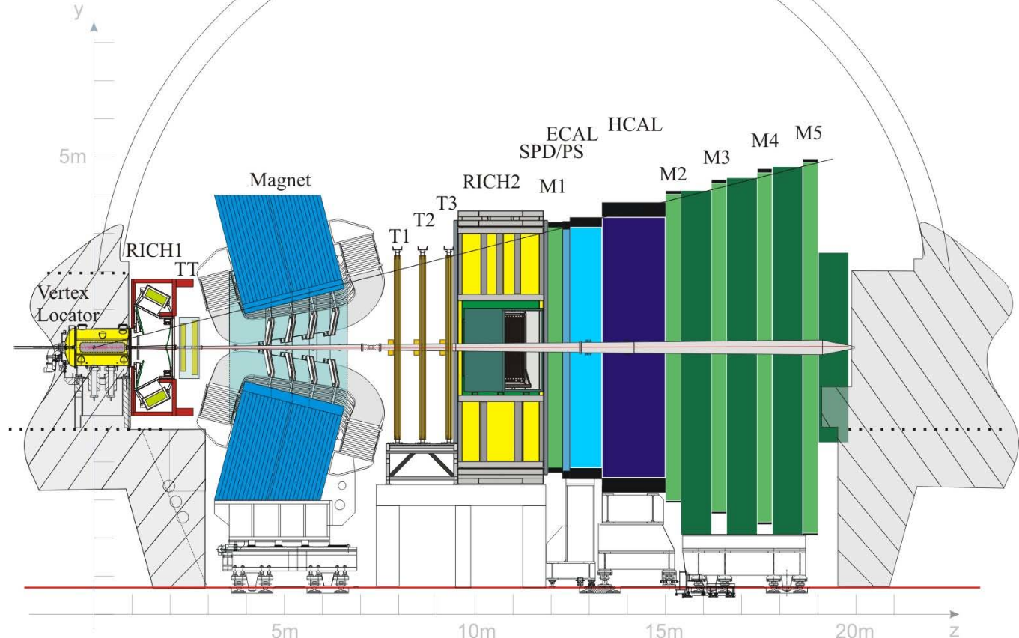
LHCb Detector Upgrade
Major tracking upgrade of LHCb
(for after LS2, ≥2020, 50fb⁻¹)
DAQ: a 40 MHz full readout of
the FE electronics, no hardware
trigger
New VELO, hybrid pixel detectors
(Si pixel based)
Tracking system: TT with new
silicon strip detector (UT) and
IT&OT with SciFi tracker
(scintillating fibres with SiPM readout)
RICH: remove aerogel from RICH1,
new photon detectors and readout
Calorimeters: remove SPD/PS and
new readout
Muon System: remove M1 and new
readout

Slide 5
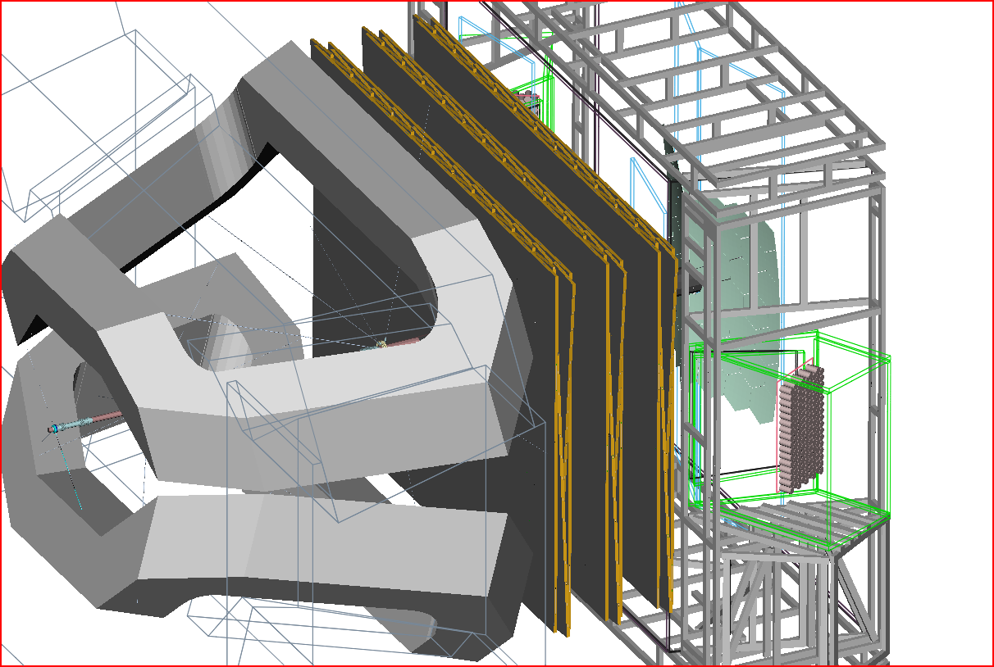
LHCb SciFi Tracker
General layout of the detector geometry:
3 stations with 4 planes each X-U-V-X

Slide 6
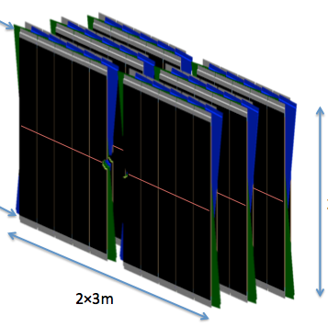
LHCb SciFi Tracker: Requirements
T1
T2
T3
X U V X
Hit detection efficiency greater than 98%, with noise less than 10% of signal
Support high occupancy, up to 2.5 clusters for a detector array of 128 channels (32mm) in the hottest region
Low material budget
Spatial resolution better than 100 µm
Operation at 25ns interaction rate,
40 MHz readout
Radiation environment,
fibres up to 35 kGy
SiPMs: approx. 1∙ 10¹² n/cm² fluence
+ 100 Gy ionizing dose
low temperature operation of SiPMs
stereo angle ± 5°
readout
1 module
mirror
readout
2 x ~2.5 m
2 x ~3 m

Slide 7
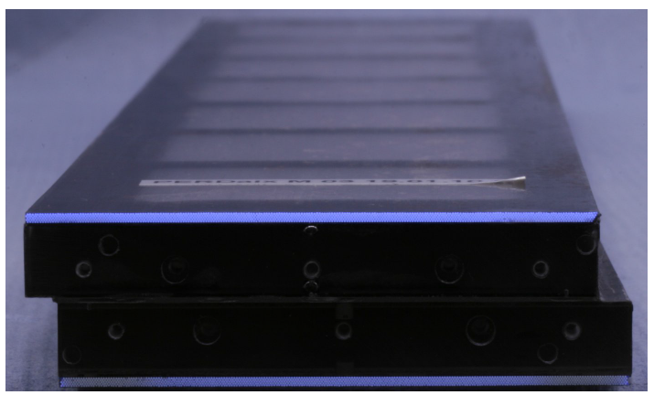
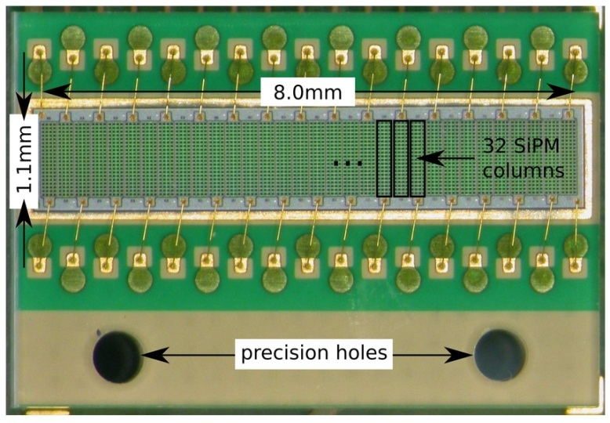
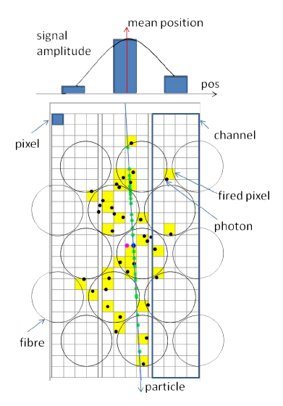
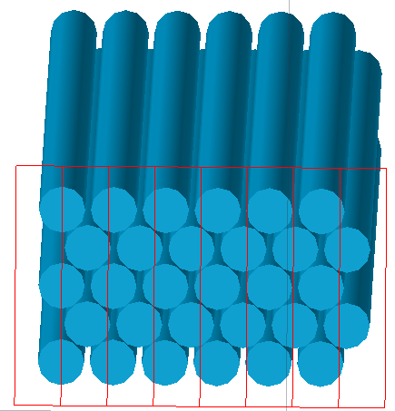
LHCb Scintillating Fibre Tracker
Scintillating Fibres and SiPMs as Photodetectors:
The SciFi tracker is following the technology developed by the RWTH Aachen group for Protoypes, the PERDaix detector (balloon experiment), BGV Detector and a Muontomograph
SiPMs
Scintillating
Fibres
5 staggered layers of Ø250 μm fibres form a ribbon (or mat)
Readout by arrays of SiPMs. 1 SiPM channel extends over the full height of the mat.
Pitch of SiPM array should be similar to fibre pitch. Light is then spread over few SiPM channels. Centroiding can be used to push the resolution beyond p/sqrt(12).
Hits consist of clusters with typical size = 2. This is an efficient approach to suppress noise hits (=single pixels in 1 channel).

Slide 8
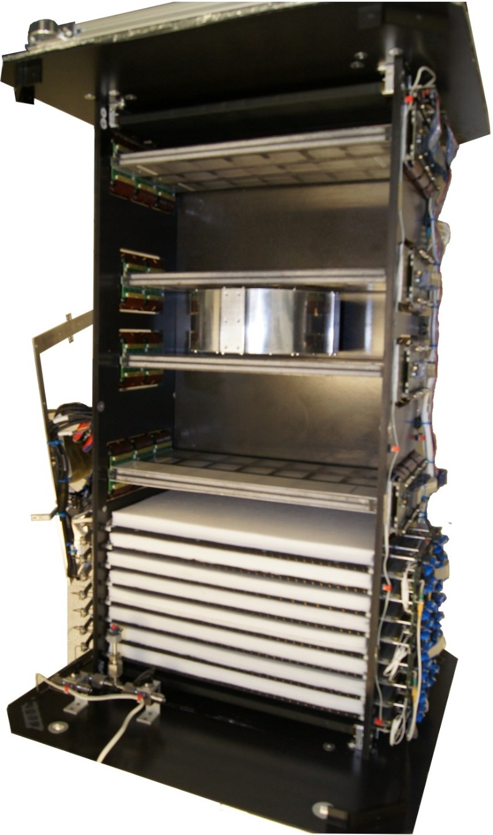
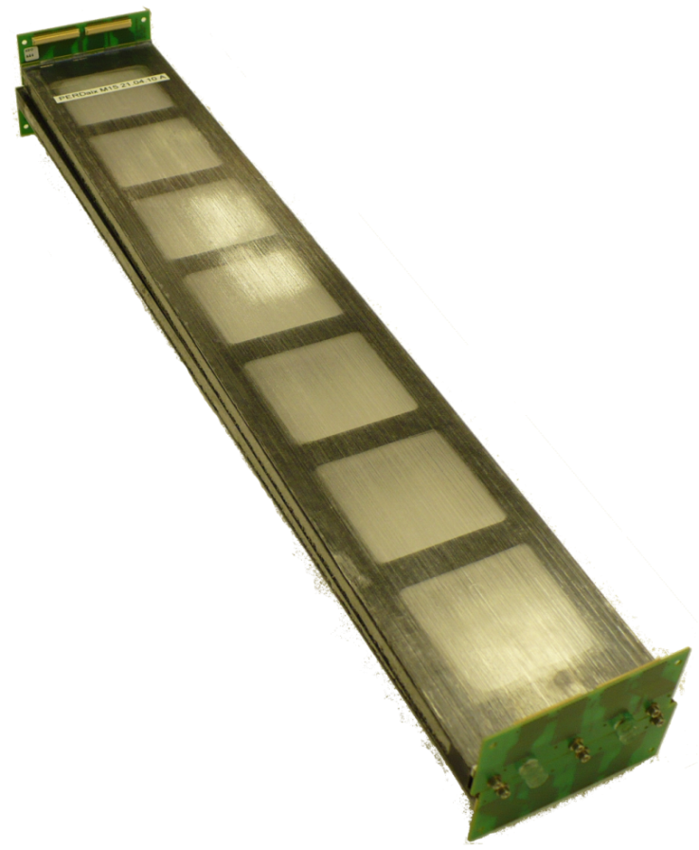
PERDaix SciFi Tracker
2010: Perdaix SciFi tracker: Length: 400 mm, width: 64 mm
See NIM A 695 (2012) 91-95
4 double layers of scintillating fiber tracker
10 stereo modules
  → 20 fiber ribbons
  → 160 SiPM arrays
  → 5120 channels
two ribbons made of 5x256 250μm thick scintillating fibers mounted on Rohacell foam/Carbon fiber support structure (ladder structure for material saving
→ 1,1 % X0 per module)
Time-of-Flight
detector
fiber tracker
magnet
80cm
Transition
Radiation
Detector

Slide 9
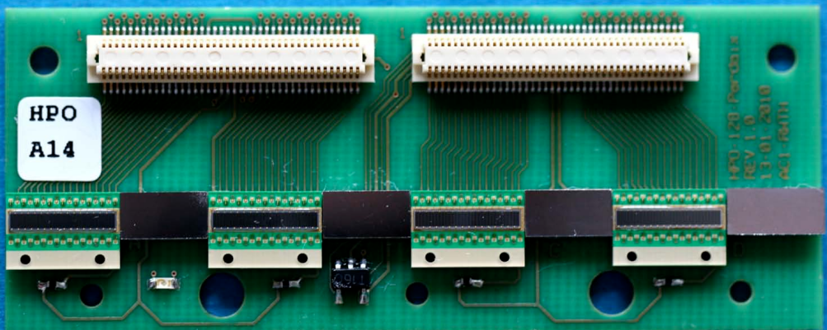
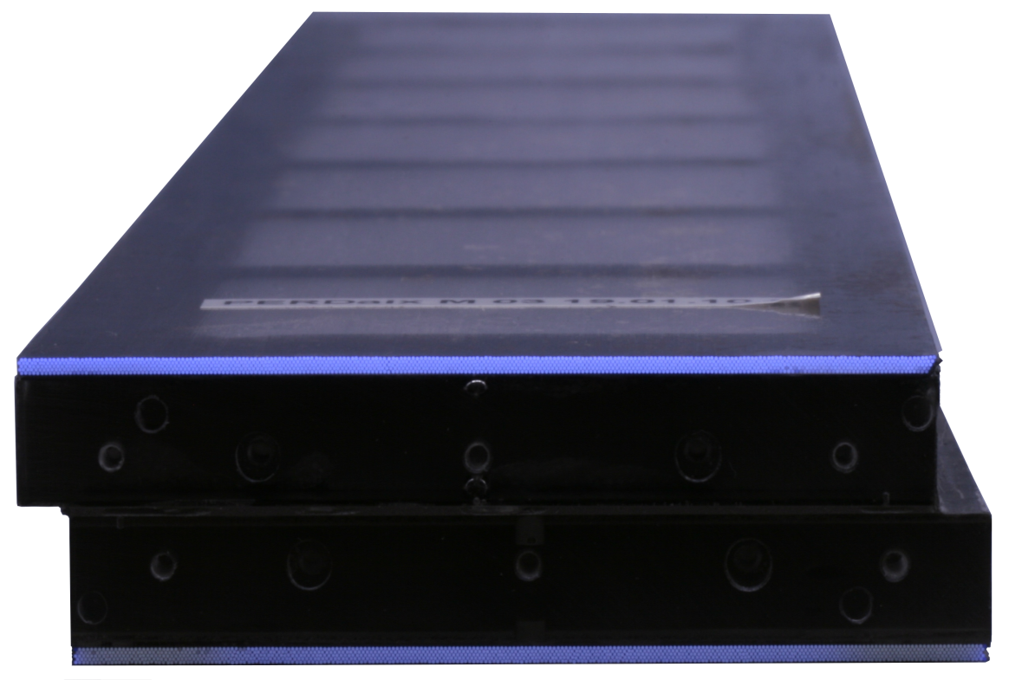
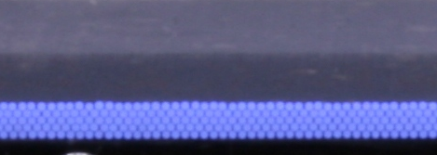
PERDaix SciFi Tracker
CFC module carrier
  fiber ribbons on top & bottom
  1° stereo angle
  1.1% X0
Kuraray SCSF-78MJ fibers
  (250 ± 6) μm fiber diameter
  λ_{Emission} = 450nm
  5 fiber layers per ribbon
  Each layer with 256 fibers
Mirrors
Temperature
Sensor
Thermistors
32 channel MPPC 5883 arrays:
0.25mm channel pitch
80 pixels (dynamic range)
U_{bias} = 70V
PDE 50%, Gain 10⁶
Pixel Crosstalk 30%
Dark count ~200kHz/channel

Slide 10
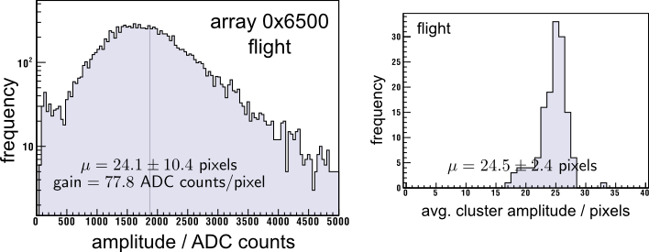
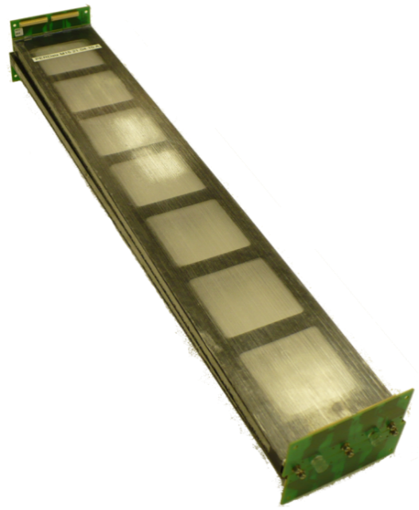
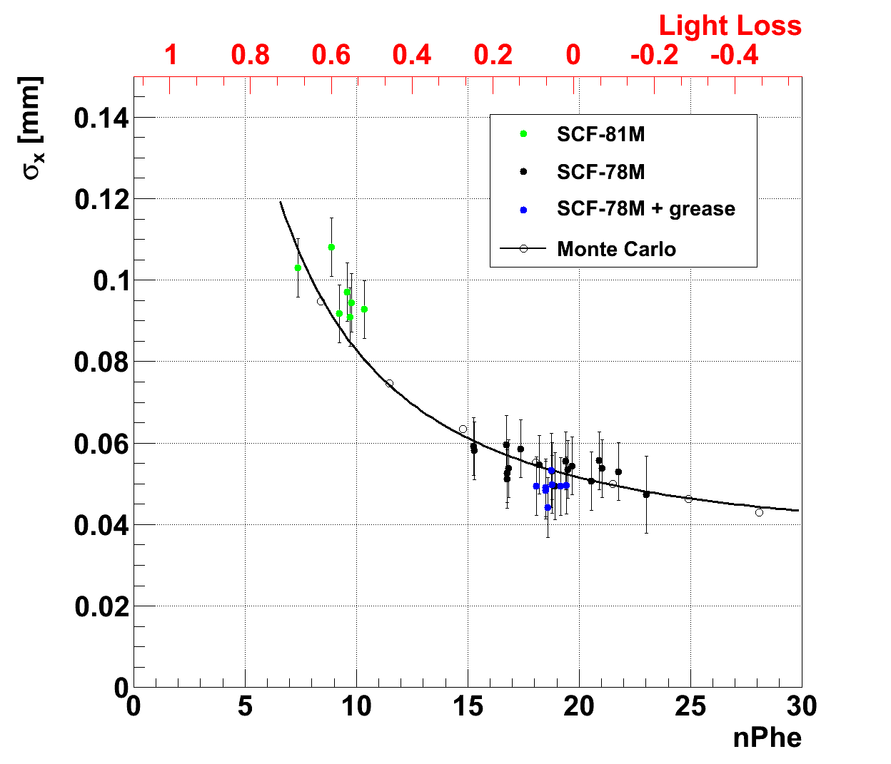
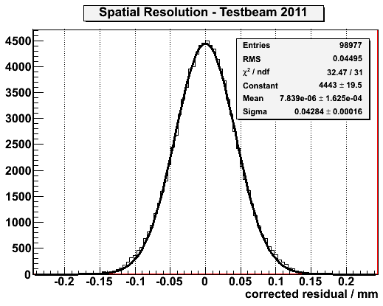
PERDaix SciFi Tracker
Prototypes with length: 860 mm, width 32 mm or 64 mm
0.05mm resolution

Slide 11
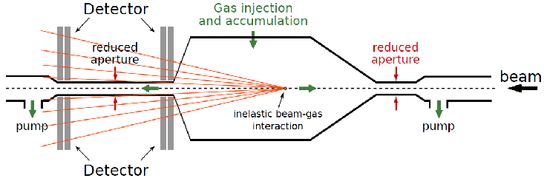
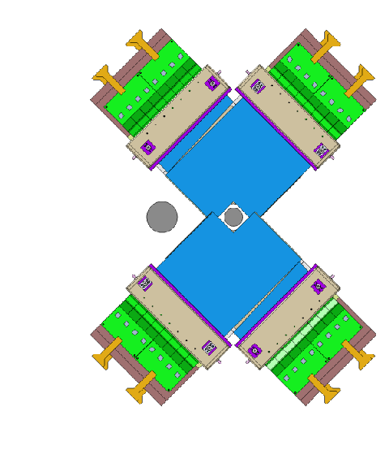
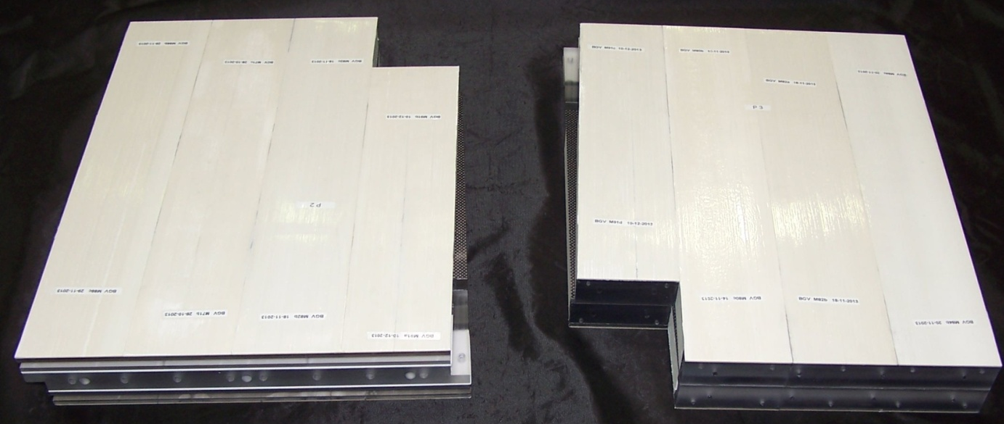
Beam Gas Vertex (BGV) Monitor
For measuring the transverse beam profile
Each vertex (inelastic beam-gas interaction) produces a number of particles
Tracking detectors measure the charged particle trajectories and determine precisely the
vertex position
Gas target generates the needed rate of beam-gas interactions
Production of:
5 Modules: 8 5-layer fiber mats with cut-outs
5 Modules: 8 4-Layer fiber mats with cut-outs
351 mm

Slide 12
LHCb SciFi Tracker
12 modules per detection plane (in total 144)
Module Carriers made out of CF skin and Nomex honeycomb, 1 Module consists of 8 fibre mats (1152 mats)
Fibre mats (6 layers per mat) run in vertical direction (L≈ 2 x 2.5m) sandwiched in module carriers (1.1% X0),
Fibres: Round double cladded, Ø 250µm, L=2.5m, total length >10,000 km)
Fibres interrupted in mid-plane (y=0) and mirrored
Fibres read out at top and bottom with SiPM arrays (128 channels, 250 µm pitch)
SiPMs + FE electronics + services in a “Readout Box”
T1
T2
T3
X U V X
53cm
stereo angle ± 5°
SiPM
fibres
1 module
mirror
fibres
readout
2 x ~2.5 m
SiPM
2 x ~3 m

Slide 13
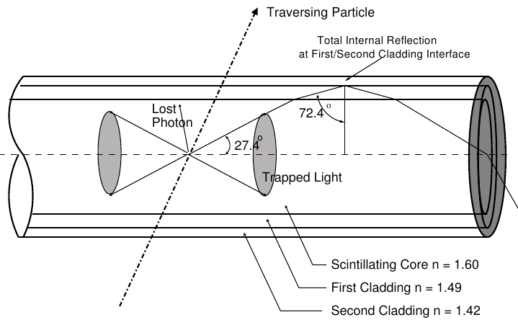
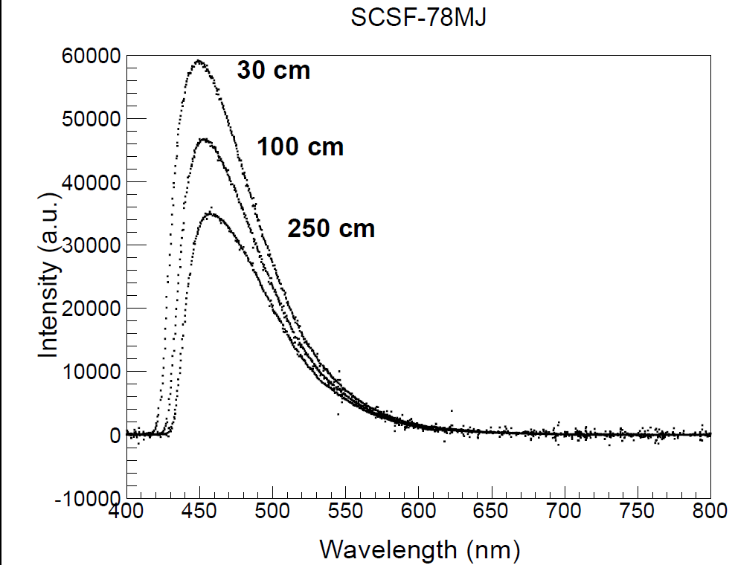
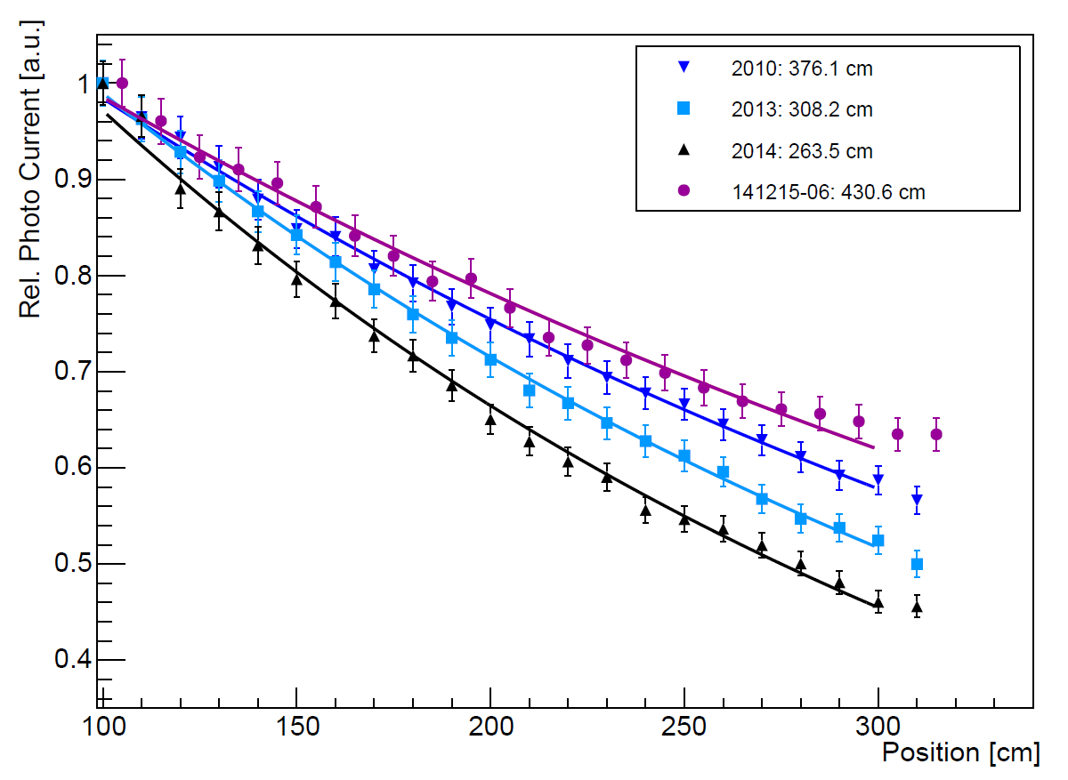
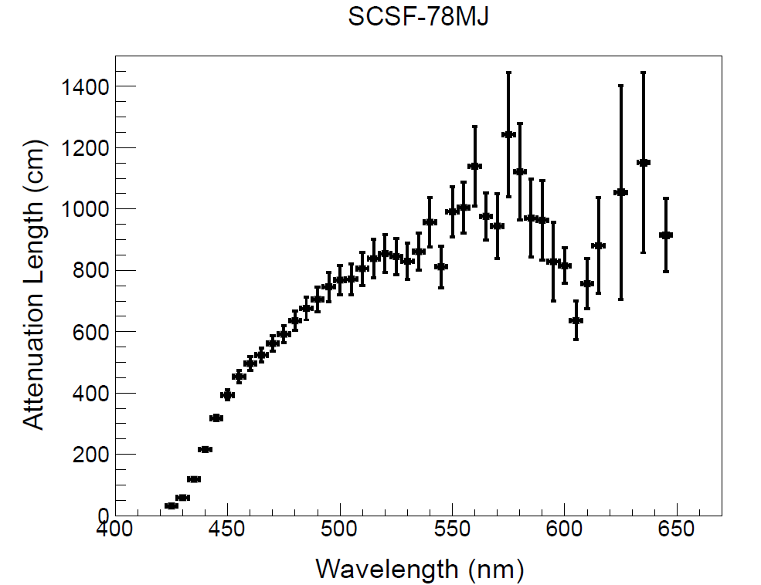
LHCb Scintillating Fibres
Kuraray SCSF-78MJ fibres: Ø (250 ± 15) μm, λ_{Emission} = 450nm, 6 fibre layers per mat,
each layer with 256 fibres with length 2.5m → 10,000 km fibres
Polystyrene core with 2 dyes
(scintillator)
Only a few photons
after 2.5m
300 photons per MIP produced (only 5% captured)
3.5m avg att. length

Slide 14
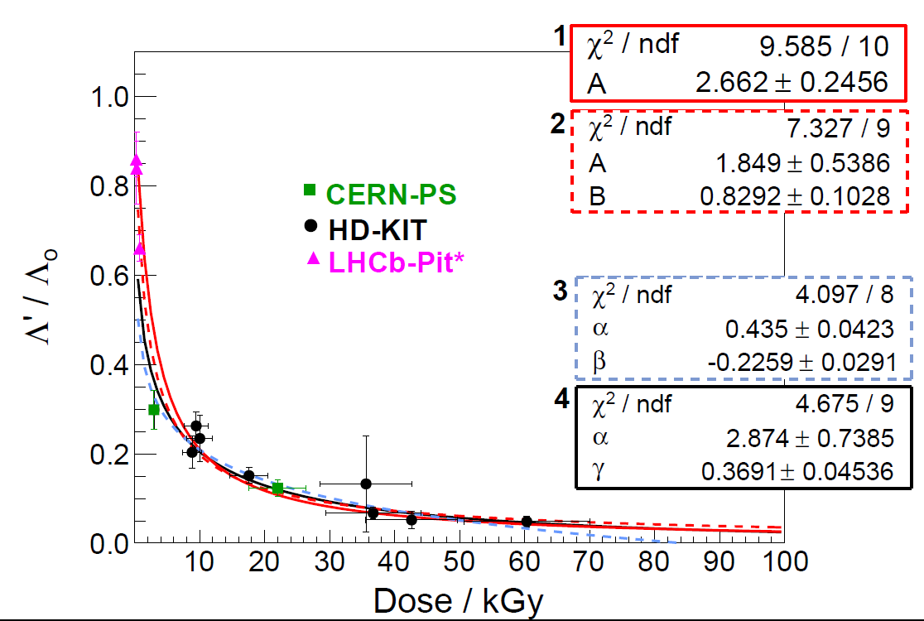
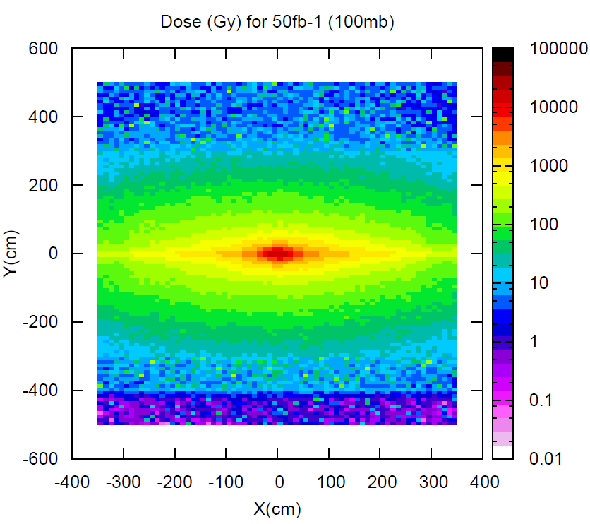
LHCb Scintillating Fibres: Irradiation
The scintillating fibres darken with radiation
(up to 35 kGy expected near the beam pipe over the upgrade lifetime)
Expected ionizing dose for LHCb Upgrade
Attenuation length ratio
Radiation damage Λ(D)/Λ₀ versus Dose is highly non-linear.
Hara model:
Λ(D)/Λ(0) = α+ β log(D)
K. Hara et al., NIM A411 (1998), no. 1 31 .
Describes data well, but has some weaknesses (can’t include D=0, can become negative)
Need more low dose data, low dose irradiations ongoing.

Slide 15

LHCb Scintillating Fibres
Measurement of fibre diameter, light leaks due to cladding damages and test for bumps (impurities in the cladding)
source fiber spool
mounted on gear
laser-interferometric
diameter scanner
w/ real-time display
LN3015
lumb/neck
detector
target fiber spool
mounted on gear
tension control
unit
cleaning
unit
SiPM
light-leak
box
transversal
translation
gear
0.2541
data
readout
PC w/
monitor
gear control
circuits
gear control
circuits

Slide 16
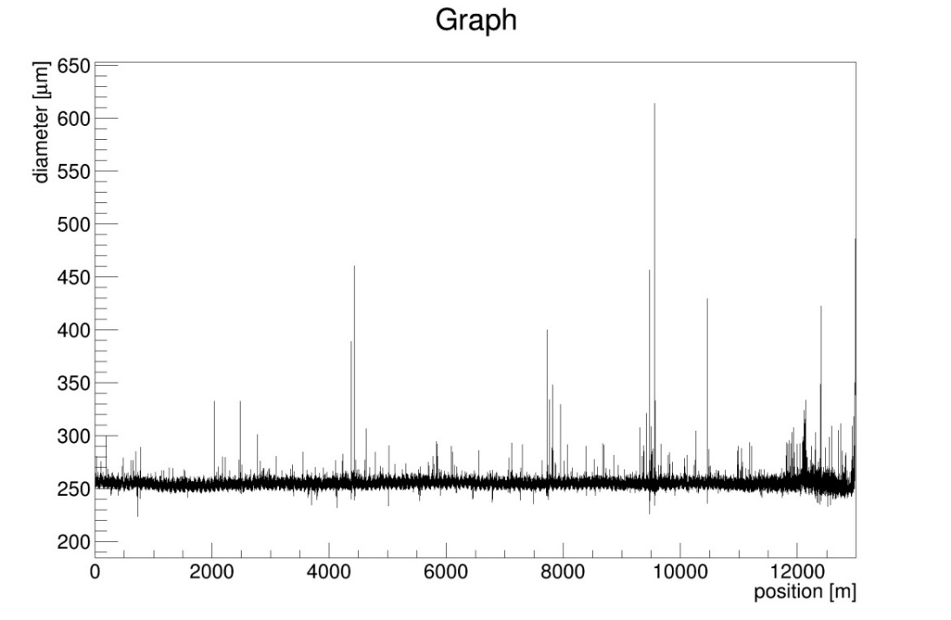
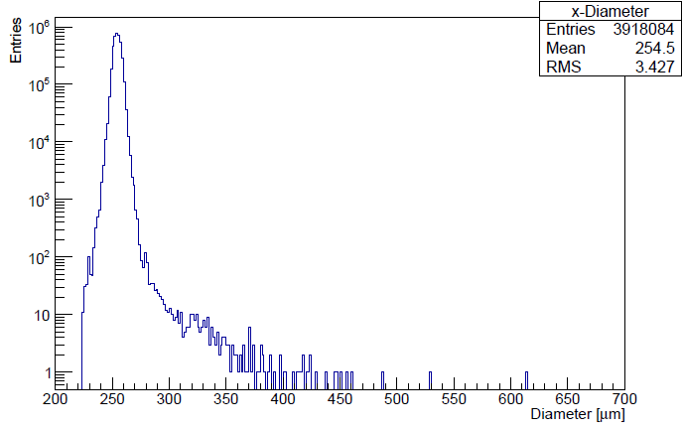
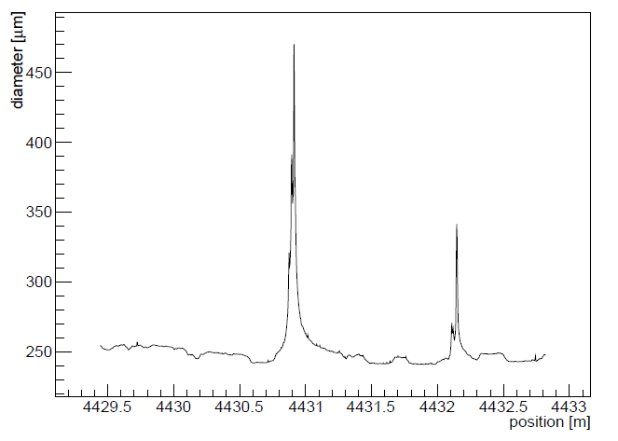
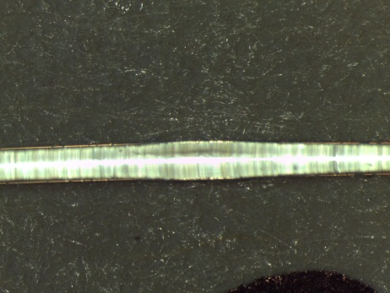
LHCb Scintillating Fibres
Fibre diameter profile (along fibre)
Measurement along 12.5 km fibre
(1 point every 3 mm), using a LASER micrometer.
Fibre diameter (250 ± 7) μm,
But bumps appear (diameter >> 300 μm) caused by impurities in cladding) ≈ 1 per km of fibre = 1 per layer of fibre mat.
Producer working on improvements
These sections are manually removed during winding process, at the position where the mat is anyway cut. Costs time (5') but no performance.

Slide 17
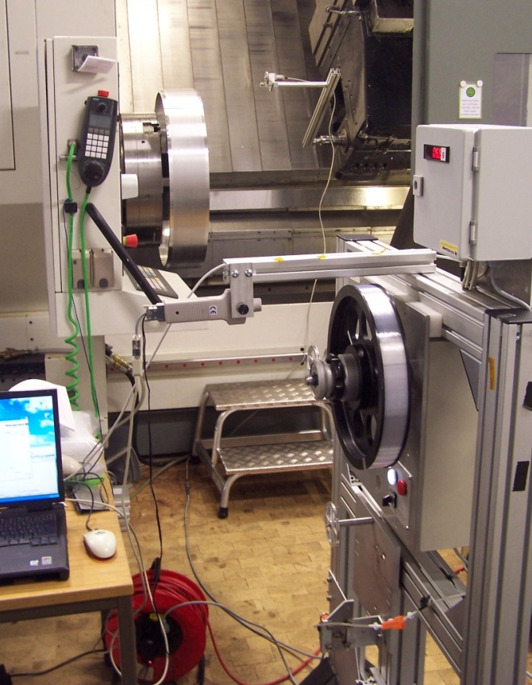
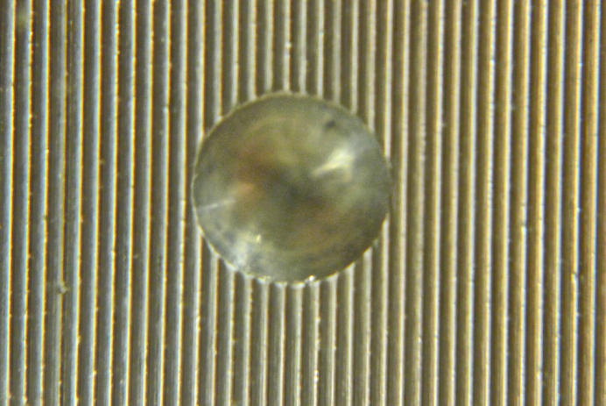
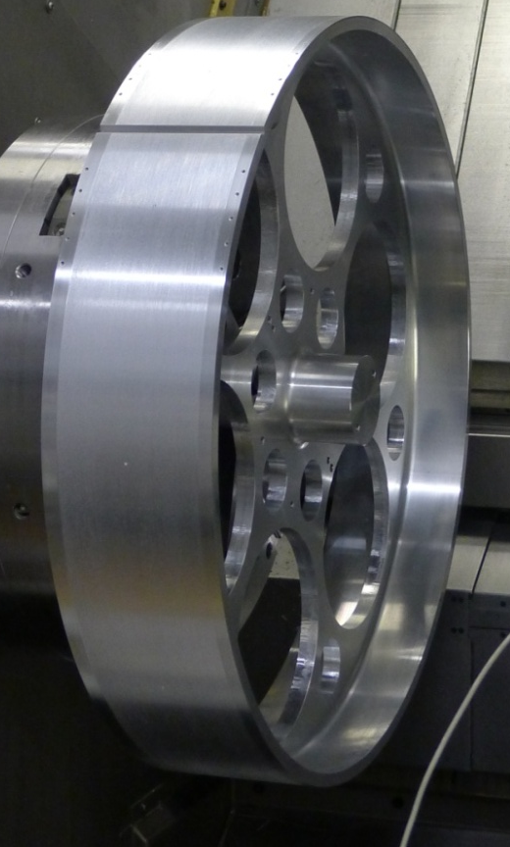
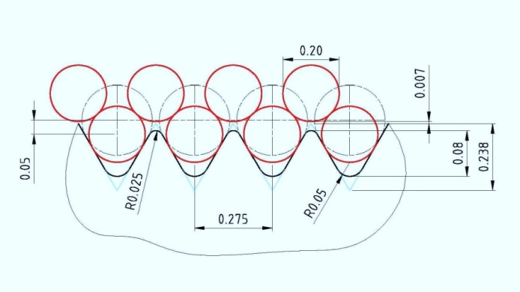
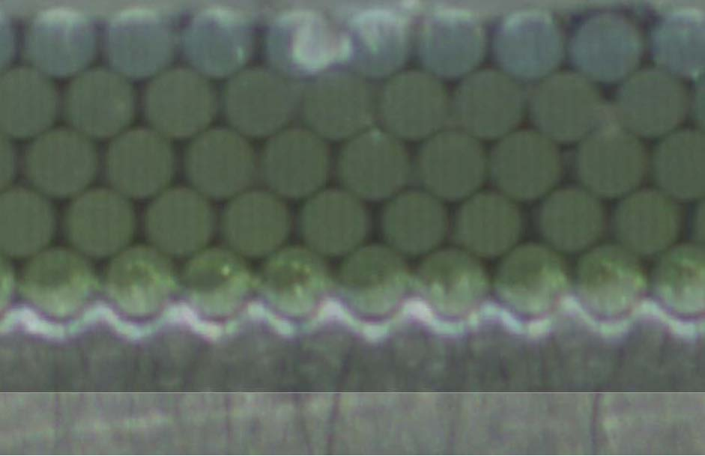
LHCb Scintillating Fibres
Threaded winding wheel
Hole for alignment pin
Winding Stand
First layer is directly wound onto hub,
following layers are wound into groove-like
depressions of preceding layers
Need about 8km of fibre for one mat of
6 layers 2.5 metres long
→ 10,000 km of fibre in total

Slide 18
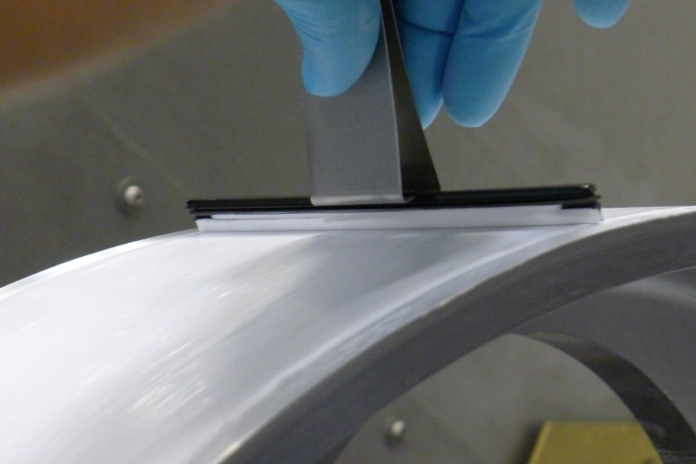
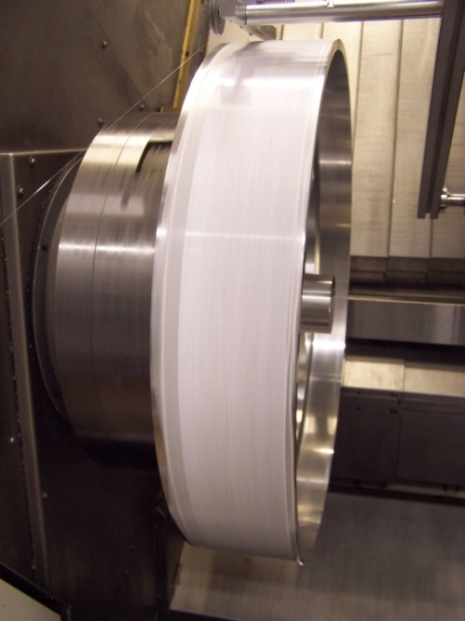
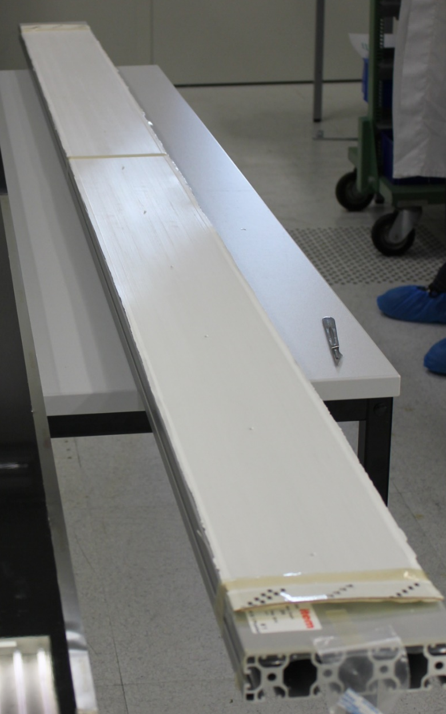
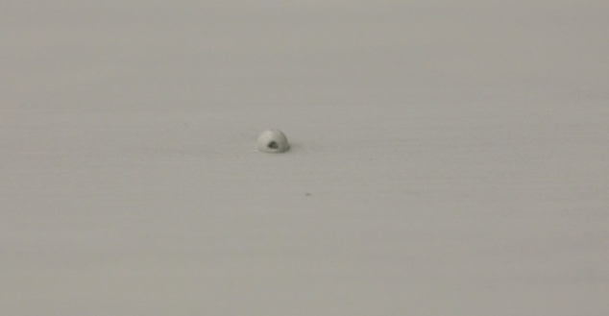
LHCb SciFi Mats
Length: 2650 mm
Glue: Epotec 301 + 25% TiO2 (optional)
→ Minimization of crosstalk between
adjacent fibers
Pin to Pin Distance:
250 mm
Pins are bonded to fibre mat on wheel as part of winding to
reach a straightness over mat length better than required
detector resolution of < 100 µm
Width: 140 mm

Slide 19
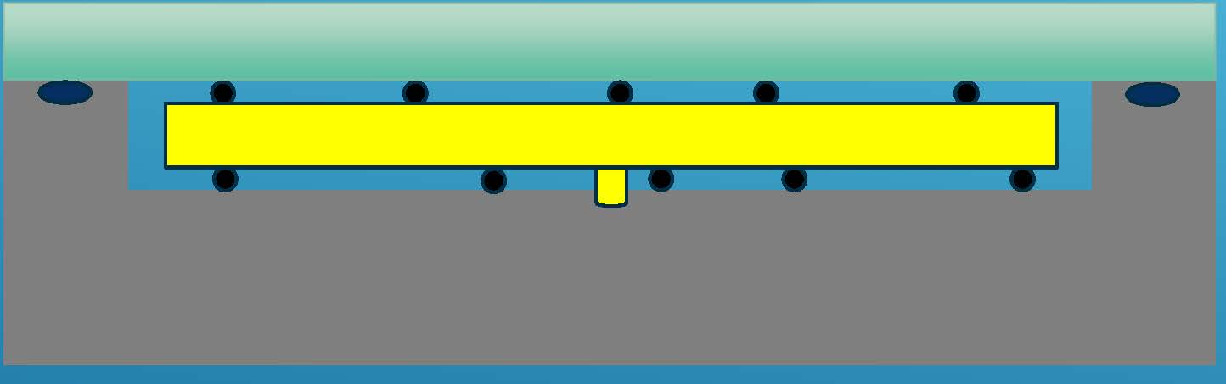
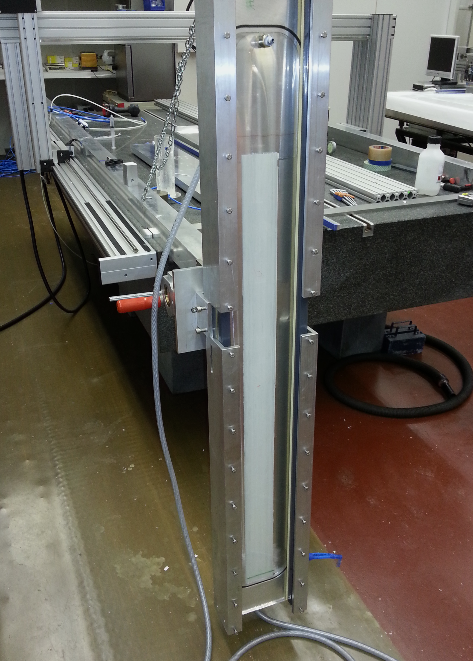
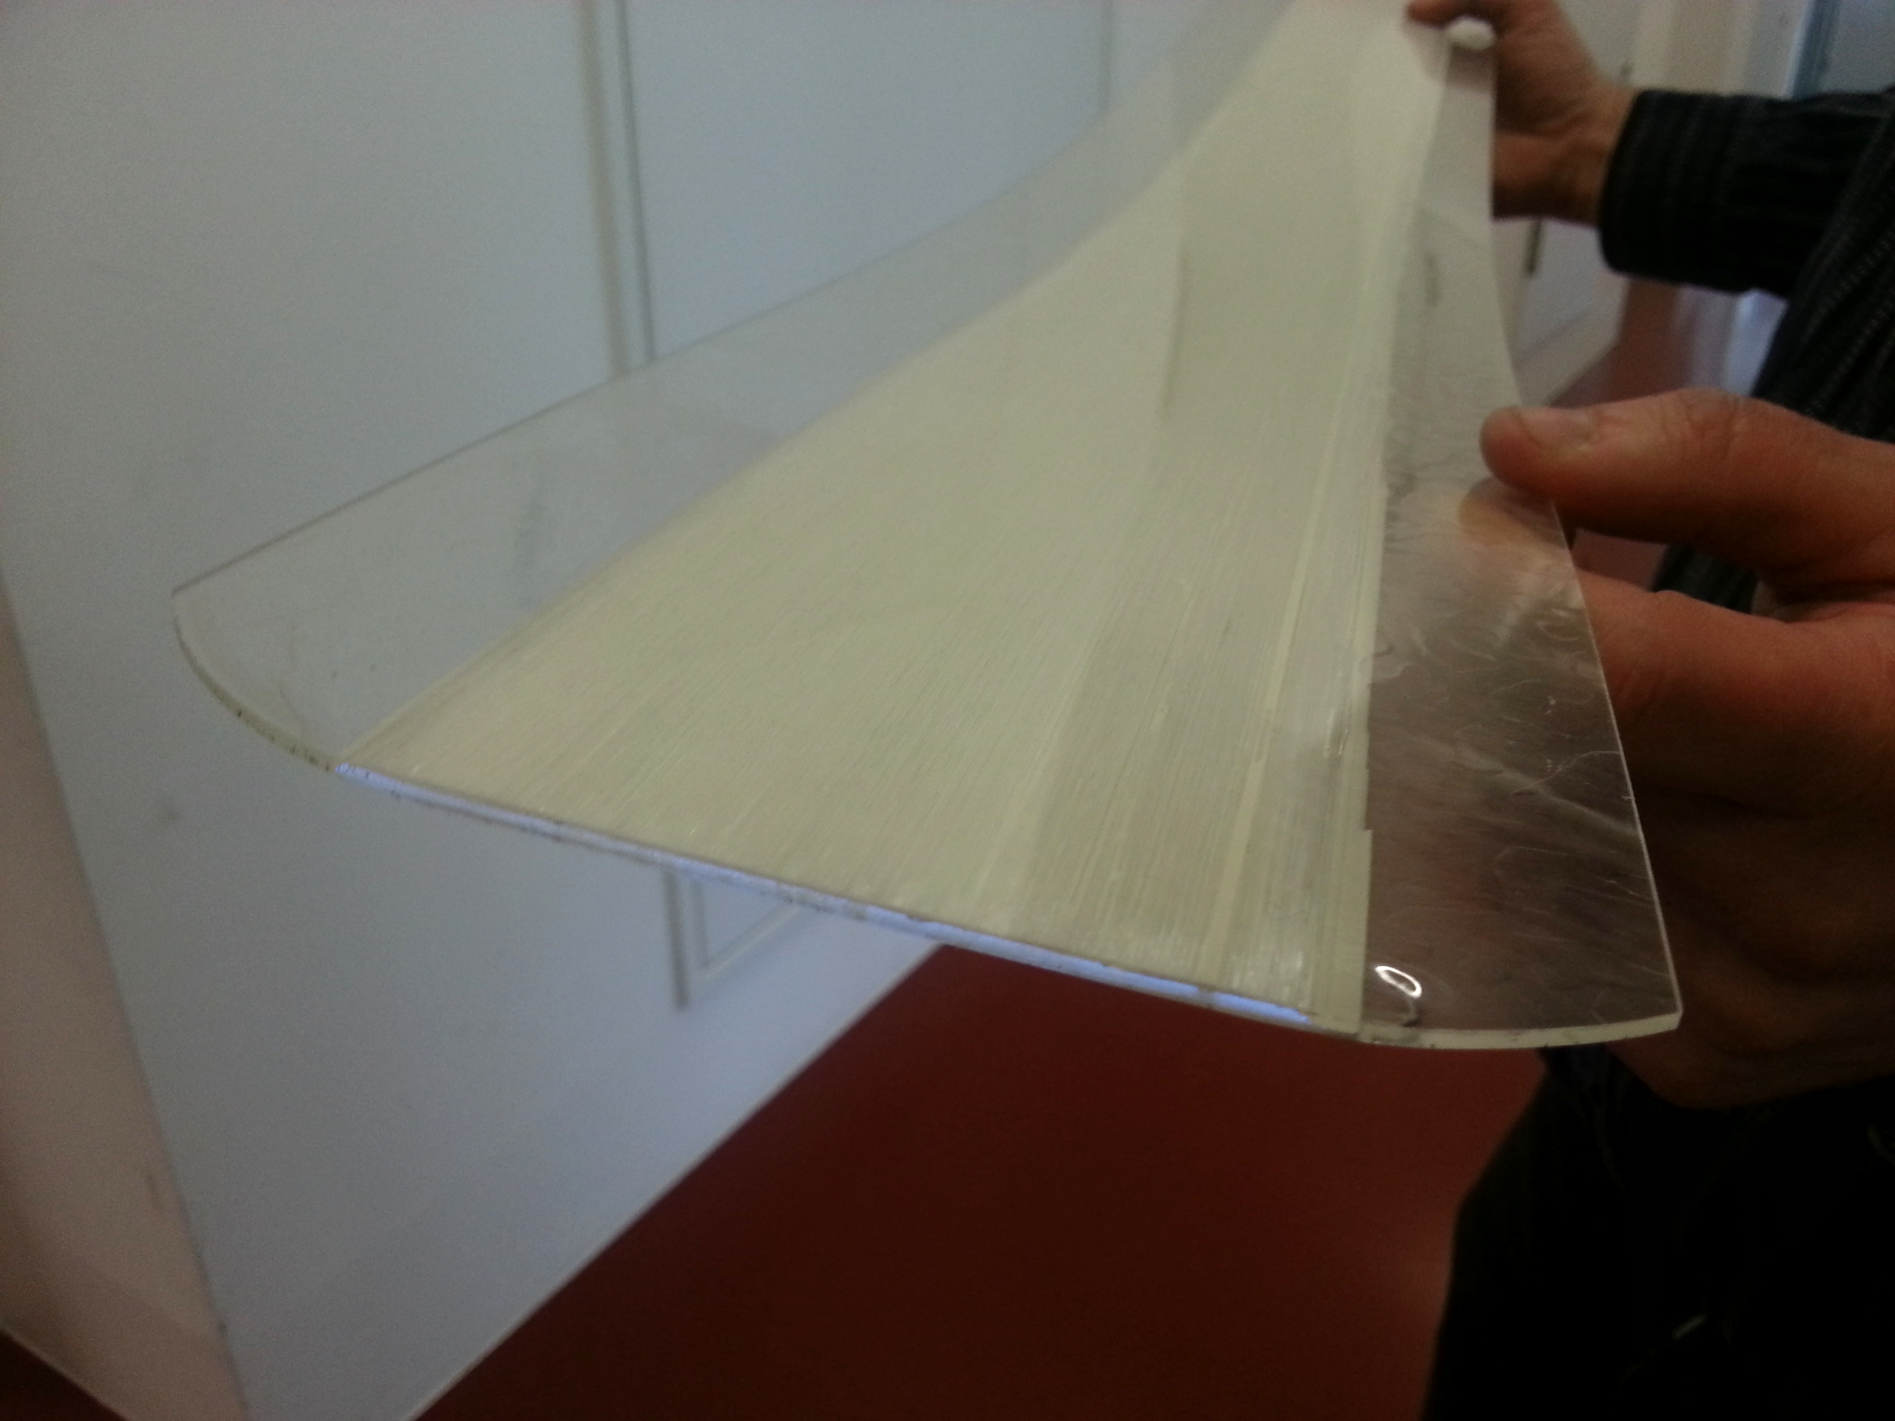
LHCb SciFi Mats: Casting
Glue-Casting of SiFi mat is done to protect fibre mat and to make handling and shipping easier. 5 fibre mat production center, 2 in Russia, 2 in Germany and 1 in Switzerland)
80 µm spacer
Fibre Mat
Fibre Mat
Epoxy is injected in the mold from the bottom up

Slide 20
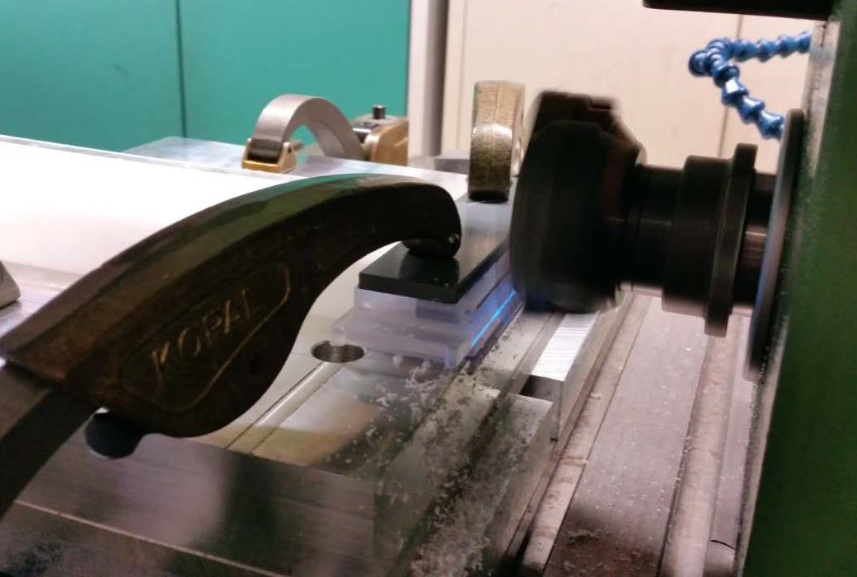
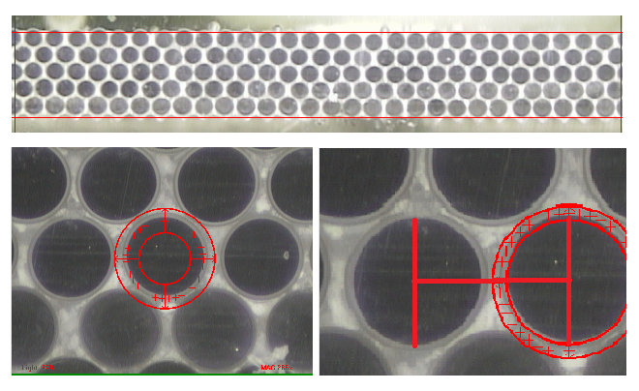
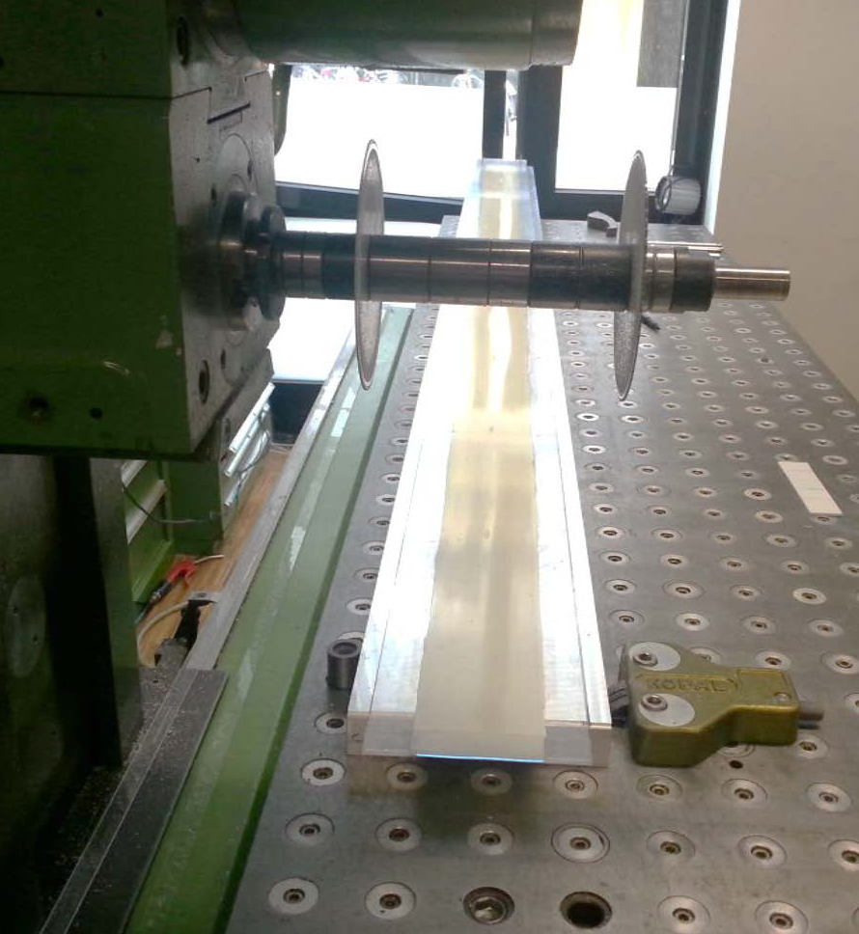
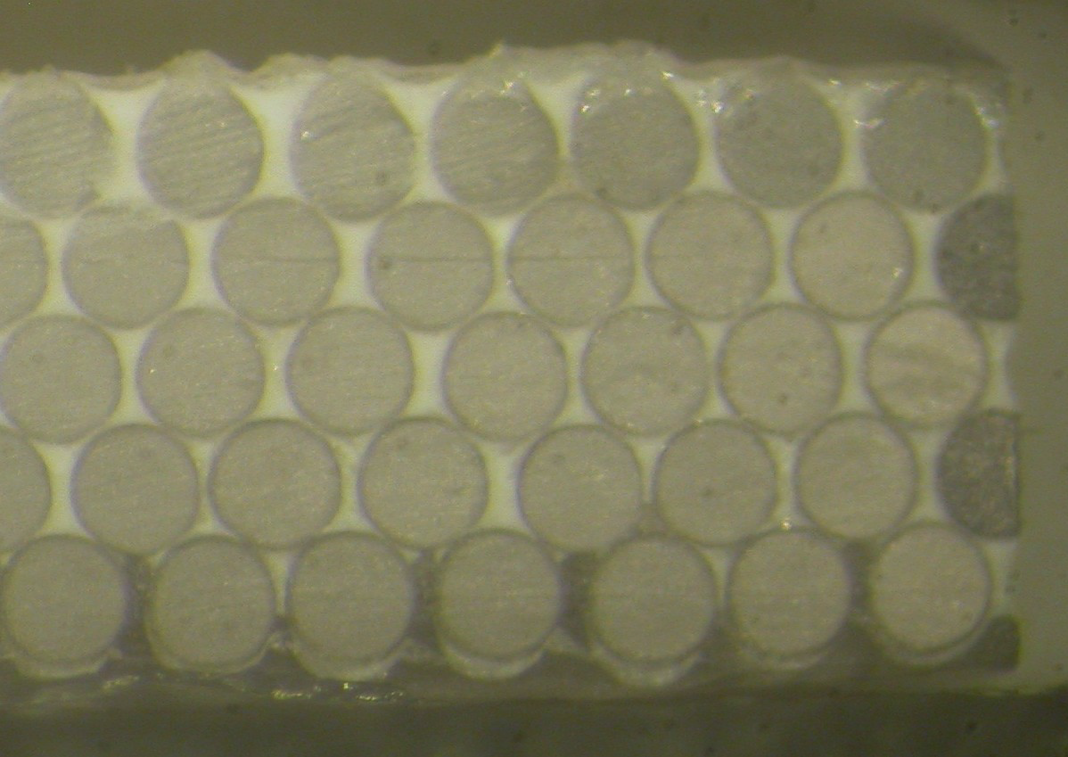
LHCb SciFi Mats: Cutting & QA
Transversal cut with optical quality
Measure interfibre alignment with pattern recognition software, Measurement of light yield (with cosmics or Sr90)
cladding
epoxy
Longitudinal cut
core
250 µm
270 µm
Cutting will create
dead fibres on the
edges

Slide 21
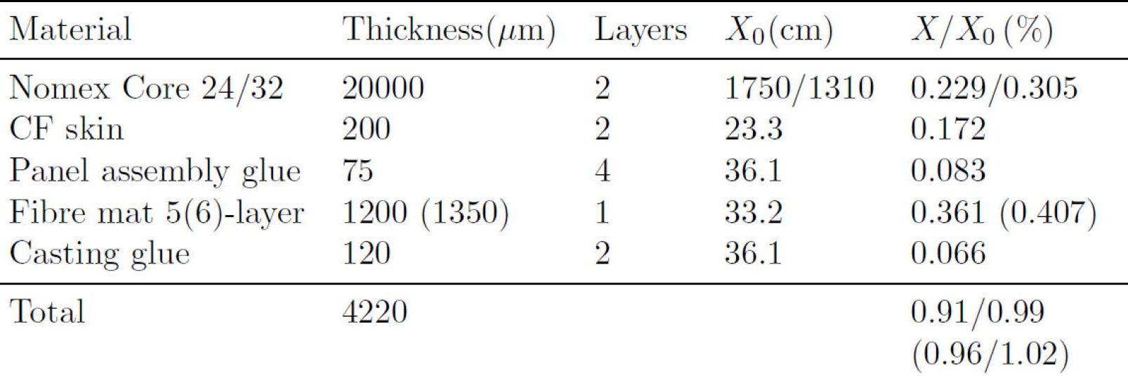



LHCb SciFi Module:
Fibre mats need to be assembled into a module that can be mounted and placed in the LHCb pit
8 mats aligned on a precision table
Bond a carbon fibre + Nomex core structure to
make a strong rigid object
→ Precision in time in z-direction better than 300 µm

Slide 22


LHCb SiPMs
Important characteristics of the SiPMs for the LHCb SciFi Tracker
High PDE: The 2.5m long fibres and radiation damage of the fibres in the center of the detector,
reduce the light output.
Low x-talk: The noise cluster rate increases exponentially with x-talk. With the high DCR after
irradiation, the noise cluster rate exceeds the acceptable level
Radiation environment: DCR increases with neutron fluence
Small temperature dependence: The operation temperature of the detector is set to -40°C.
Temperature non-uniformity is expected for different regions of the detector.
Small dead regions: Dead regions at the edge between adjacent SiPM arrays reduce the
overall hit detection efficiency
Thin entrance window:The entrance window defuses the light and therefore the thick window
increases the cluster size and makes the spatial resolution worse.
Hamamatsu (Jp)
Ketek (D)
170μm
250μm
1.62mm
32.59 mm

Slide 23





LHCb SiPMs Development:
SiPM arrays, 128-channels (2x 64) with 250 µm gap with very similar dimensions,
Channel width approximately matches the fibre spacing and diameter
Hamamatsu (Jp)
Ketek (D)
170μm
250μm
1.62mm
1 channel
different pixel sizes
32.59 mm
1 channel
4 x 24 pixels
(~50 micron)
trenches
0.25mm x 1.52 mm

Slide 24


LHCb SiPMs:
Photon Detection Efficiency: PDE = QE · ε_{geom} · ε_{avalanche}
Quantum efficiency
Geometrical efficiency (active area/total area of pixels)
Avalanche probability (bias voltage depending)
Reflectivity of surface (surface coatings)
Hamamatsu (Jp)
Ketek (D)
Fibre λ
Fibre λ

Slide 25

LHCb SiPMs:
X-talk (Pixel to pixel cross talk): photons are generated by the charge avalanche
Direct: photons enter an adjacent pixel causing it to fire
Indirect: absorbed in a sub-layer and re-emited into an adjacent
pixel
X-talk has appearance of increasing signal amplitude
Crosstalk can be reduced with trenches (bias voltage dependent)
Hamamatsu
Ketek

Slide 26


LHCb SiPMs:
Dark Count Rate (DCR)
From thermal excitations of single electrons into conduction band causing avalanches
Temperature dependence of DCR is an important characteristic for the SciFi tracker. Cooling -40°C is foreseen to reduce the DCR to an acceptable level
Detector with trenches can work at higher over voltage to increase the PDE but this increases also the DCR
Hamamatsu
Ketek

Slide 27



LHCb SiPMs: Irradiation
Expected neutron fluence of ≈ 1∙10¹² 1MeV neq / cm² at the location of photodetectors → creation of single photo-electron signals from thermal electrons → increase of x-talk → Cooling to
-40°C required,
Ketek 2-3 times worse noise compared to Hamamatsu after irr.
SiPM arrays
Hamamatsu
Ketek

Slide 28

LHCb SciFi Module and SiPMs:
fibre

Slide 29



LHCb SiPMs: Cooling in Readout Box
fluid supply tube
8 x PACIFIC →
T=-40°
Single phase liquid cooling
Compact space
< 20 W thermal load per module
SiPMs produce little to no heat, box dominated by parasitic heat load
Issues with condensation and frost need to be dealt with

Slide 30



LHCb SciFi Tracker: Electronics
Fast readout with manageable data volume
Digitizes the 560,000 SiPM signals and forms the cluster and hit positions
40 MHz readout rate
Signal propagation time up to 5m · 6ns/m = 30ns → some spill over to next BC
No adequate (fast, low power) multi-channel ASIC available
LHCb develops its own ASIC, called PACIFIC, with 128 channels (130 nm CMOS)
Concentrator
FPGA
Current layout of motherboard
For 8 x 128 channels.

Slide 31




LHCb SciFi Tracker Electronics: PACIFIC
LHCb develops its own ASIC, called PACIFIC, with 128 channels (130 nm CMOS)
3 hardware thresholds (=2 bits) (seed, neighbour, high) plus a sum threshold (FPGA) are a good compromise between precision (<100 μm), discrimination of noise and data volume.
25ns
25ns
Charge integration
(2 x 25ns)
Thresholds
Tail cancellation, etc.
amplifier
Z_{in} ~20-40 Ω
τ~5 – 10ns

Slide 32

LHCb SiPMs: Calibration Light Injection System
emitted light from Ø2mm fiber
Scratched fibre embedded in the module ends
Shines evenly across the fibre and SiPMs
Driver
Gigabit LASER Driver
(GBLD, a radiation tolerant ASIC)
Vertical-cavity surface emitting laser (VCSEL) with
wavelength of 670 nm
Light intensity will be adjusted via I2C
Radiation hardness of GBLD OK
Radiation hardness of VCSEL must be tested
4 scratched fibres

Slide 33


LHCb SciFi Modules: Testbeam 2014
5-layer and 6-layer modules
with length up to 3m
Aim: measurement of light yield
Testbeam 2015
Aim: Measurement of spatial resolution and hit efficiency
Analysis still ongoing

Slide 34
Summary
The order of magnitude increases in precision will allow new physics searches down to Standard Model theoretical uncertainties
The SciFi tracker is crucial to scope with the upgrade requirements
  Leaving the R&D phase and start with Preproduction Phase this year
  Scintillating fibres low dose irradiation ongoing, attenuation length and light yield before irradiation sufficient
  SiPM improvements ongoing
  Testbeam 2014 5- and 6-layer mats investigated
Testbeam in May 2015
Engineering Design Reviews starting June 2015
Begin construction in end of 2015; Ready for installation in 2018

