Slide 1
The PERDaix Detector
„TRDs for the 3rd Millenium“
IV Workshop on advanced Transition Radiation Detectors for accelerator and space applications,
Bari, 14-16 September 2011

Slide 2
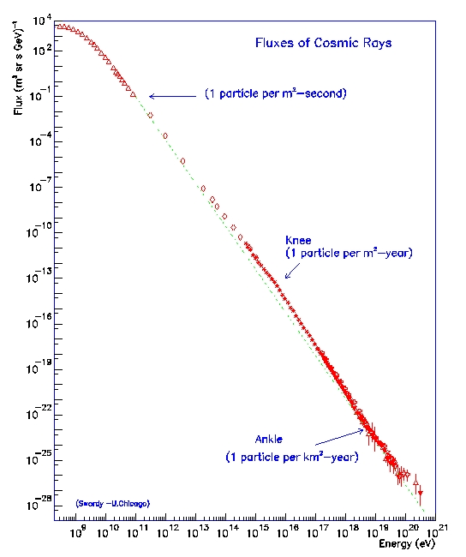
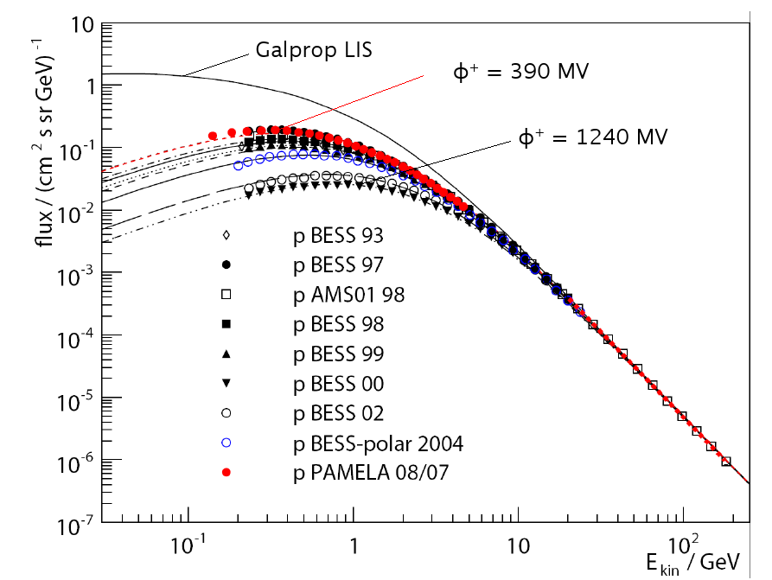
Motivation
Cosmic Ray Composition:
Protons 88 %
Helium 10 %
e⁻ 1 %
e⁺ 0.1 %
Antiprotons 0.01 %
E^{-2.7}
E^{-3.0}
E^{-2.7}

Slide 3
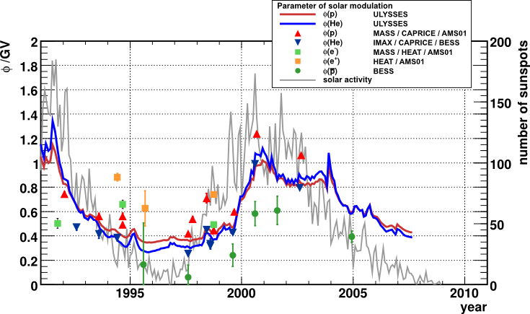
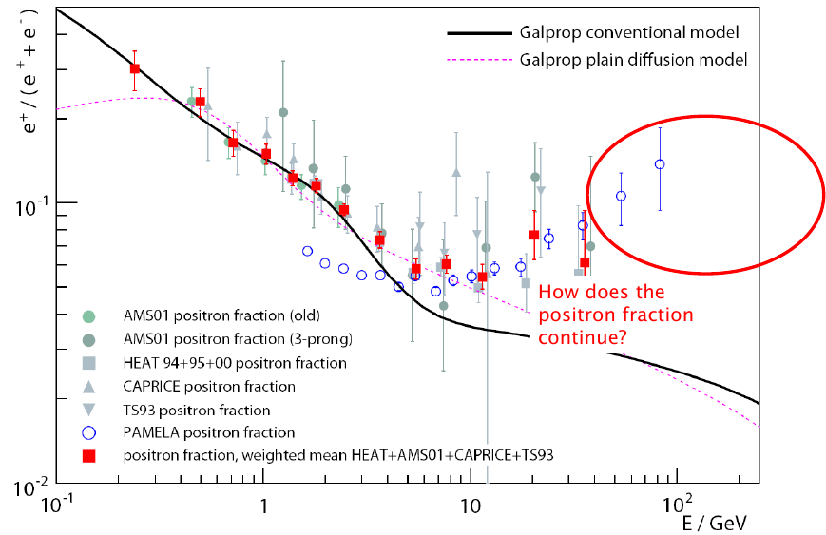
Motivation
Charge sign dependent solar modulation?

Slide 4
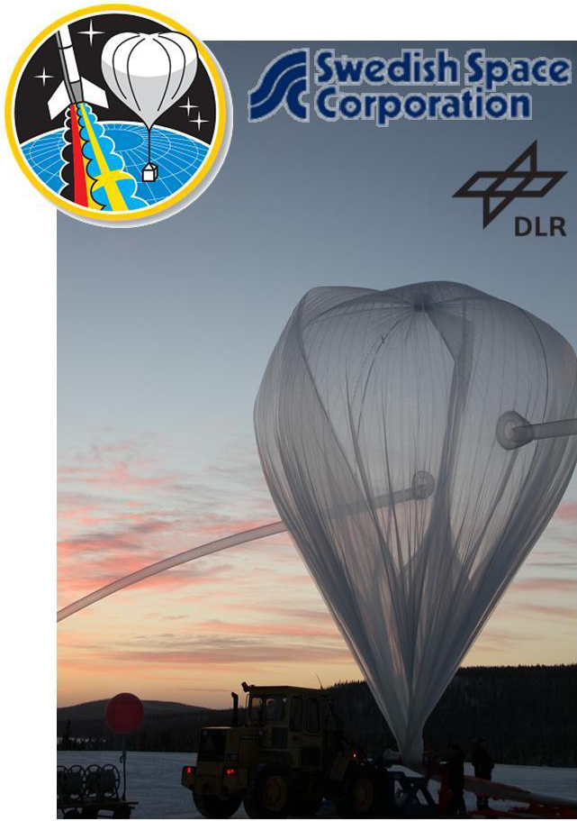
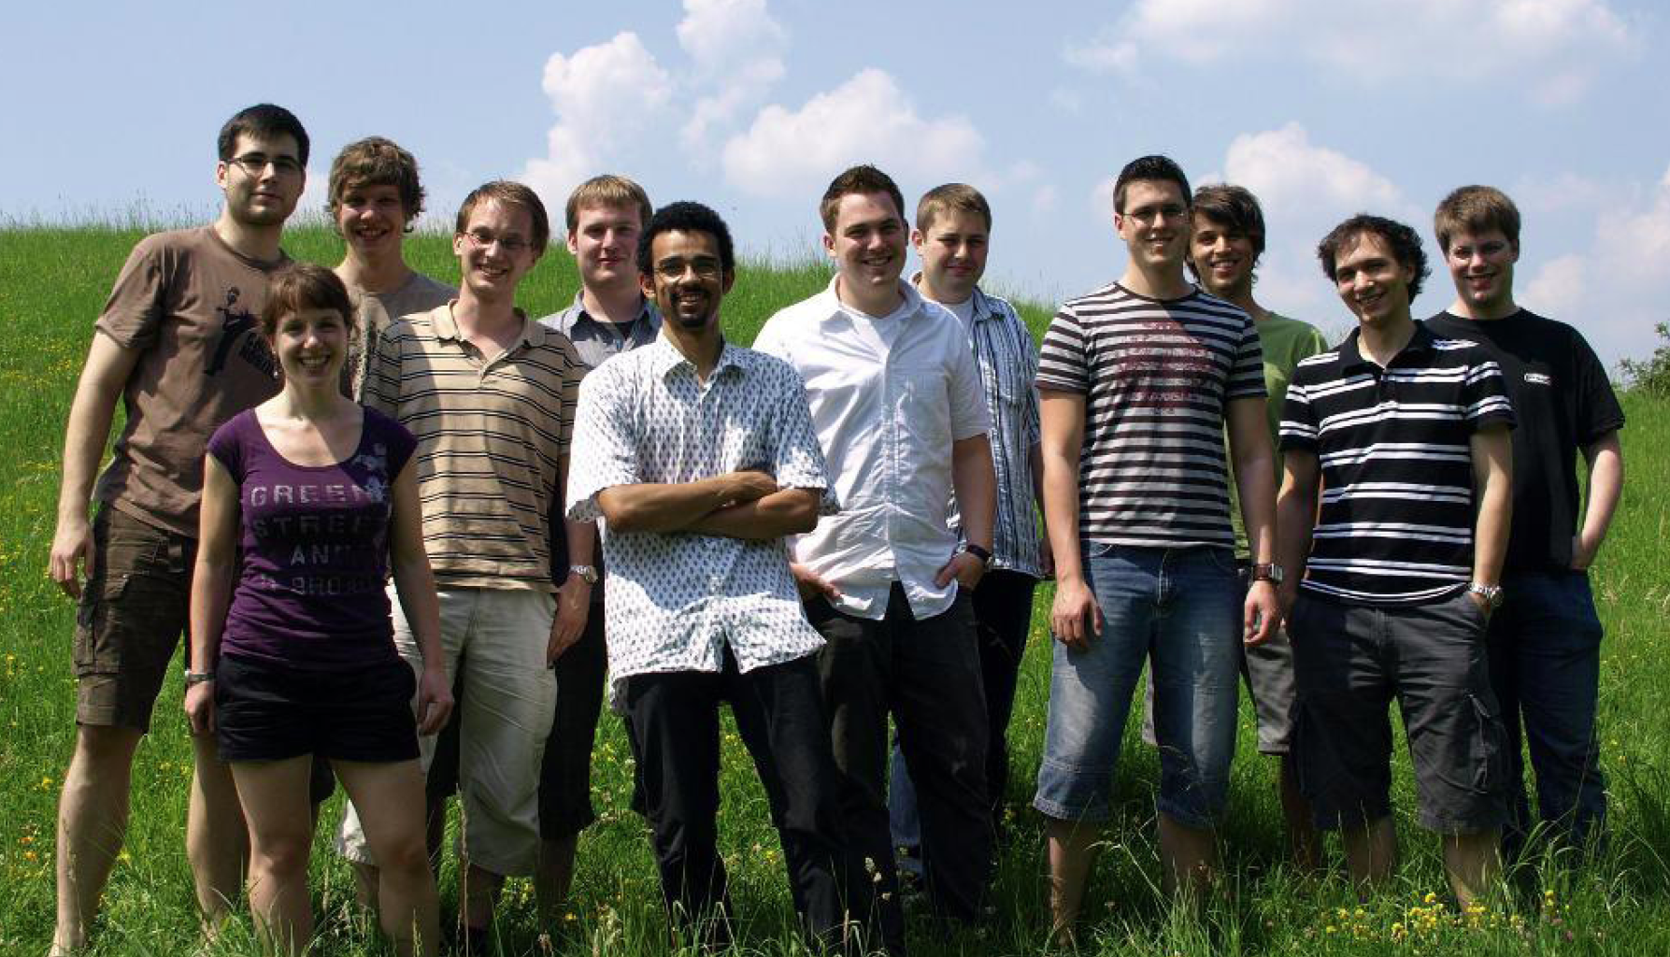
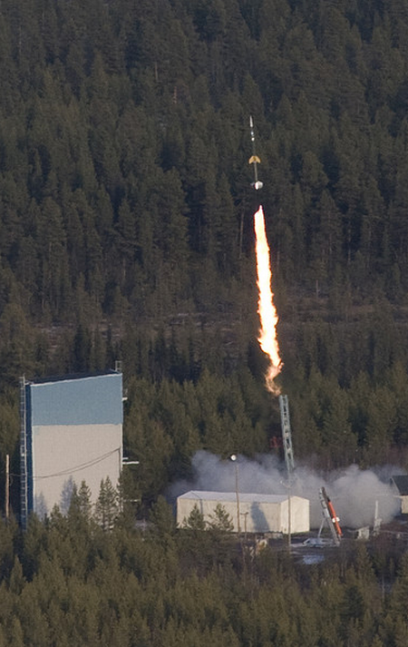
REXUS/BEXUS program
Rocket and Balloon Experiments for University Students
project sponsored by German and Swedish aerospace agencies
two rocket and two balloon launches from ESRANGE near Kiruna, Sweden per year
balloons
  Maximum scientific load 100 kg
  Maximum height 35 km
  Float time up to 5 hours
  Temperature -50°C
  Low pressure ≈1mbar

Slide 5
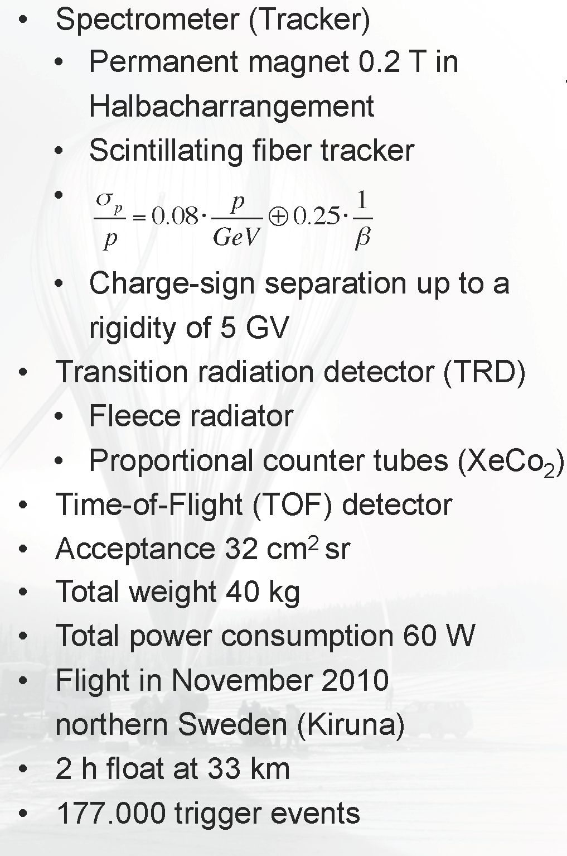
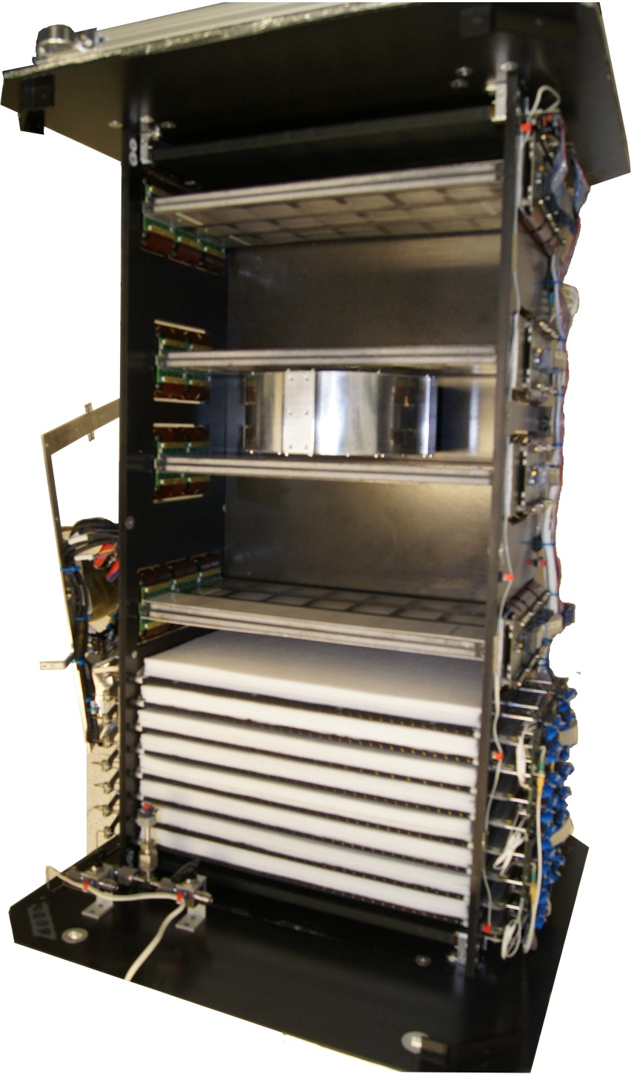
The PERDaix detector
Time-of-Flight
detector
fiber tracker
magnet
80cm
Transition
Radiation
Detector

Slide 6
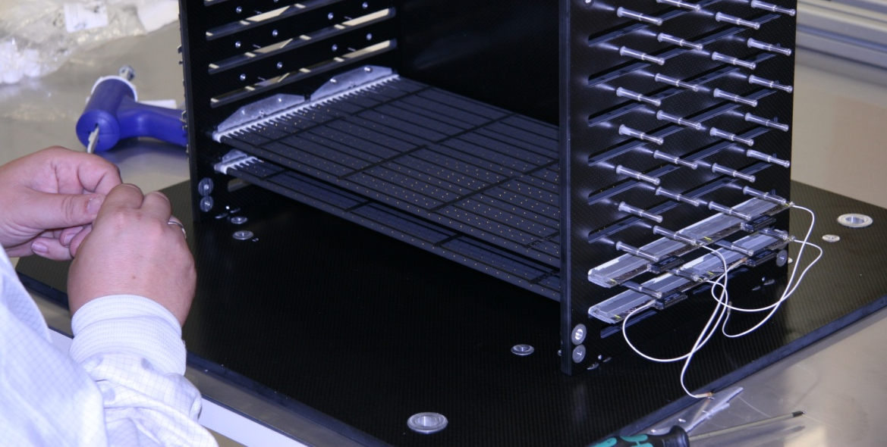
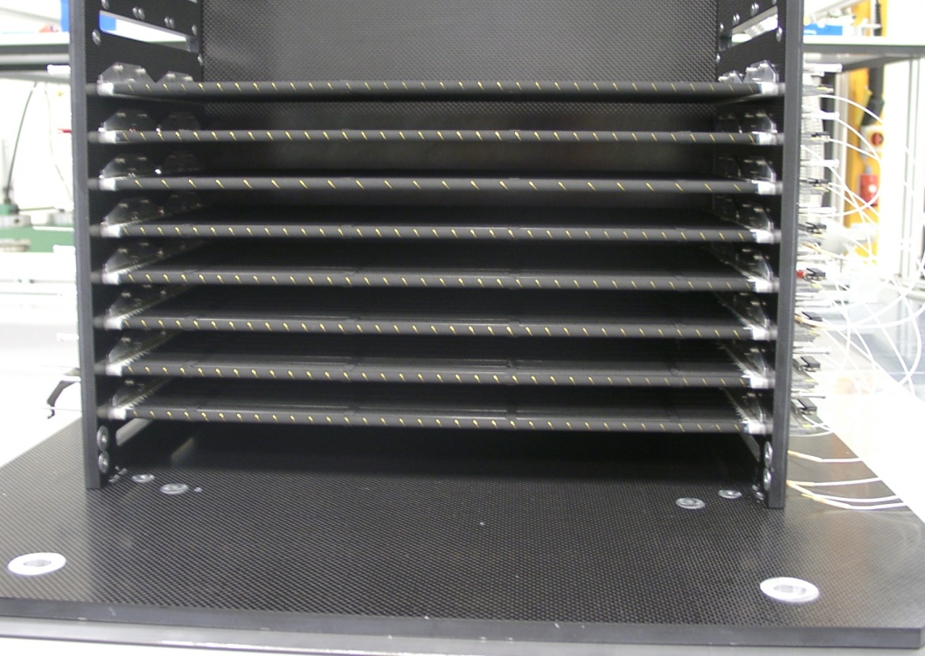
Transition Radiation Detector
Made out of spare parts of AMS-02 TRD
16 modules
  400 mm long
  each covered by 20mm thick PP/PE fleece radiator
Each module consists of 16 straw tubes with ∅ 6mm
  filled with Xe/CO2 at 1.1 bar absolute pressure
  30 µm thick tungsten wire
  operated at 1.5 kV
  e±/p separation
  read out with VA_32 chips and USB digitizer boards, like tracker
Danger of corona discharges in near vacuum

Slide 7
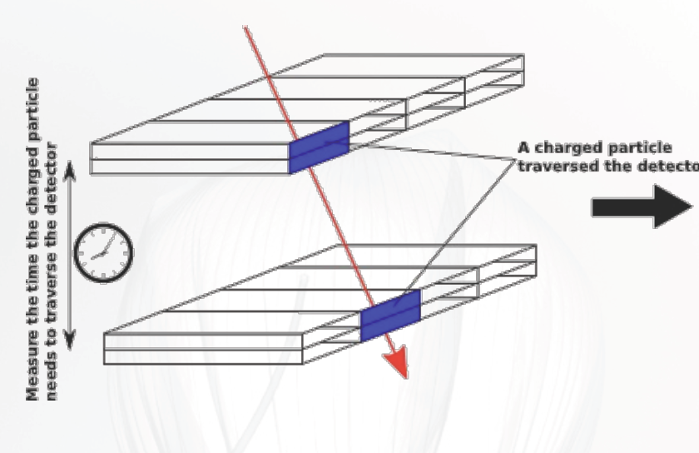
Time-of-Flight System
Time-of-Flight
detector
Trigger
Mandatory tasks
• Main trigger
• Rejection of upward from downward
flying particles (Albedo particles)
• Four layers of scintillator bars
• Two at top and two at bottom
• Distance 80 cm → 2.7 ns flight time
• Modular design

Slide 8
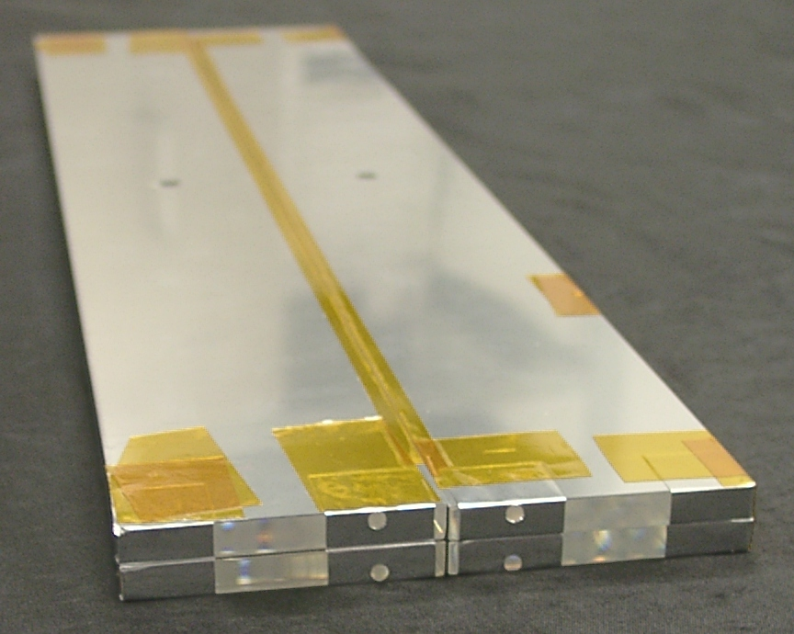
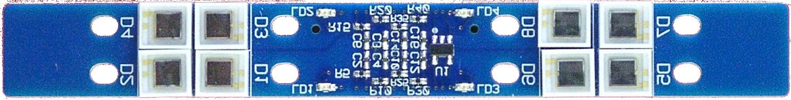
Time-of-Flight System
Bicron BC-408
scintillator bar
6 x 50 x 395 mm³
(λ = 430 nm)
two top and two bottom modules
scintillator bars optically separated, wrapped in reflective aluminized Mylar foil
2 optical hybrids
  8 Hamamatsu S10362-33-100C on each side of module
  (440 nm peak sensitivity)
Coupling with optical grease
TOF module
MPPC
calibration
LED
digital temperature
sensor

Slide 9
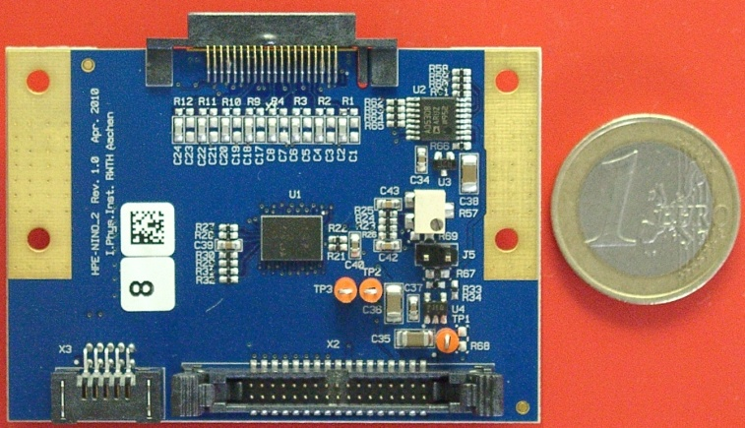
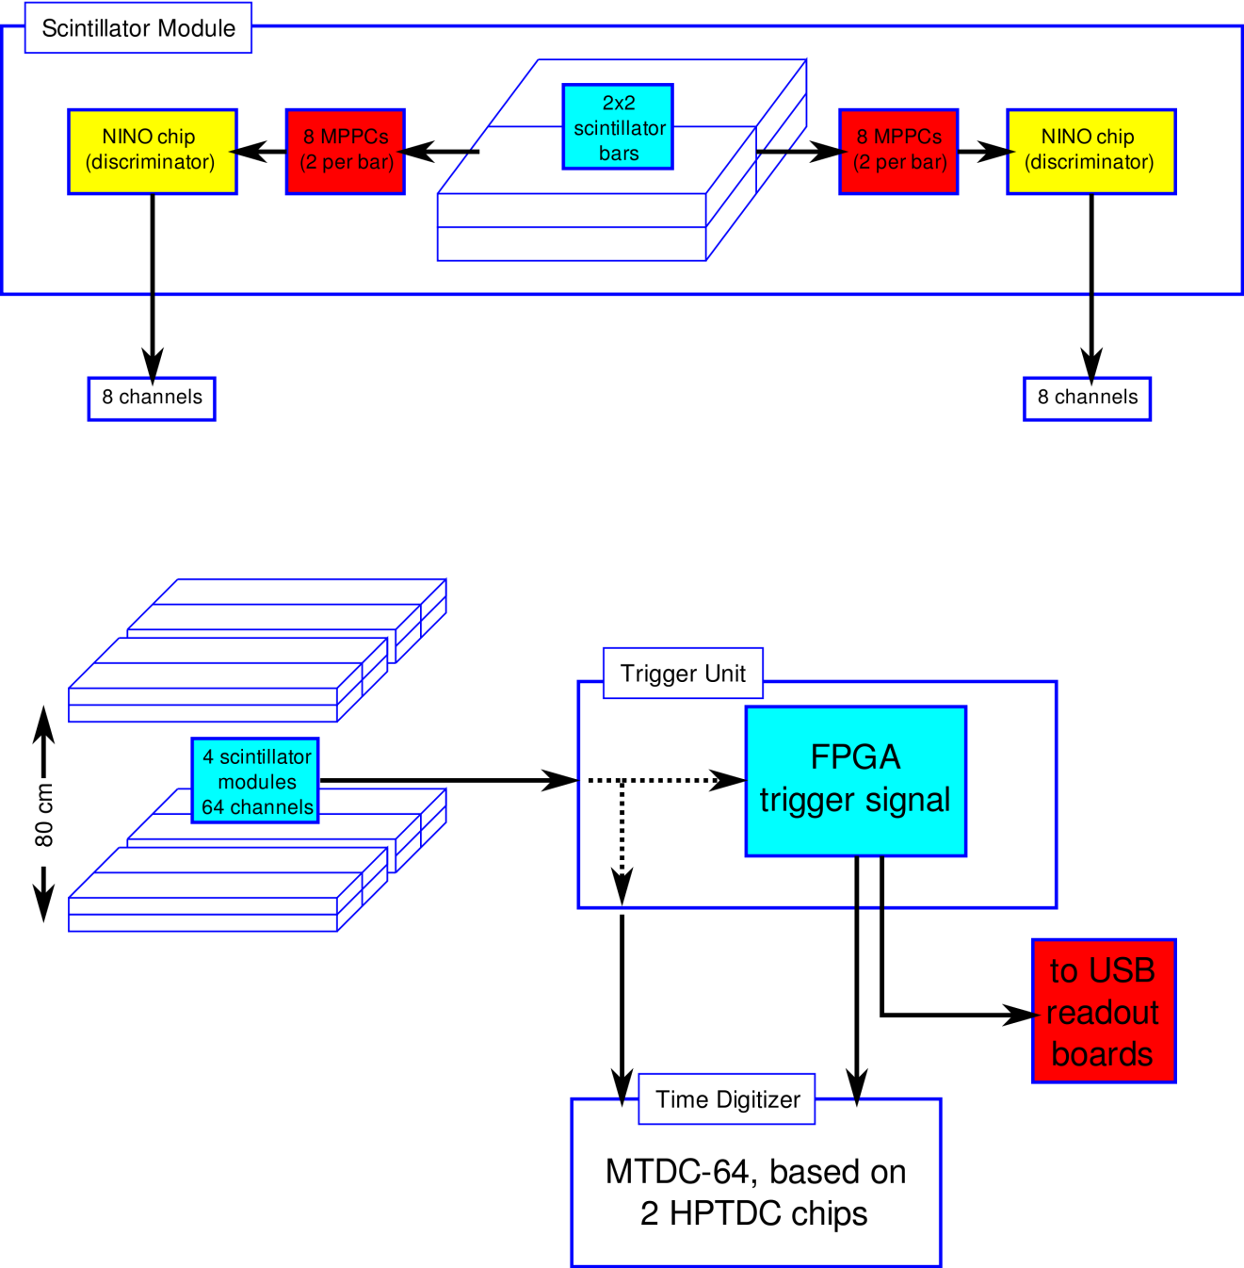
Time-of-Flight system
NINO: 8 channel preamplifier discriminator ASIC
power consumption 30 mW/channel
fully differential readout chain
1 ns rise time
DAC for individual MPPC voltages on PCB

Slide 10
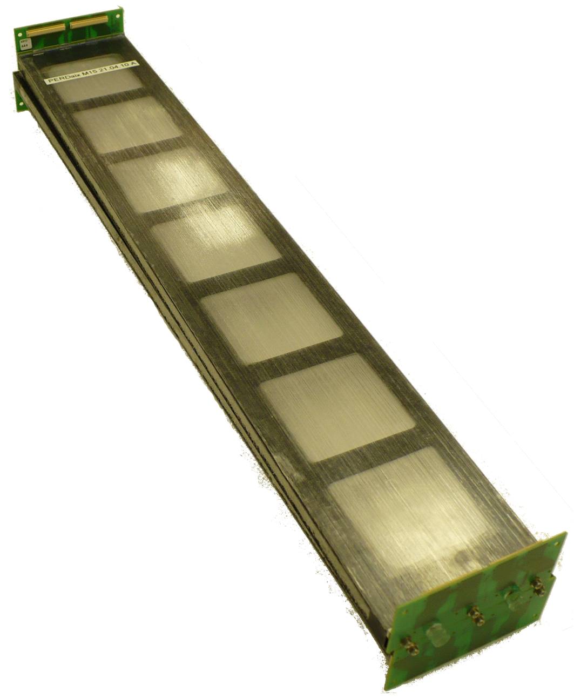
Scintillating Fiber Tracker
4 double layers of scintillating fiber tracker
10 stereo modules
  → 20 fiber ribbons
  → 160 SiPM arrays
  → 5120 channels
two ribbons made of 5x256 250μm thick scintillating fibers mounted on Rohacell foam/Carbon fiber support structure (ladder structure for material saving
→ 1,1 % X0 per module)
Scintillating
fiber tracker

Slide 11
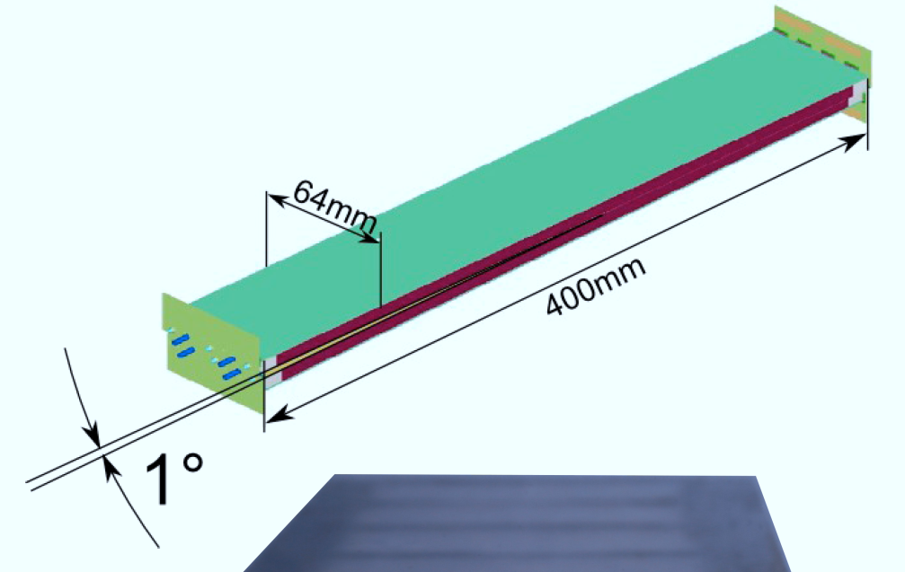
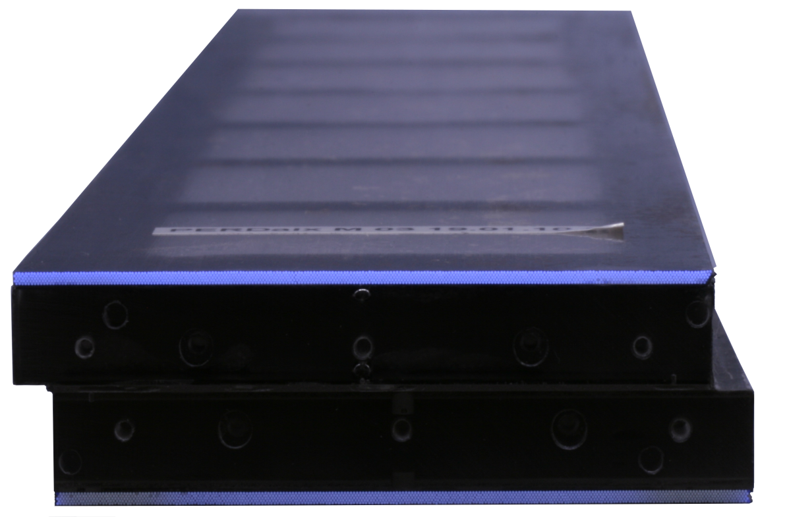
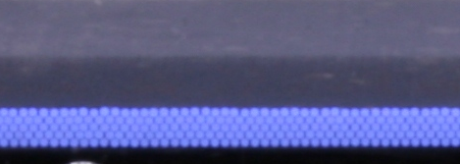
Scintillating Fiber Tracker
CFC module carrier
  fiber ribbons on top & bottom
  1° stereo angle
  1.1% X0
Kuraray SCSF-78MJ fibers
  (250 ± 6) μm fiber diameter
  λ_{Emission} = 450nm
  5 fiber layers per ribbon
  Each layer with 256 fibers

Slide 12
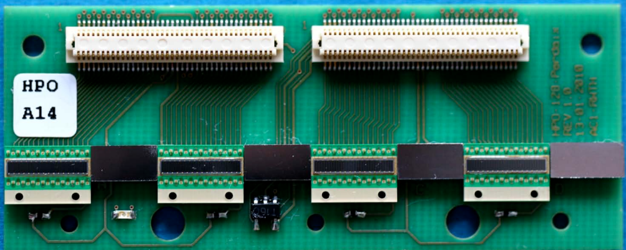
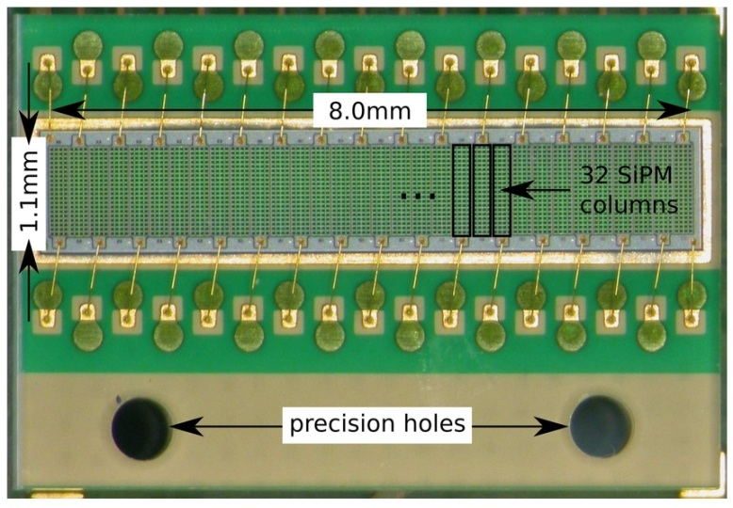
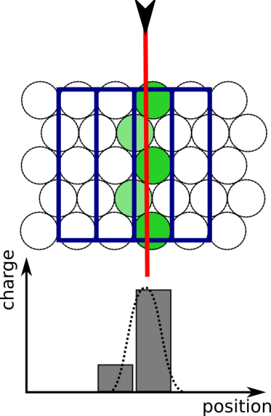
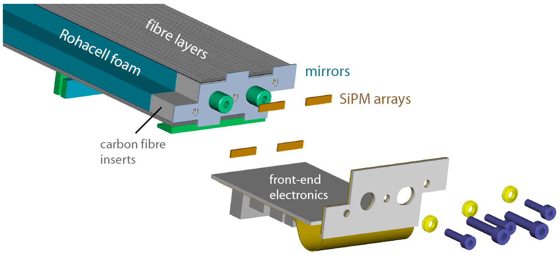
Scintillating Fiber Tracker
Readout of scintillating fibers with 32 channel MPPC 5583 arrays
Thermistors
Temperature
Sensor
Mirrors

Slide 13
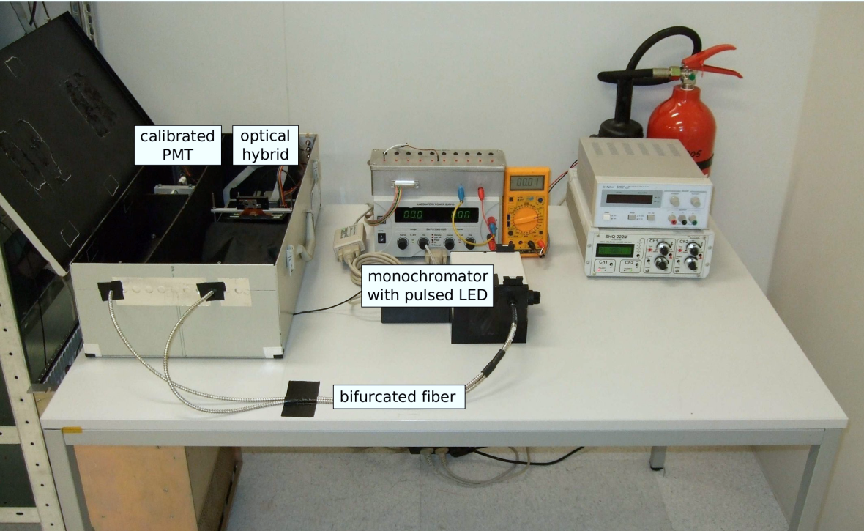
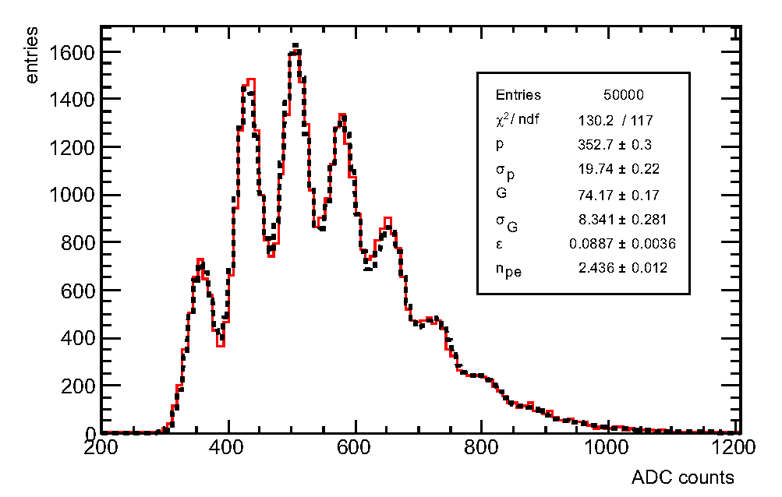
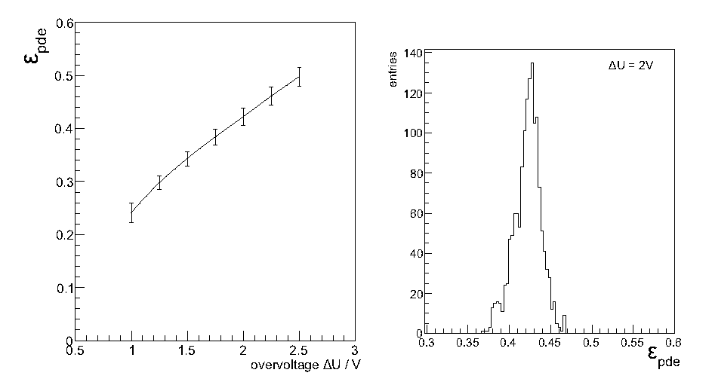
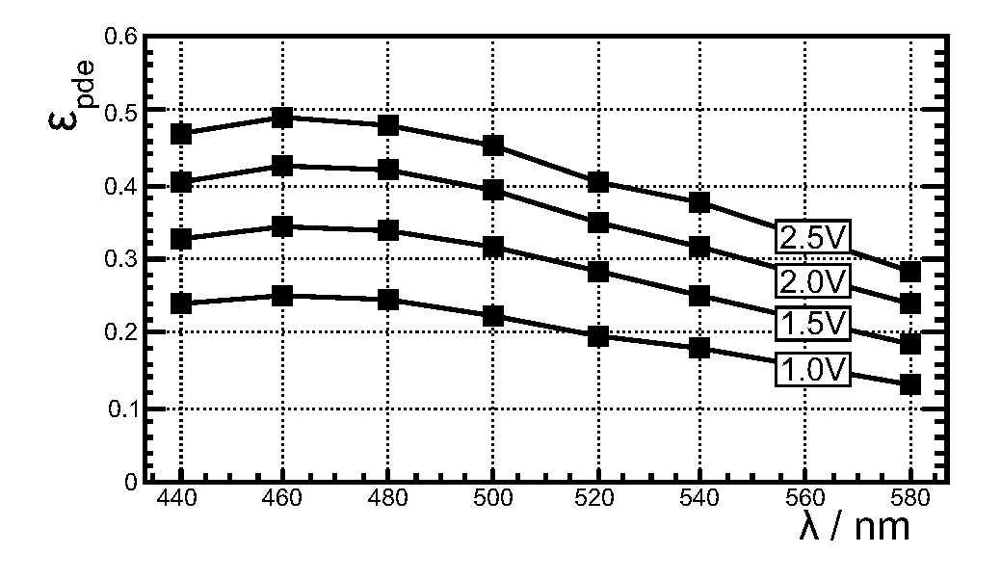
Scintillating Fiber Tracker

Slide 14
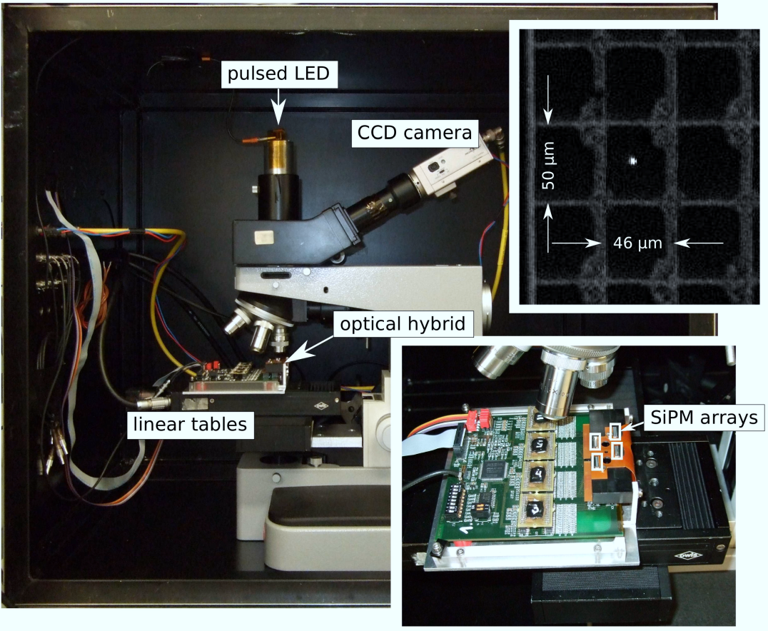
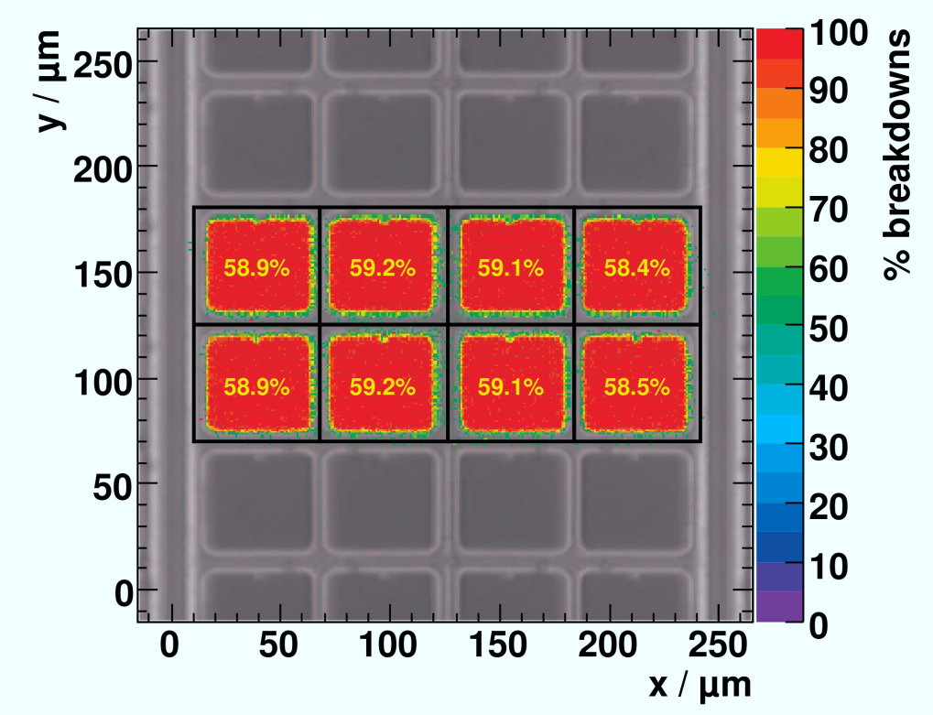
Tracker

Slide 15
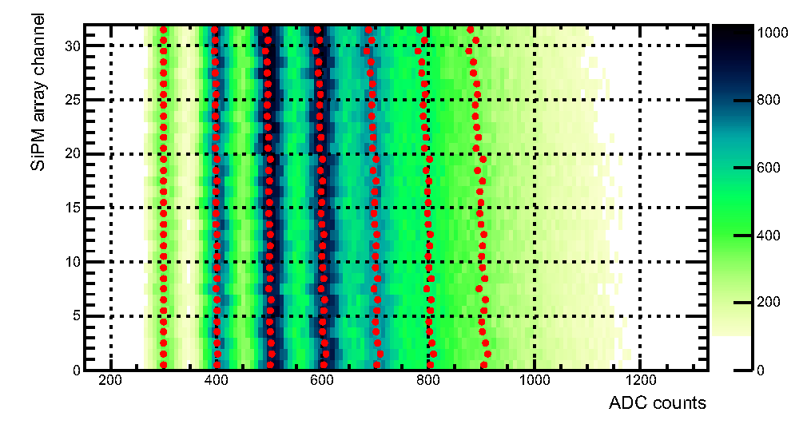
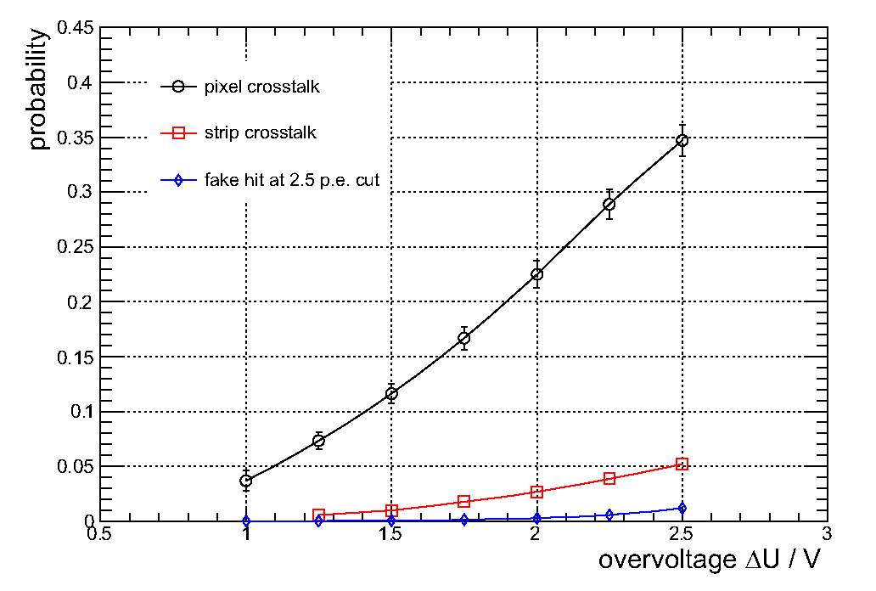
Scintillating Fiber Tracker
Hamamatsu MPPC 5883
  32-channel SiPM arrays
  0.25mm channel pitch
  80 pixels (dynamic range)
  U_{bias} = 70V
  PDE 50%, Gain 10⁶
  Pixel Crosstalk 30%
  Dark count ~200kHz/channel

Slide 16
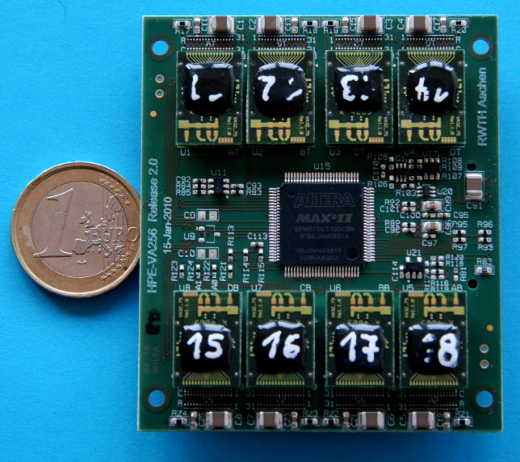
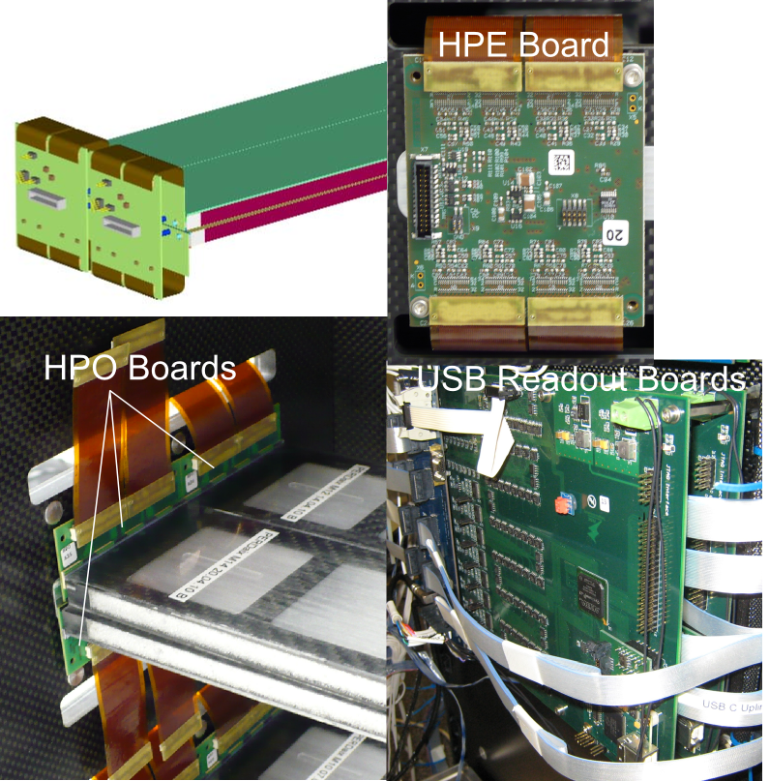
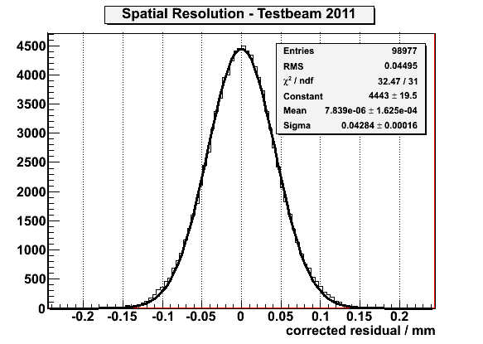
Scintillating Fiber Tracker
HPE Board
< 50 μm

Slide 17
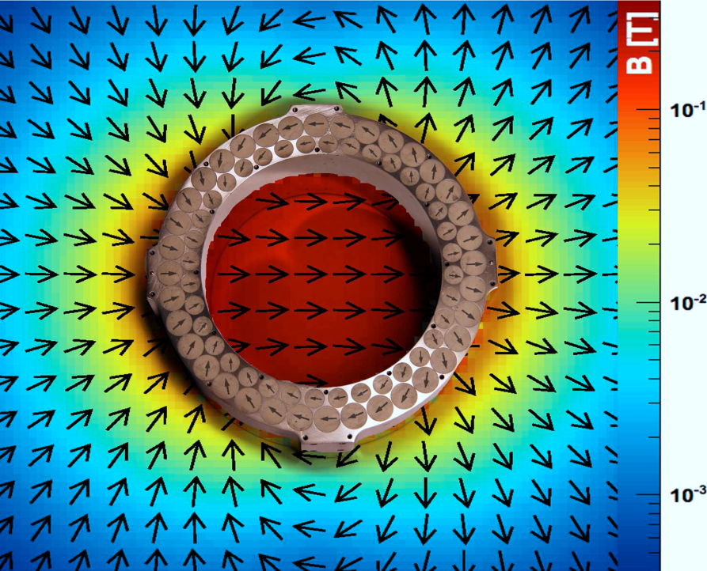
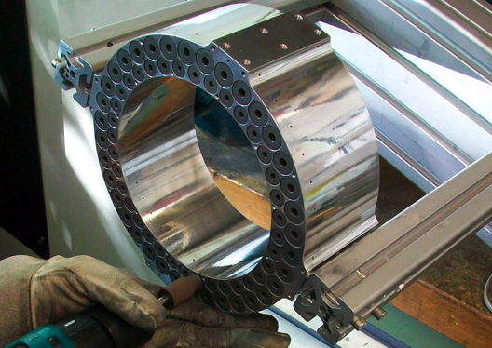
Magnet
small zylindrical magnets
inner magnetic field: 0.2T
weight: 7.4kg
inner diameter: 15cm
outer diameter: 21cm
height: 8cm

Slide 18
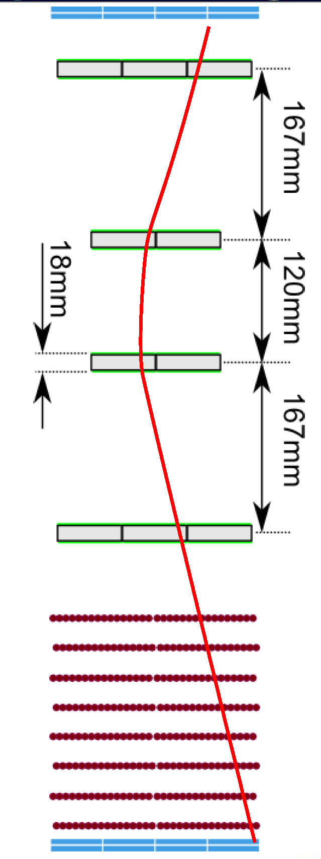
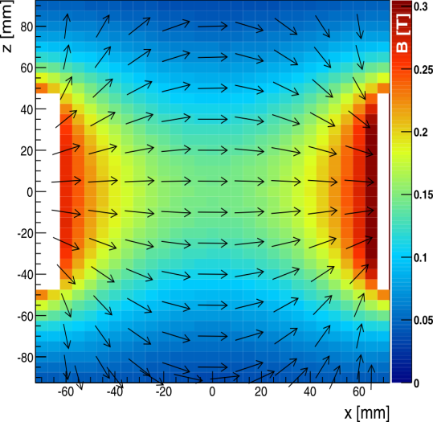
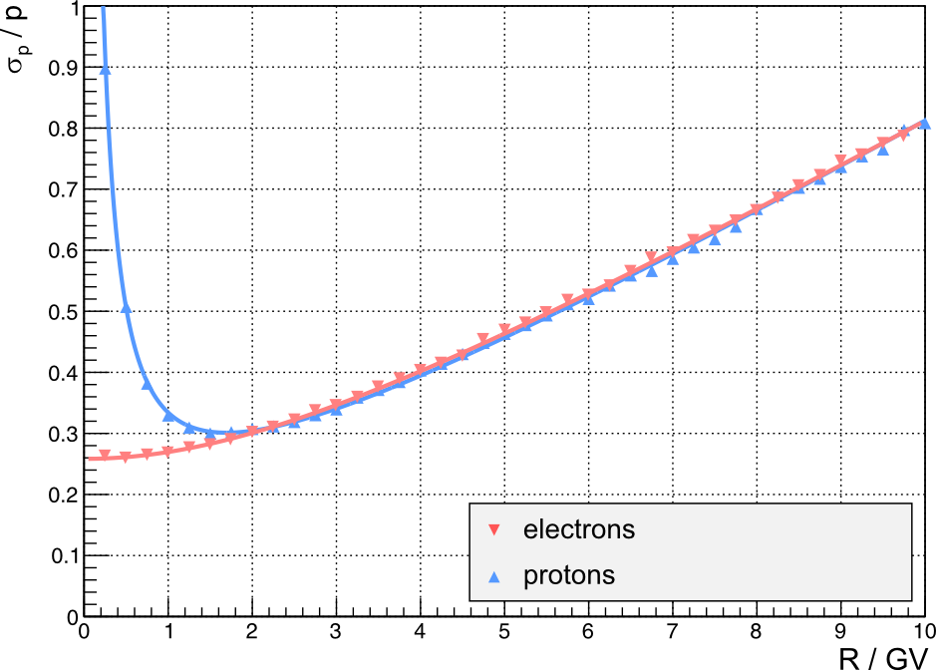
Momentum resolution
PERDaix magnetic field 0.2T
< 50 μm
Geant4 Simulation of detector provides momentum resolution
3d reconstruction algorithm:
inhomogeneity of magnetic field
stereo angle in modules
multiple scattering
maximum detectable rigidity
~10GV

Slide 19
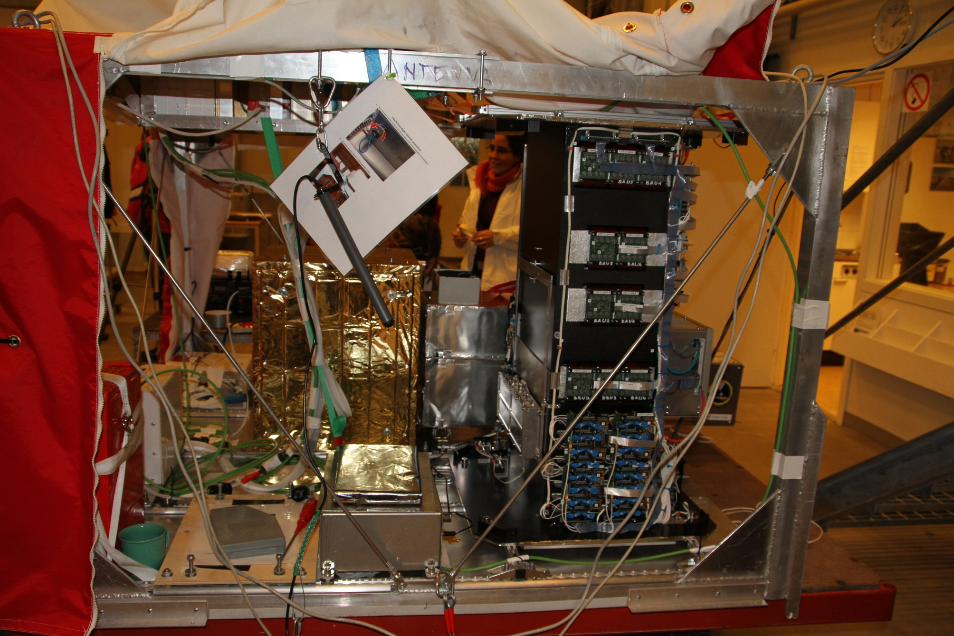
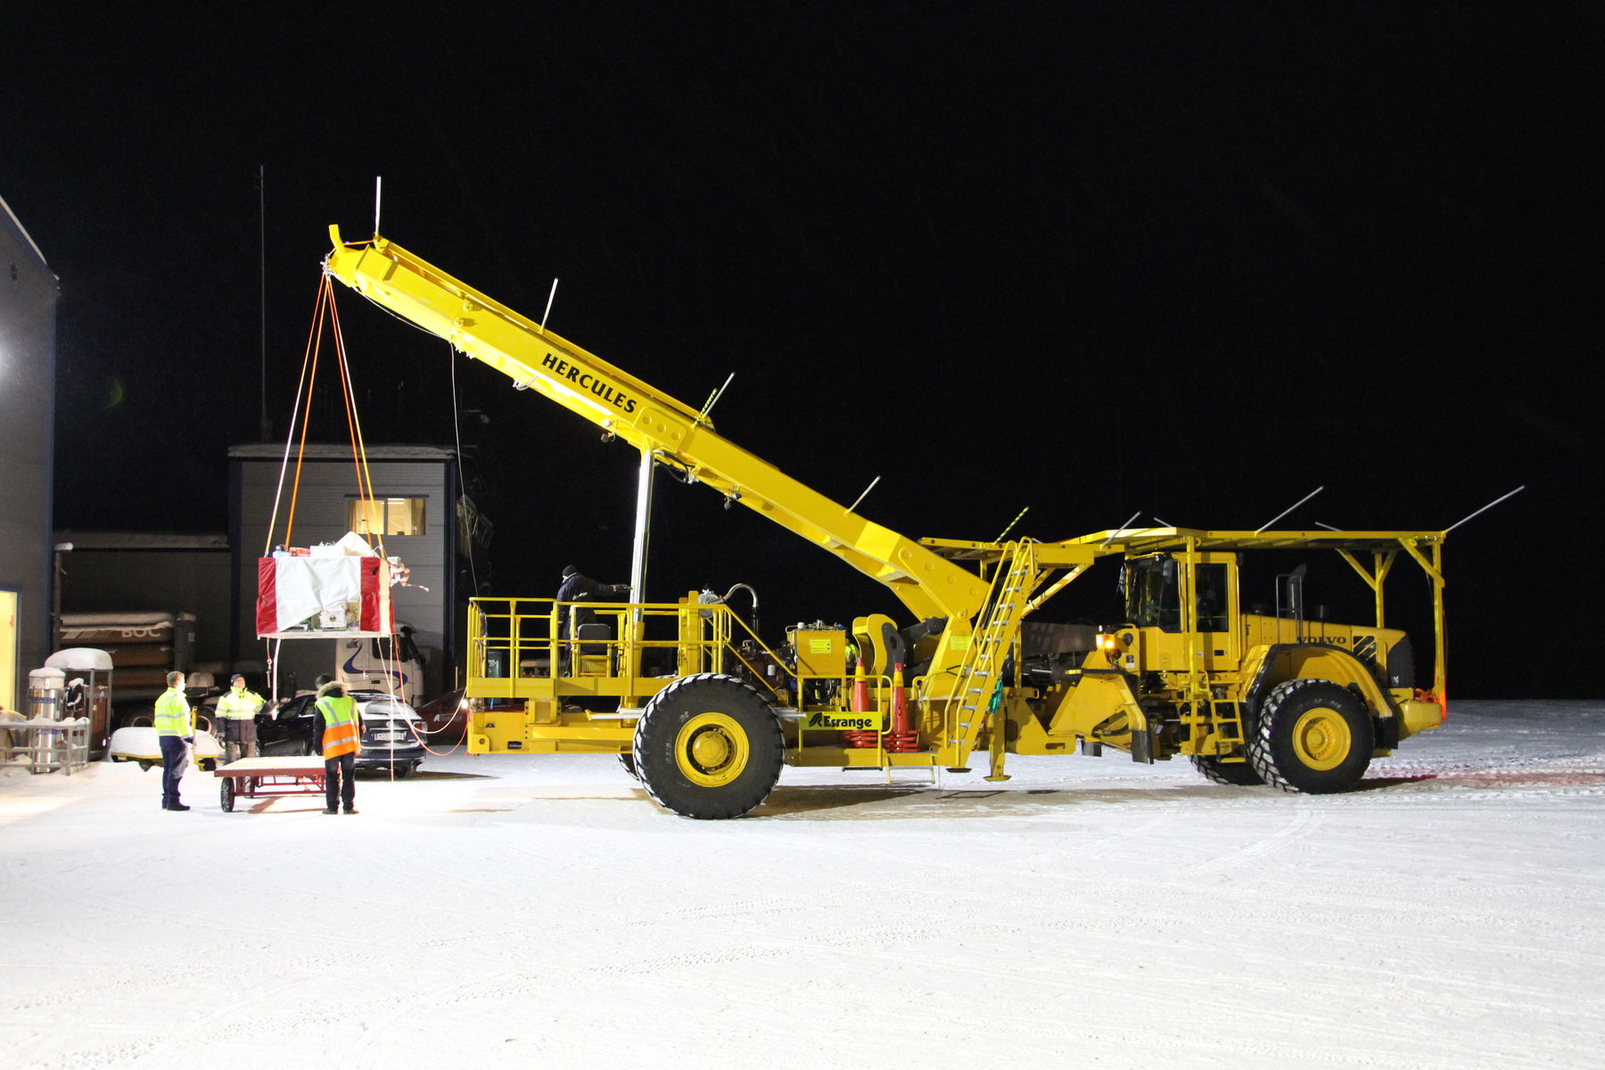
Bexus 11 Launch & Flight
November 23rd, 2010 03:00 am
T-5:30 Start Countdown
November 23rd, 2010 05:30 am
T-3:00 Gondola to Launchpad

Slide 20
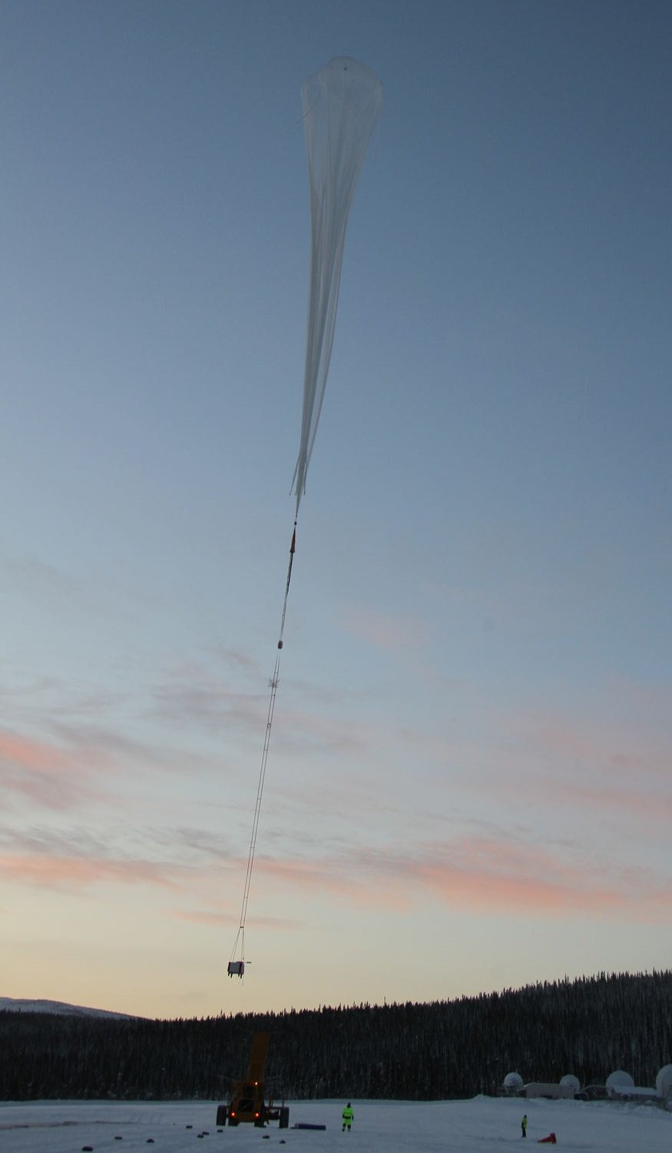

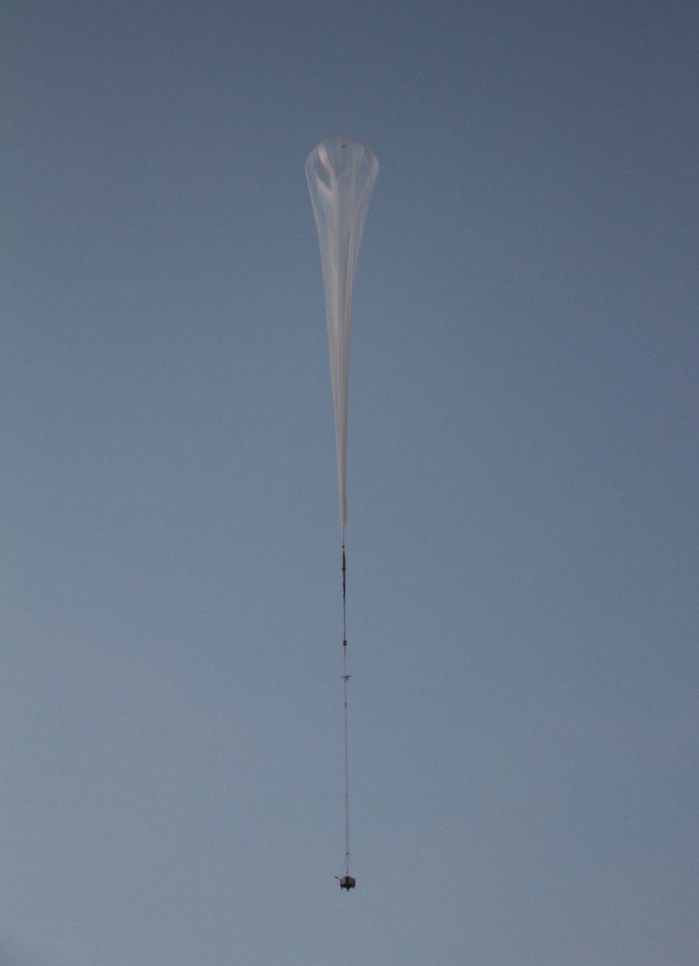
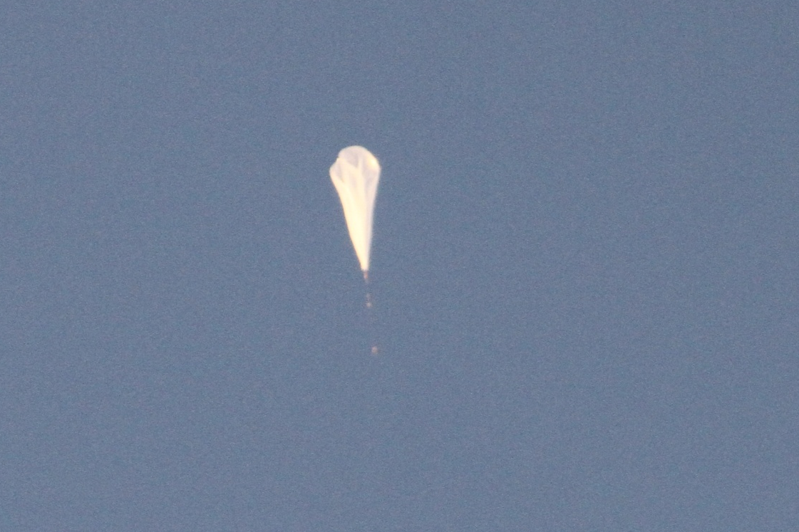
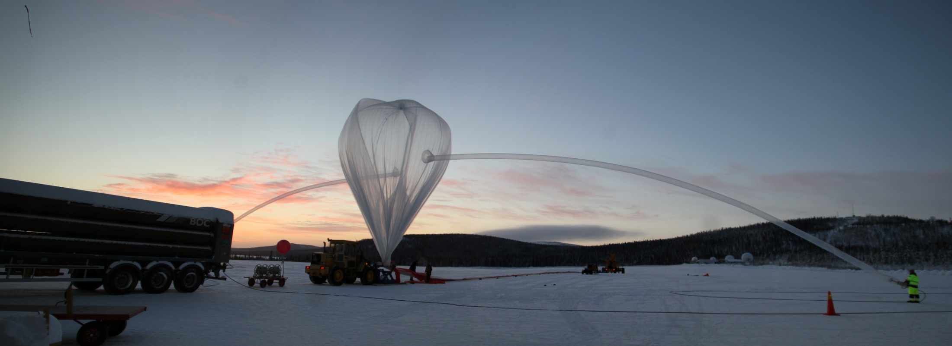
Bexus 11 Launch & Flight
November 23rd, 2010 07:50 am
T-0:40 Balloon Filling
09:18 Liftoff
≈20km
≈30km

Slide 21
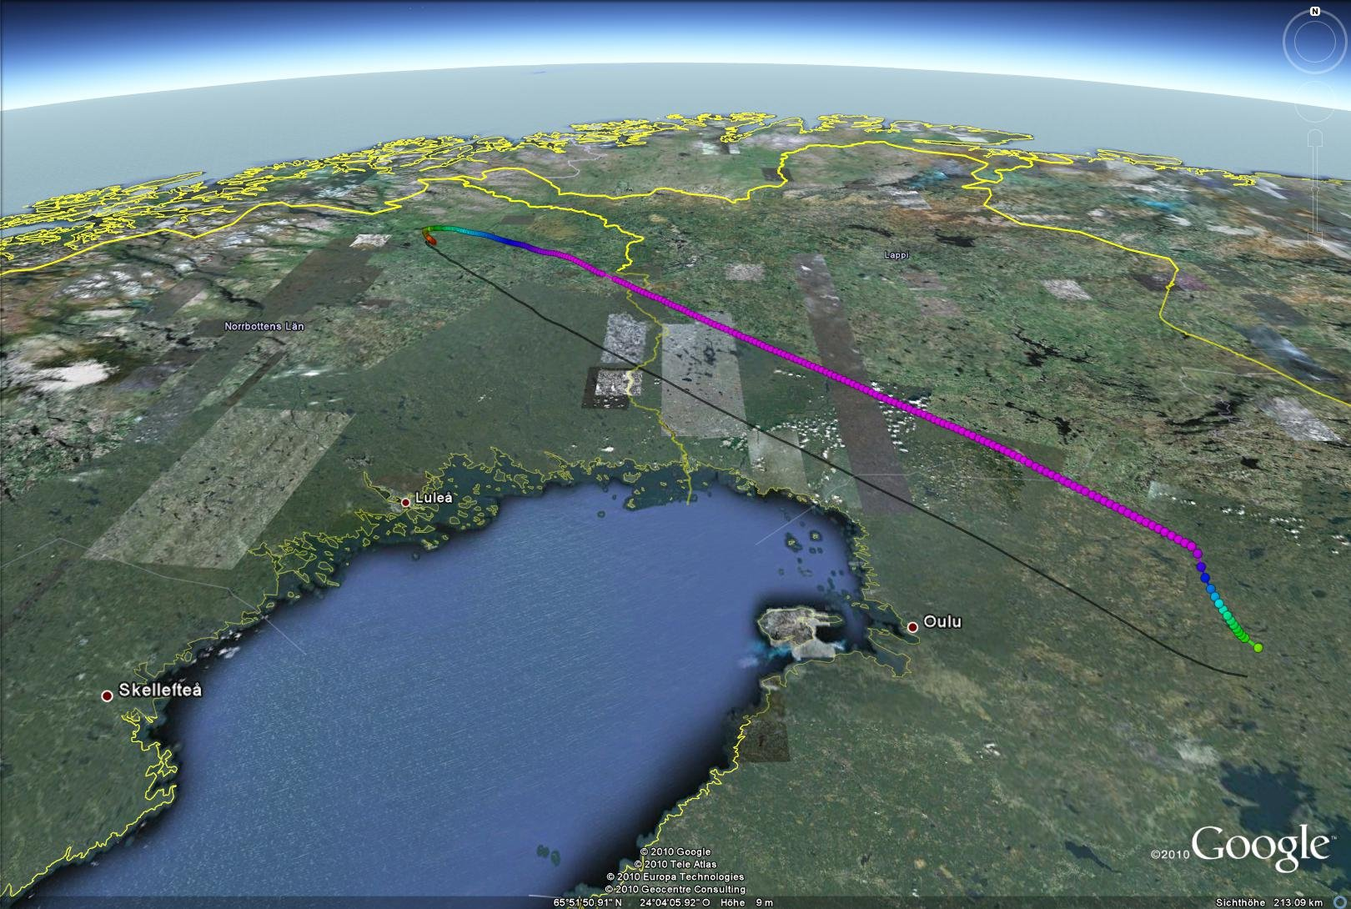
BEXUS-11 trajectoy
34 km
25 km
17 km
9 km
0 km
Norway
Finland
Russia
T=1h40m
177.000 events
T=3h10m
Sweden
Baltic Sea
T=3h40m

Slide 22
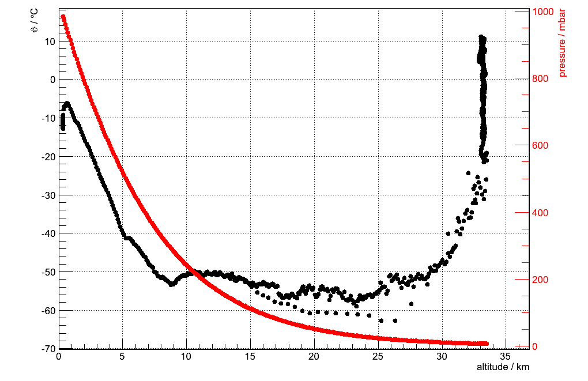
Bexus-11 environment

Slide 23
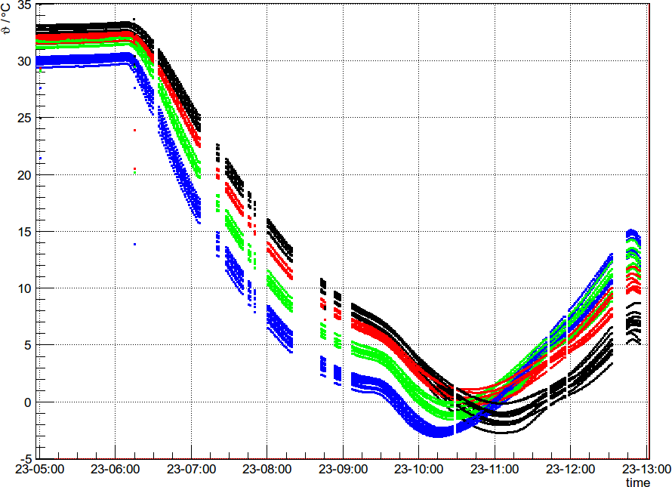
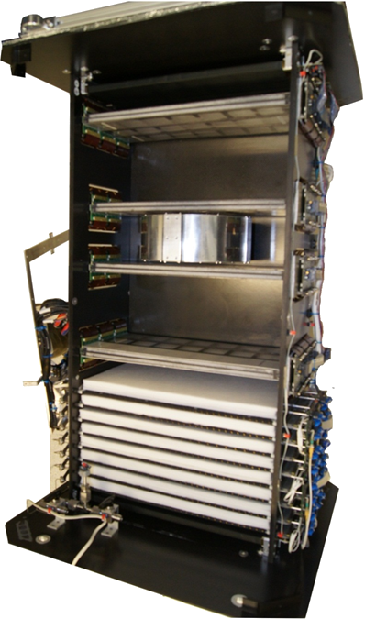
Tracker temperatures
experiment
to launch pad
launch

Slide 24

Online event display

Slide 25

Trigger rate
Height
Height
Time

Slide 26

Time-of-Flight System
TOF module

Slide 27

Time-of-Flight System
Correlation between y-coordinate measured by TOF and by Tracker
(Y-coordinate measured by difference in photon travel time to each side of the scintillator bar)

Slide 28



Tracker, Photon Yield
Random Trigger → Dark Spectra
  Pedestal position & width
Channels in signal clusters
  Gain calculation

Slide 29


Tracker, Photon Yield
Good S/N
≈ 15-20 Photons/MIP

Slide 30


Comparison to muons
upward going paritcles
so-called Albedos
Cosmic data on ground before launch
Flight data taken on Nov 23rd 2010

Slide 31



Preliminary Z⁺ particle spectrum
PRELIMINARY, WORK IN PROGRESS!
descrepancy in spectral shape due to detector resolutions
unfolding

Slide 32

Testbeam May 2011
PERDaix
beam
CERN, PS accelerator
T9 beamline
particles: p±, π±, μ±, e±
0.5-10.0 GeV
calibration measurements as input for further analysis

Slide 33


Momentum Resolution
e±
p

Slide 34


Transition Radiation
1.0 GeV
3.0 GeV
e±
e±
p⁺, μ⁺, π⁺
p⁺, μ⁺, π⁺

Slide 35

Preliminary Z⁺ particle spectrum
PRELIMINARY, WORK IN PROGRESS!

Slide 36


Summary & Outlook
Summary
Very successful balloon flight in November 2010
177.00 particle tracks recorded
Spatial resolution of 50 μm
Lightyield 15-20 Photons/MIP
First preliminary estimation of proton spectrum
Outlook:
e⁻ - spectrum, He - spectrum
further corrections
(rest atmosphere, geomagnetic cutoff, etc.)
Next SiPM-generation (128 channels)
→ Next Ballon experiment

